Slide 1
Secular Evolution in Disk Galaxies

Slide 2
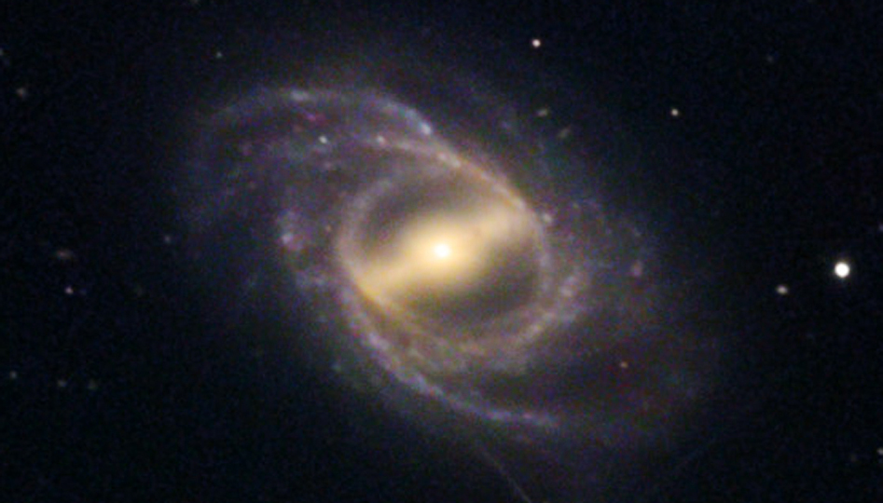
OUTLINE
1 — Barred galaxy structure and evolution: A heuristic introduction
⇒ Bar growth by outward angular momentum transport;
Construction of inner and outer rings;
Bar death ⇒ formation of lens components
2 — Internal secular evolution in disk galaxies
⇒ radial transport of gas by bars, ovals, spiral structure
— Secular growth of pseudobulges (PB) that retain
some memory of their disky origin.
Star formation rates ⇒ (PB/Total) ↑.

Slide 3
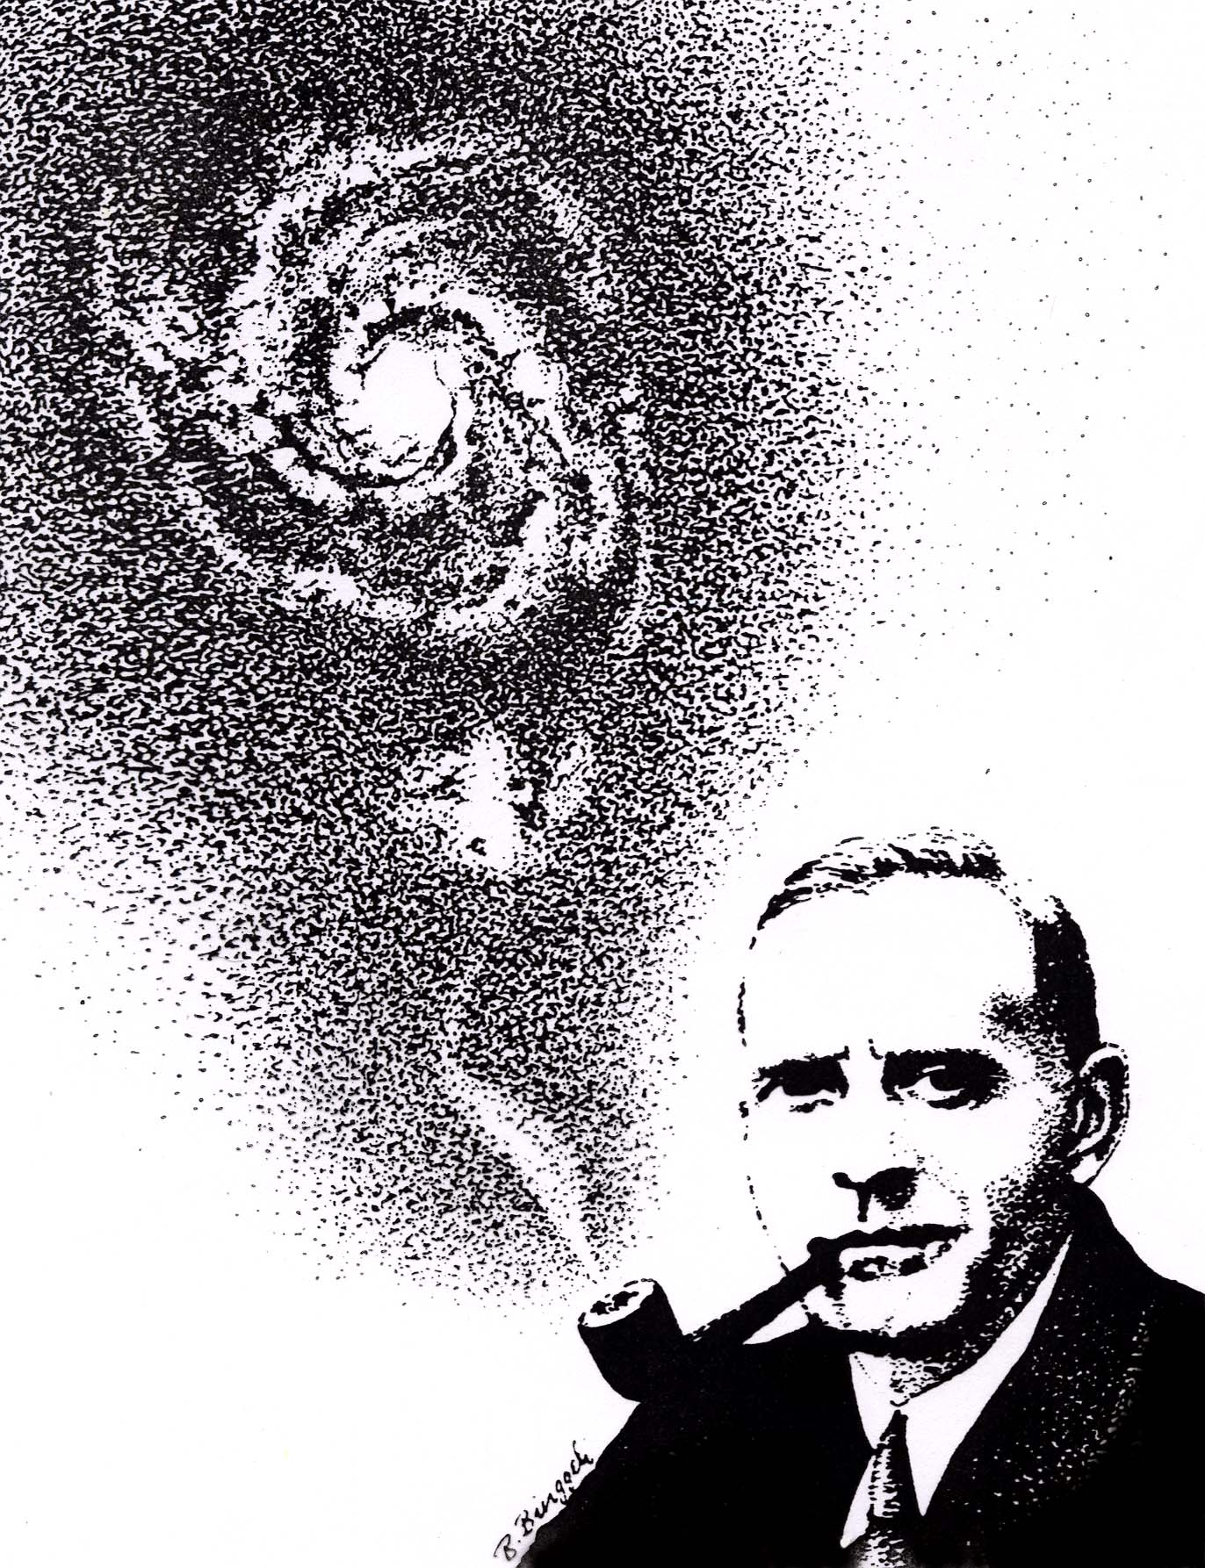
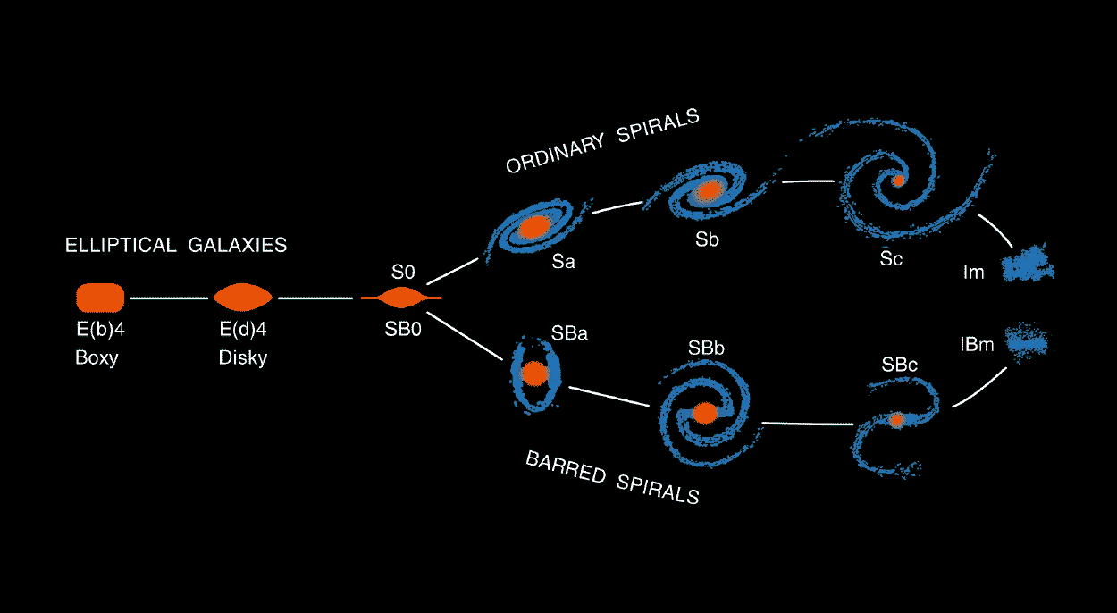
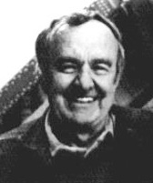
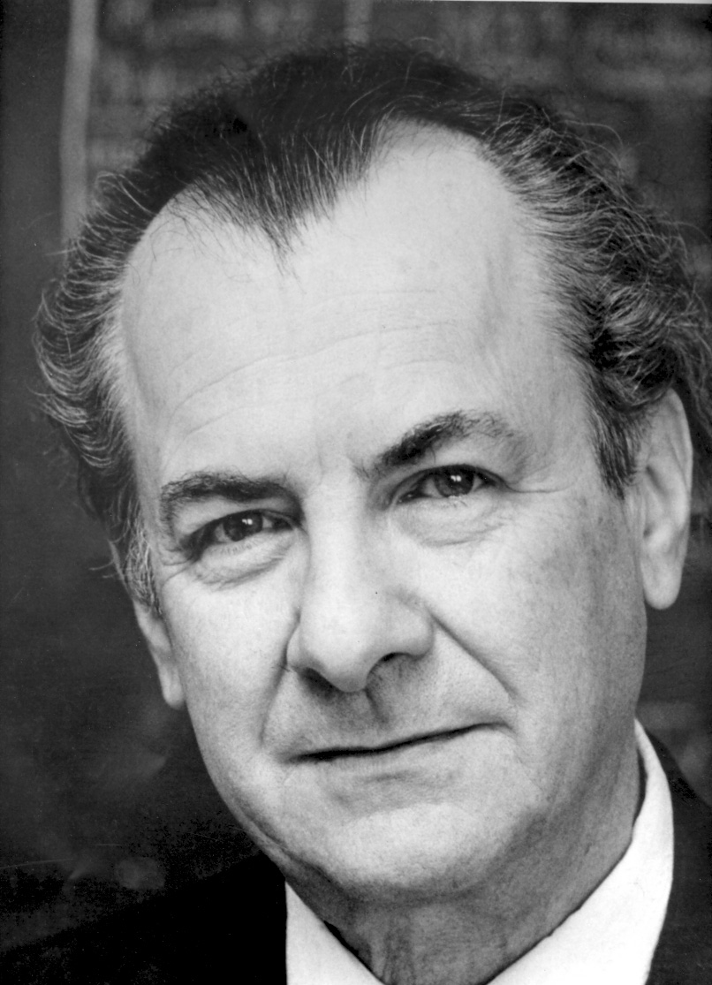
Important Goal of Extragalactic Astronomy: Explain Hubble Classification
Kormendy & Bender 1996, ApJ, 464, L119
Notes:
Hubble tuning-fork diagram is alive and well!
I disagree with David Weinberg.

Slide 4
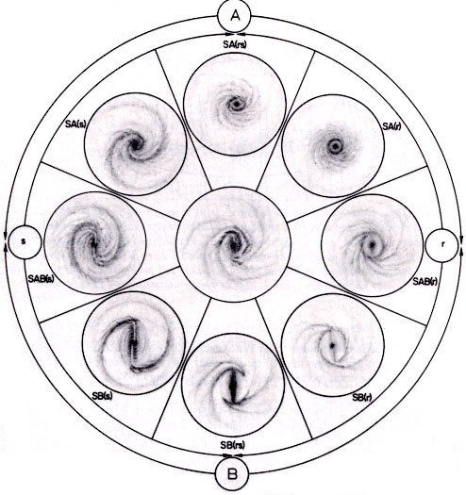
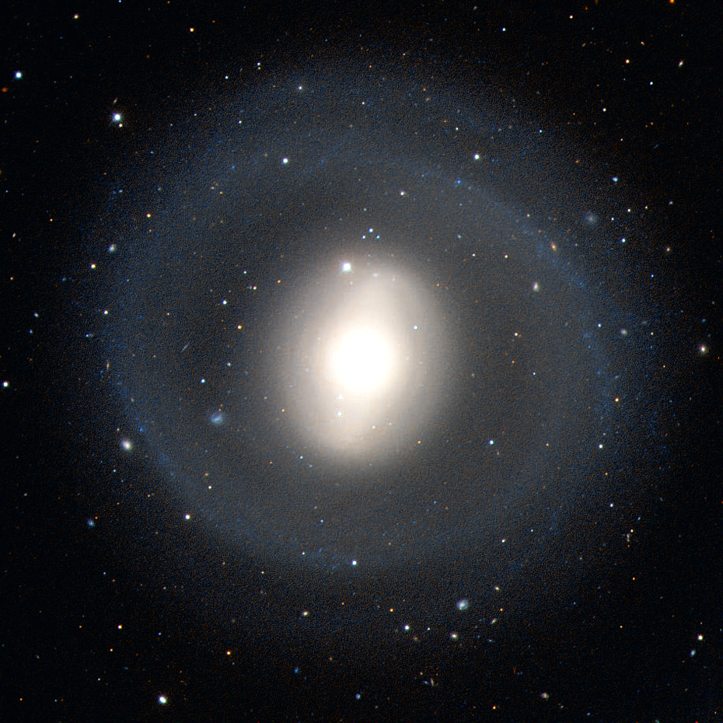
de Vaucouleurs revised types add detail.
de Vaucouleurs, G., & de Vaucouleurs, A. 1964, Reference Catalogue of Bright Galaxies
(Austin: Univ. of Texas Press)
In revised types like
(R)SB(r)bc,
every letter contains
understandable physics.

Slide 5
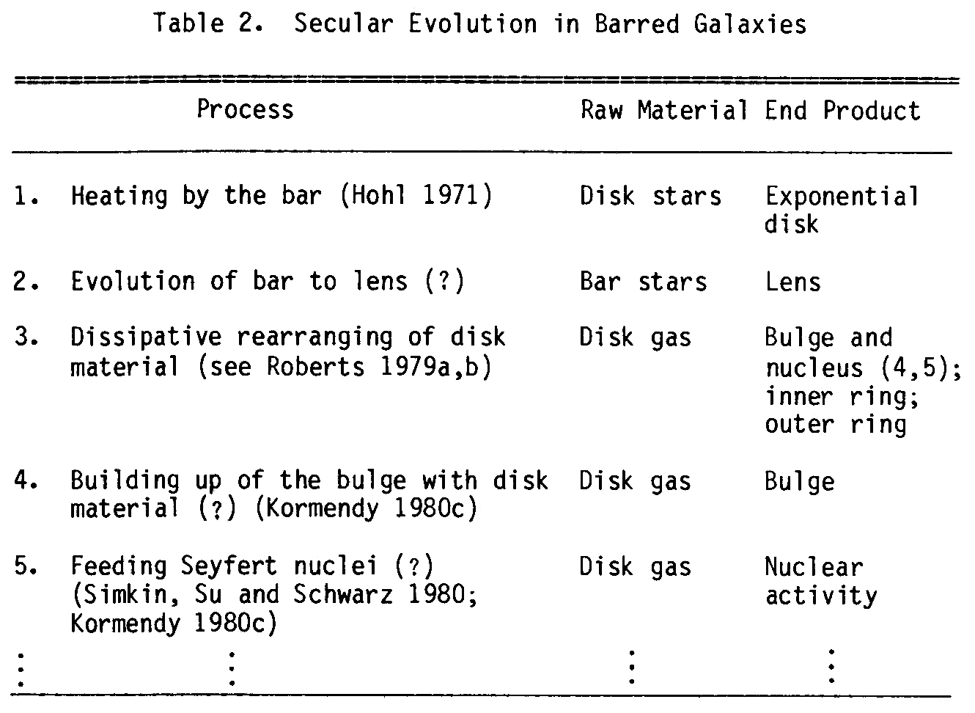
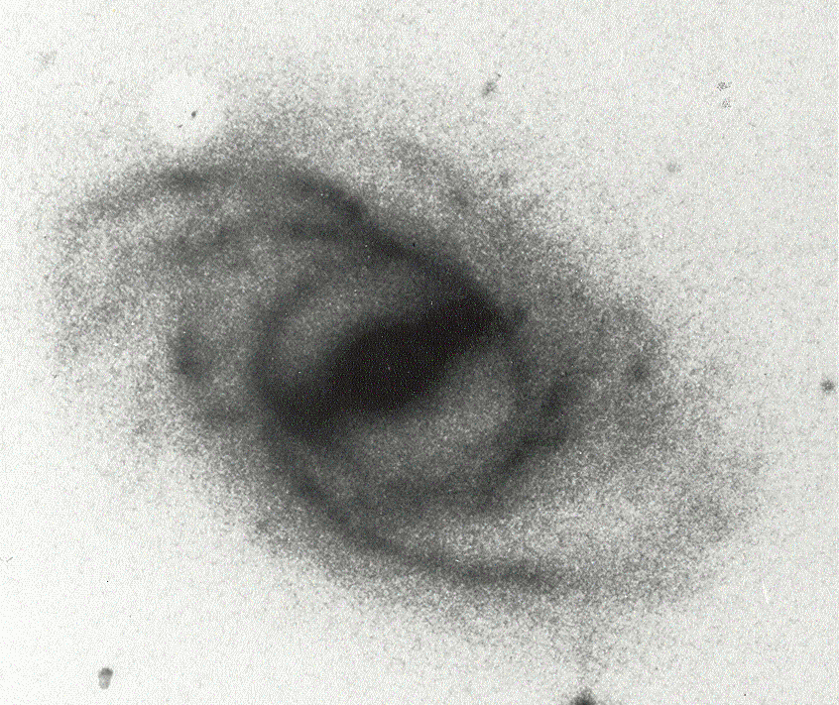
Kormendy 1979, ApJ, 227, 714;
Kormendy 1981, in Structure and Evolution of Normal Galaxies, ed. Fall & Lynden-Bell, CUP, 85
Duus & Freeman 1975, in La Dynamique des Galaxies Spirales, ed. Weliachew, CNRS, 419
Kormendy 1982, in Morphology and Dynamics of Galaxies (Saas-Fee Course 12):
“A significant fraction of the bulge in many SB galaxies consists of disk gas
which has been transported to the center by the bar. As the gas accumulates,
it forms starts and builds up a very centrally concentrated stellar distribution
which is photometrically like a bulge but dynamically like a disk.”

Slide 6
The Universe is in transition from early times dominated by
hierarchical clustering and galaxy mergers
to a time when internal secular processes
will dominate galaxy evolution.
At present, both processes are important.

Slide 7
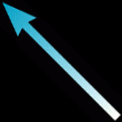
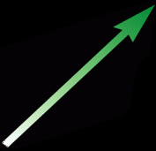
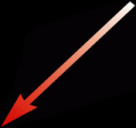
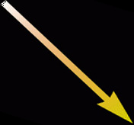
Kormendy & Kennicutt 2004, ARA&A, 42, 603
PROTOGALACTIC
COLLAPSE
internal versus external
GALAXY MERGERS
star formation,
gas recycling,
metal enrichment,
energy feedback via supernovae & AGNs,
etc.
fast
versus
slow
fast
versus
slow
INTERNAL
SECULAR EVOLUTION
driven by bars and oval distortions,
by spiral structure,
etc.
ENVIRONMENTAL
SECULAR EVOLUTION
driven by prolonged gas infall,
by minor mergers,
by ram-pressure-stripping,
by galaxy harassment,
etc.
internal versus external
Notes:
Morphological box -- cf Zwicky <-------->
^
|
|
v

Slide 8
Kormendy & Kennicutt 2004, ARA&A, 42, 603
PROTOGALACTIC
COLLAPSE
internal versus external
GALAXY MERGERS
Awkwardly, we have 2 names
for merger products:
“elliptical galaxies” and,
when surrounded by a disk,
“bulges”.
star formation,
gas recycling,
metal enrichment,
energy feedback via supernovae & AGNs,
etc.
fast
versus
slow
fast
versus
slow
INTERNAL
SECULAR EVOLUTION
driven by bars and oval distortions,
by spiral structure,
etc.,
ENVIRONMENTAL
SECULAR EVOLUTION
driven by prolonged gas infall,
by minor mergers,
by galaxy harassment,
etc.
internal versus external
We need one convenient name for all bulge-like products of these processes: “pseudobulges”.
Notes:
Morphological box -- cf Zwicky <--------> internal vs external
^
| fast vs
| slow
v

Slide 9
The physics that underlies the internal evolution of disks is very general (Lynden-Bell, Tremaine):
Self-gravitating objects spread because their heat capacity is negative.
Kormendy & Fisher 2005, RevMexA&A, 23, 101
Temperature T ∝ v²;
Virial theorem 2KE + PE = 0. Total E ≡ KE + PE = -KE.
Therefore heat capacity ≡ dE/dT ∝ d[ -Nmv²/2 ]/d[ v² ] < 0.
Therefore, if the system loses energy, it gets hotter.
If the center of the system gets slightly hotter than the outside,
heat flows outward, the center gets hotter, and this promotes
more heat flow.
The system spreads — it forms a dense core by expanding a
diffuse halo — if ∃ mechanism to transport energy outward.

Slide 10
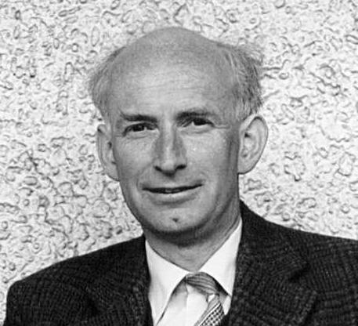
Orbits are donkeys.
Donald Lynden-Bell

Slide 11
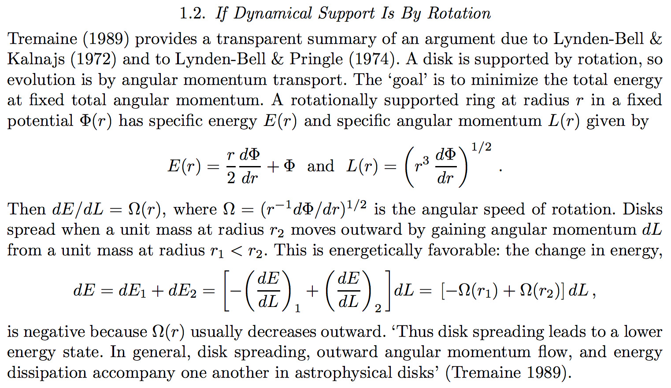
Self-gravitating disks spread because outward angular momentum transport minimizes total energy.
Kormendy & Fisher 2005, RevMexA&A, 23, 101
Kormendy 2007, IAU Symposium 245, 107

Slide 12
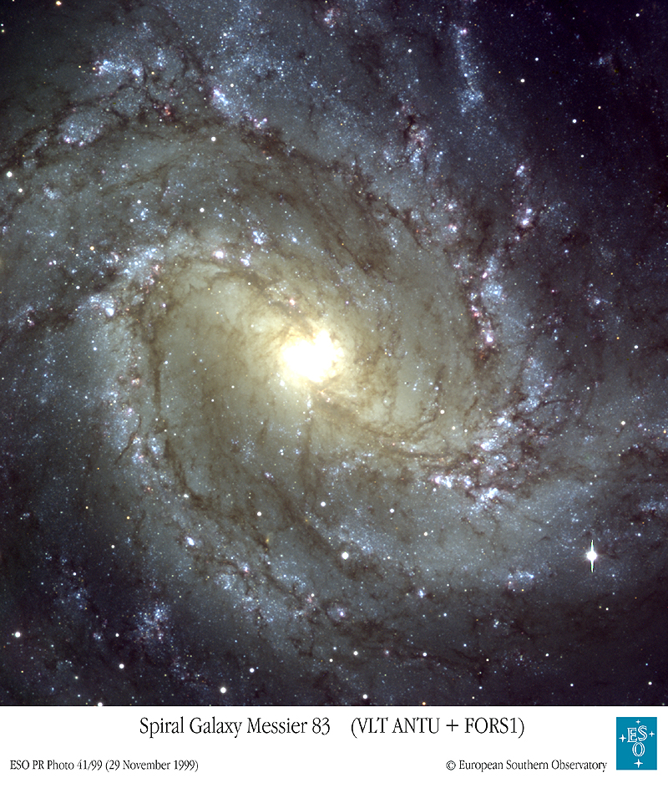
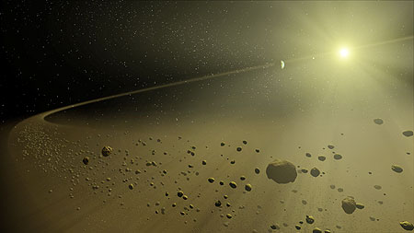
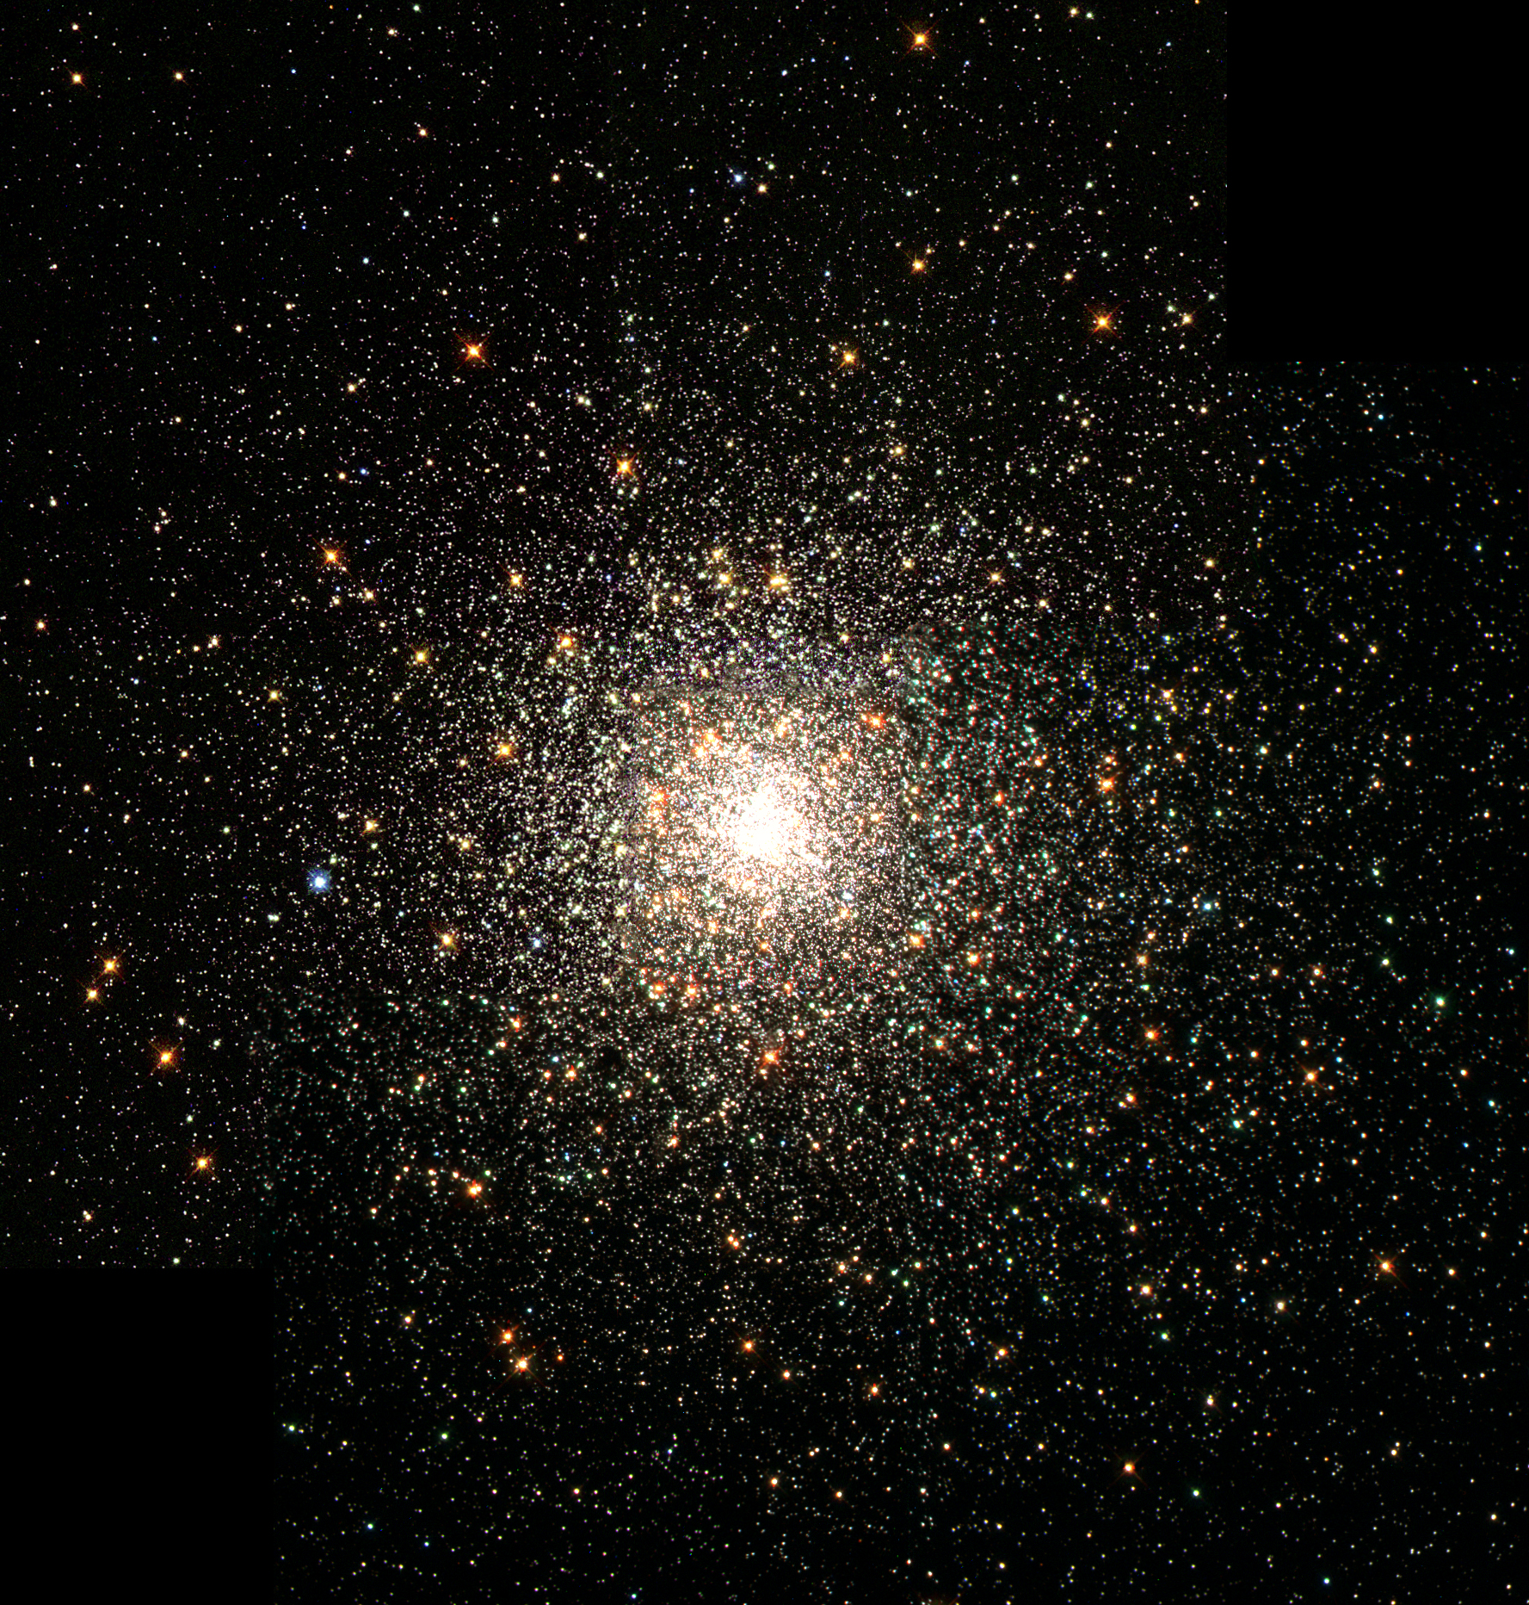
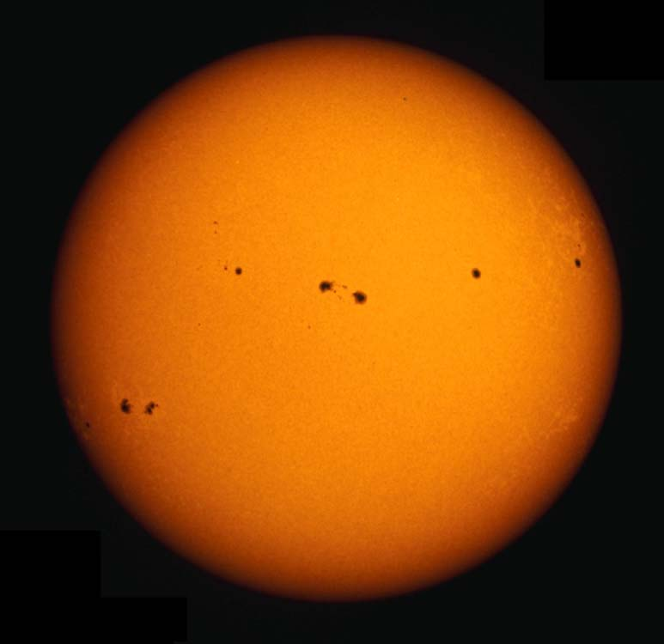
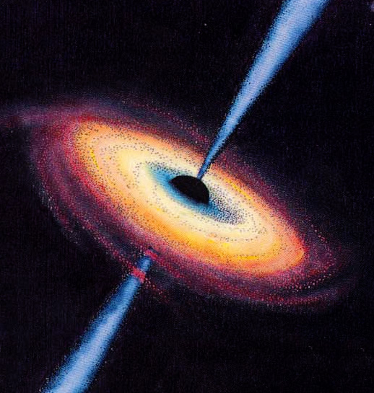
It is energetically favorable to spread — to form a denser core and a more diffuse halo.
Galaxy disks are supported by rotation; they spread in 2-D by
outward angular momentum transport driven by nonaxisymmetries like bars.
Growth of pseudobulge is analogous to growth of star from protostellar disk.
Protoplanetary disks are supported by rotation; they spread in 2-D
when big planets fling little planets (hot Jupiters & colder Neptunes).
Spherical stellar systems are supported by random motions; they spread in 3-D
by outward energy transport driven by 2-body relaxation (“core collapse”).
Stars are supported by hydrostatic pressure; they spread in 3-D
by outward energy transport via radiation and convection, and by
outward angular momentum transport driven by magnetic coupling
to protostellar disks. Result: compact remnants like stellar-mass BHs.
BH accretion disks are supported by rotation; gas flows inward in 2-D via
outward angular momentum transport mediated by magnetic coupling to jets.
BH growth is as natural in galaxies as proto-BH core growth is in stars.

Slide 13
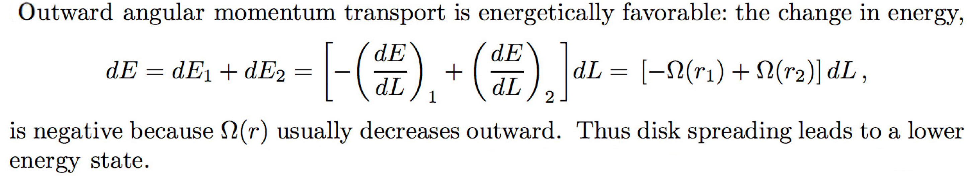
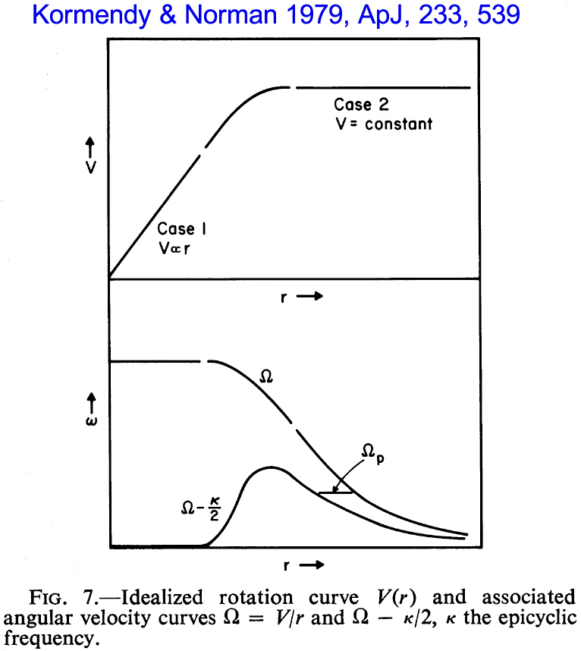
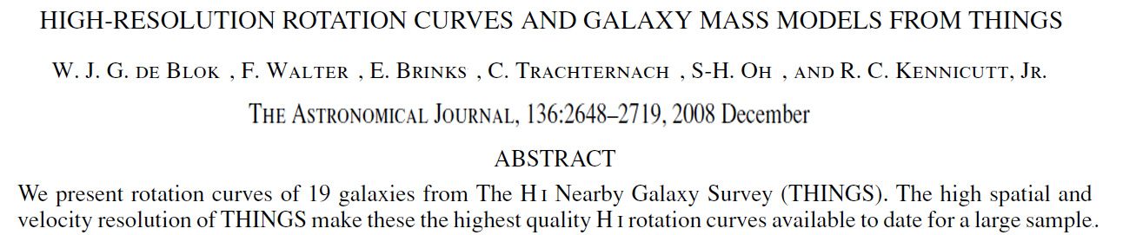
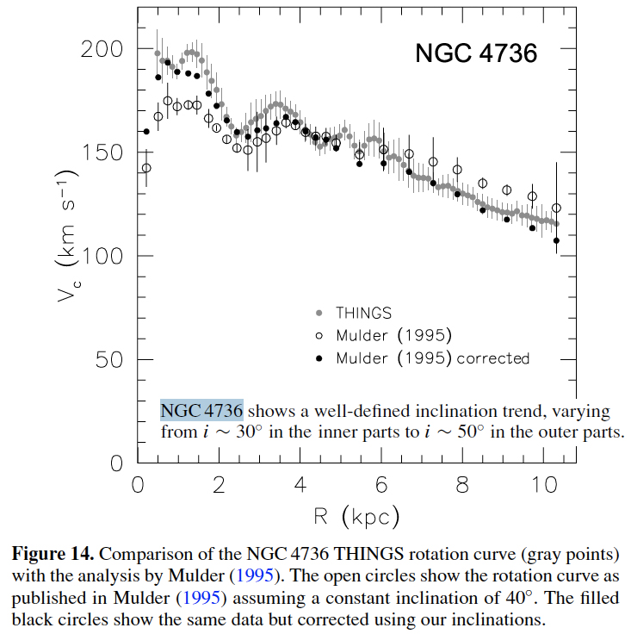
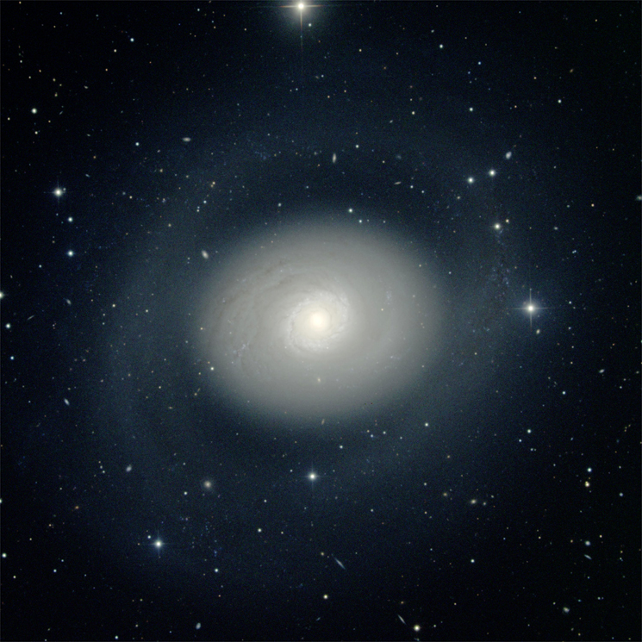
Evolution tends to be rapid in galaxies like NGC 4736 (Sab) in which V or V➢ …
When does secular disk evolution happen?
Ω ≡ V/r
NGC 4736 = “poster child”
for secular evolution.
… provided ∃
a driving agent.
(here: oval disk).

Slide 14
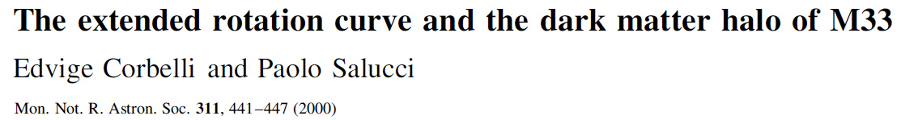
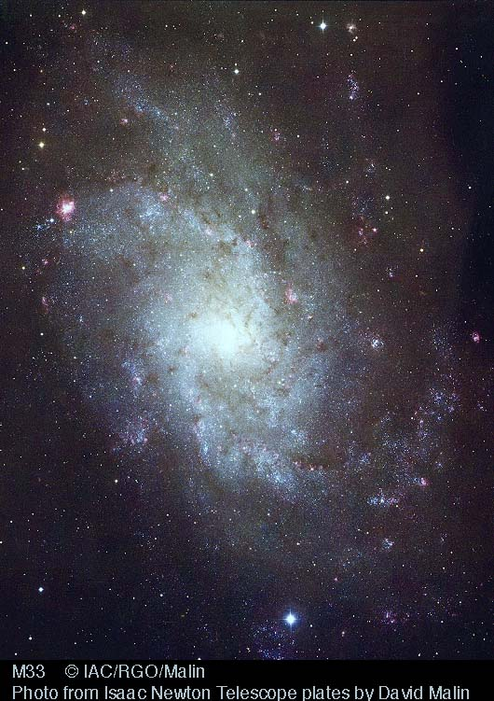
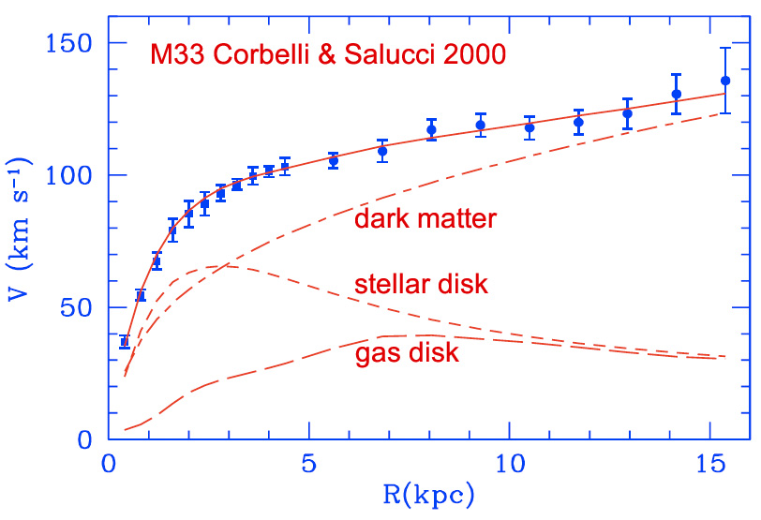
Evolution tends to be slow in galaxies like M33 (Scd) in which V∝ r or V  …
When does secular disk evolution not happen?
Ω ≡ V/r
M33 has essentially
no pseudobulge.
… especially since (1) global spiral structure is a weaker driving agent than a bar and
(2) dark matter “dilutes” disk self-gravity.

Slide 15
At what Hubble types does secular evolution happen?
Some S0 – Sa galaxies
evolved secularly in the past:
they contain pseudobulges.
Ellipticals: Any secular evolution
in progenitor disks
got scrambled by mergers.
Ellipticals have
different secular processes
not discussed here.
Sd – Im galaxies have
little internal secular evolution
because
it is not energetically favorable
to transport angular momentum
outward.
This is where internal
secular evolution is
most important.

Slide 16
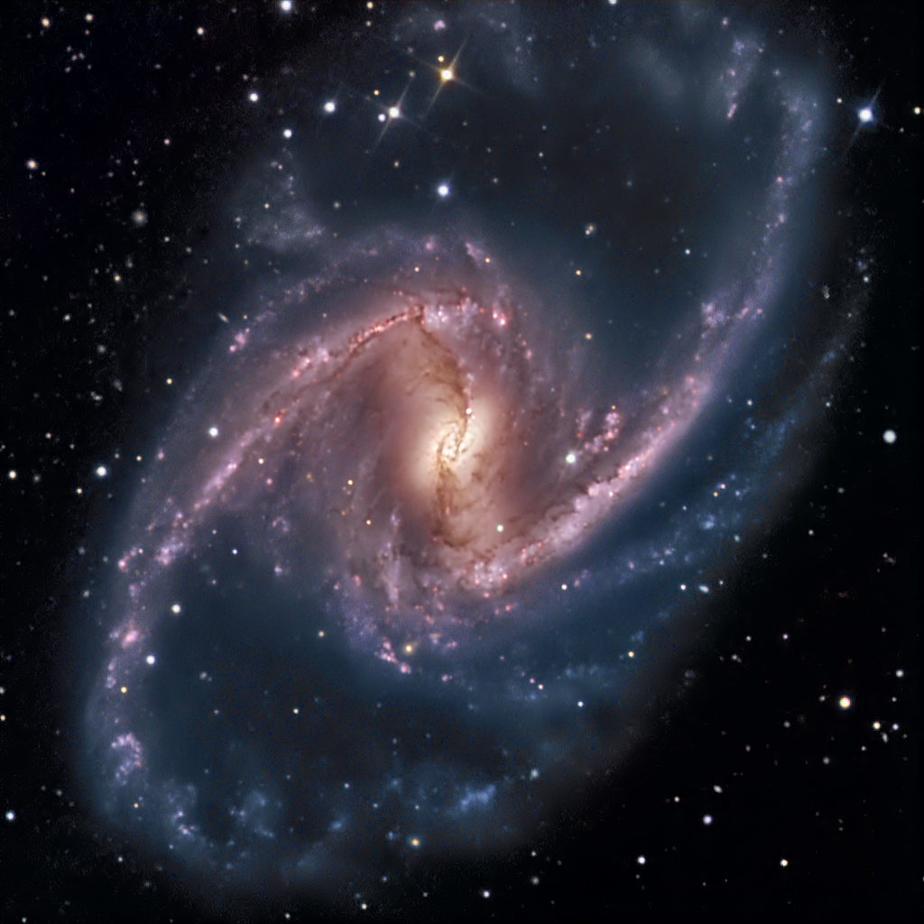
NGC 1365 (SBb)
Structure and Evolution of Barred Galaxies:
A Heuristic Introduction

Slide 17
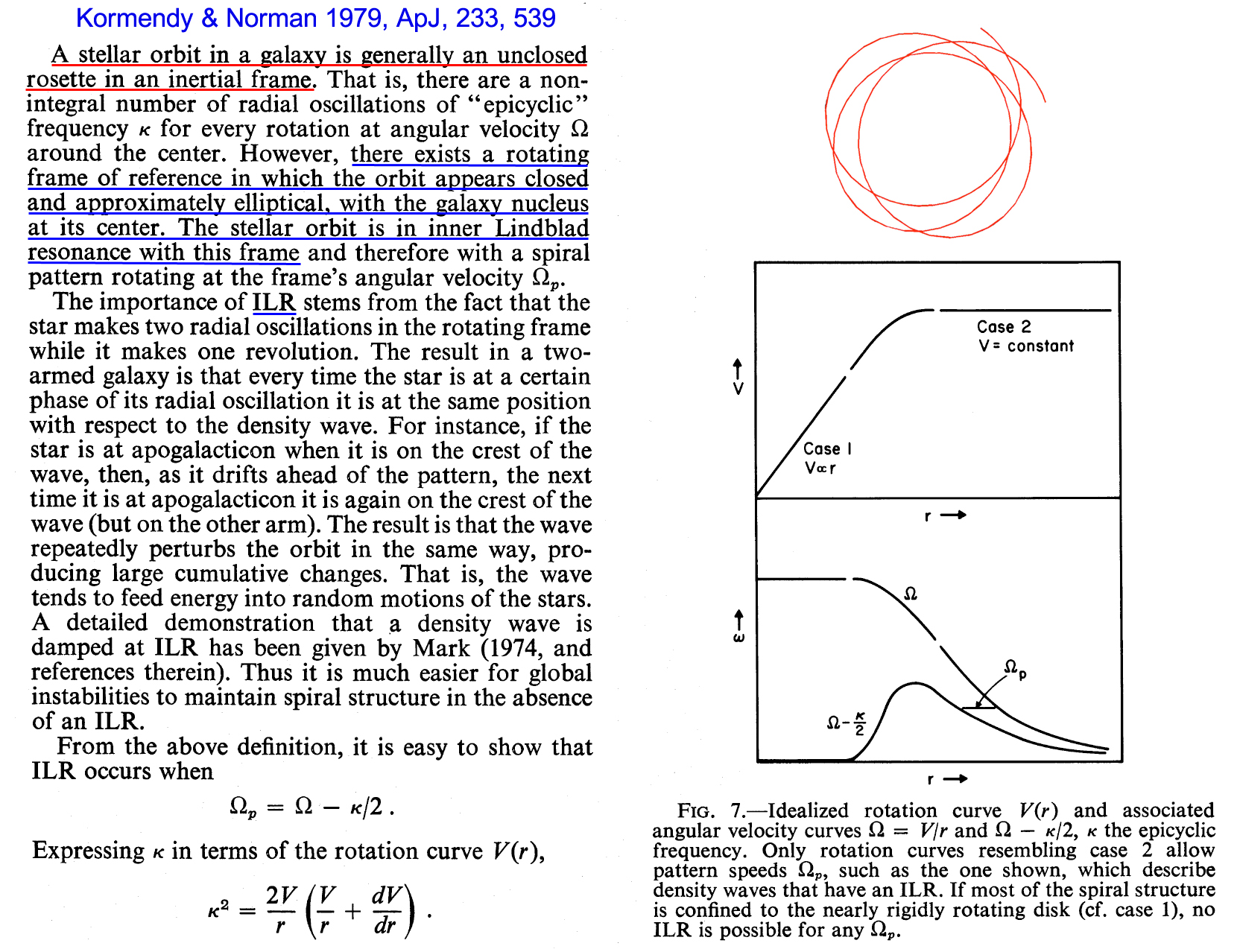
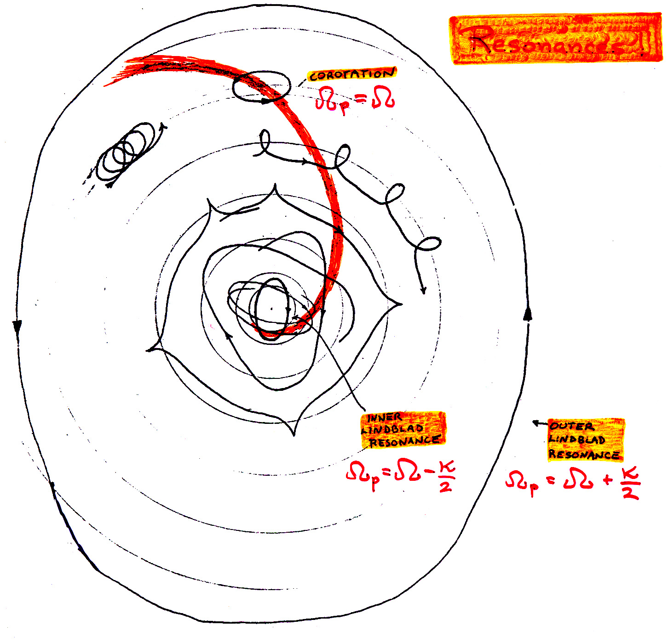
Evolution tends to be slow in galaxies like M33 (Scd) in which V∝ r or V  …
Bars and their pattern speeds Ω_{p}
Resonances
corotation
inner
Lindblad
resonance
outer
Lindblad
resonance
If Ω-κ/2 is constant with radius, you can line up IRL orbits into a straight, elongated structure: a bar, and they will precess together.
Notes:
THERE CANNOT BE AN ILR UNLESS THERE IS A GLOBAL DENSITY WAVE
with some pattern speed.

Slide 18
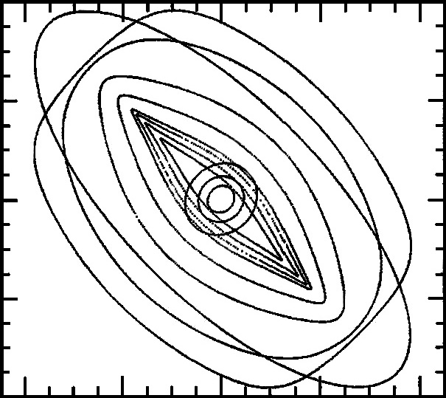
Evolution tends to be slow in galaxies like M33 (Scd) in which V∝ r or V  …
Bars and their pattern speeds Ω_{p}
Ω ≡ V/r
inner
Lindblad
resonance
corotation
If Ω-κ/2 is constant with radius, you can line up IRL orbits into a straight, elongated structure: a bar, and they will precess together.
Notes:
There cannot be an ILR unless there is a global density wave with some pattern speed.

Slide 19
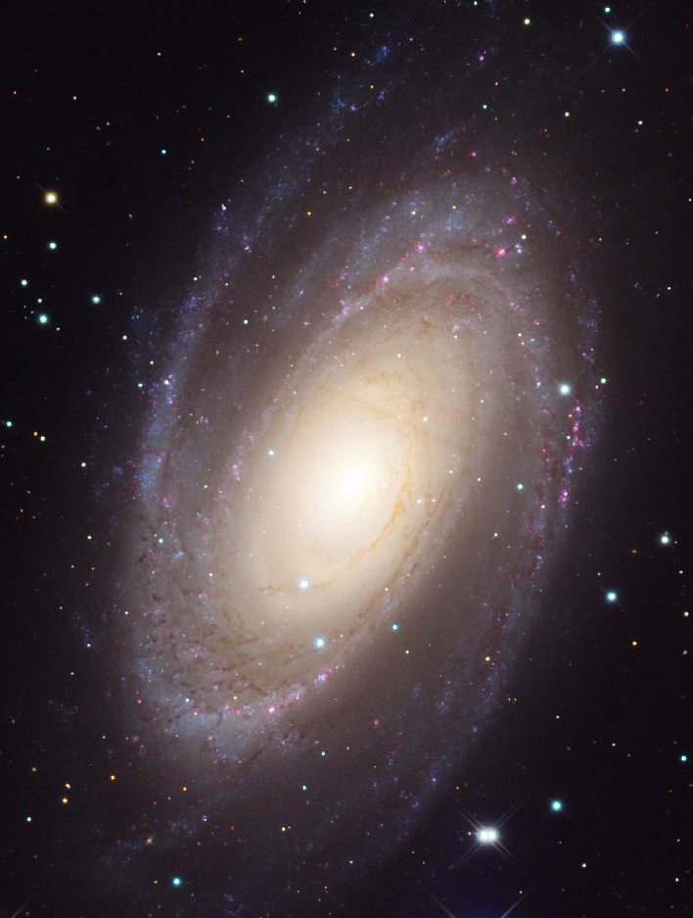
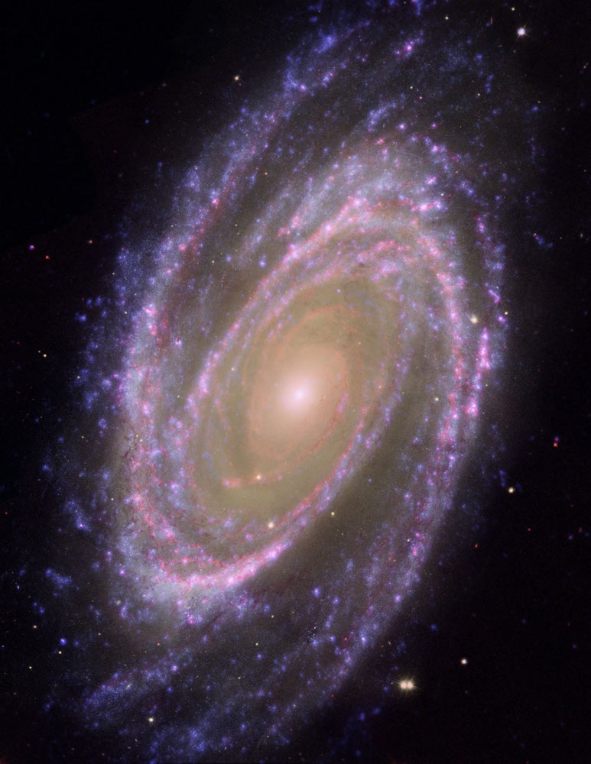
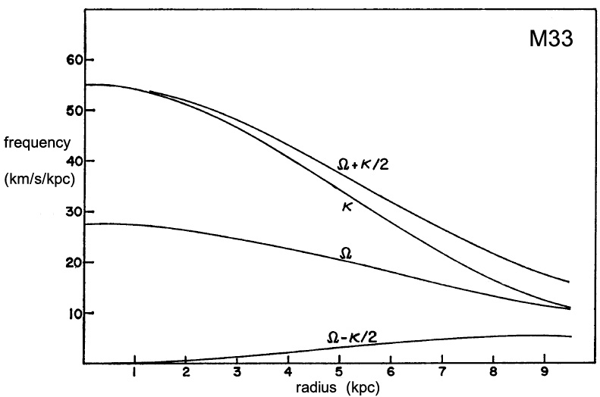
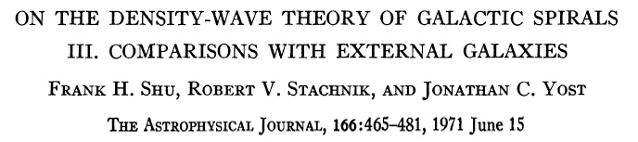
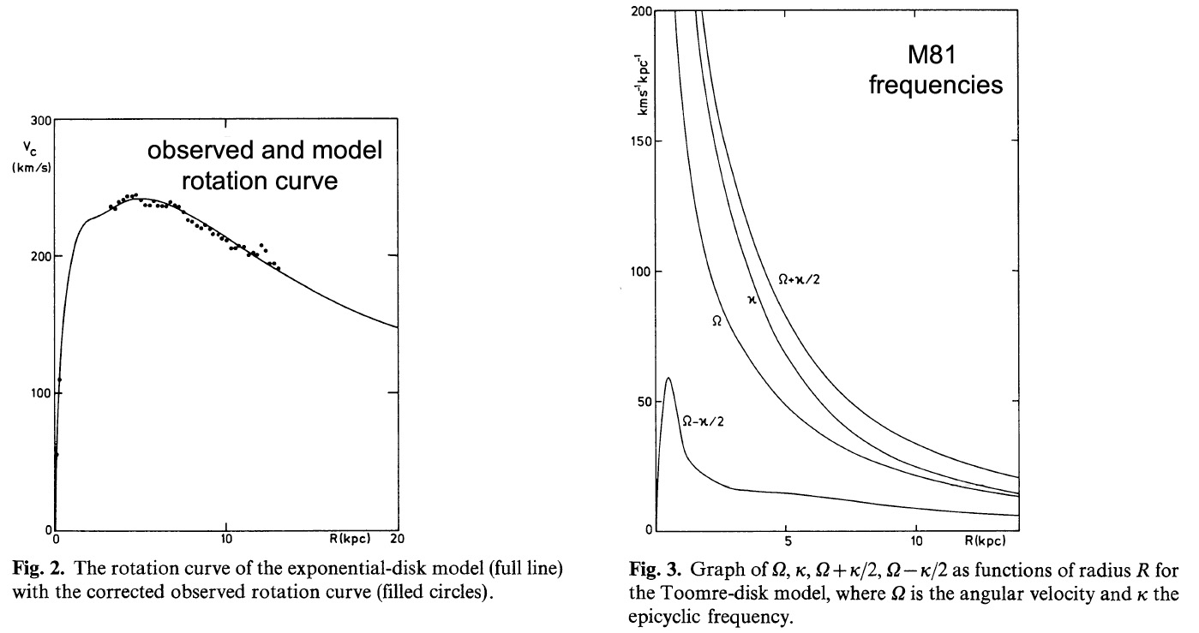
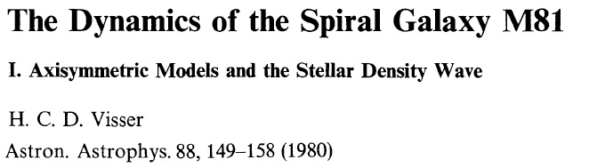
Growing a central mass concentration (e. g., a pseudobulge)
⇒ Ω - κ/2 has a higher peak at small radii and a steeper falloff at large radii
⇒ it gets harder for bar self-gravity to keep the bar orbits progressing together
⇒ the bar dies.
Bars commit suicide via the secular evolution that they drive!
Bars and their pattern speeds Ω_{p}
M81
Galex-HST-Spitzer
If Ω-κ/2 is constant with radius, then
you can line up IRL orbits into a straight,
elongated structure: a bar.
They will precess together.
This is easiest in a galaxy like M33.
M81
This is hard in a galaxy like M81
that has a big bulge.
inner
Lindblad
resonance
corotation
M33

Slide 20
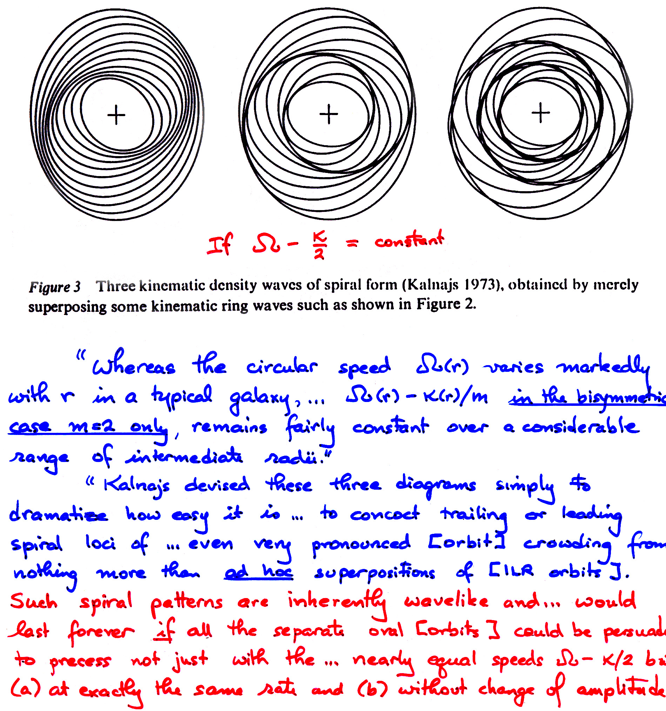
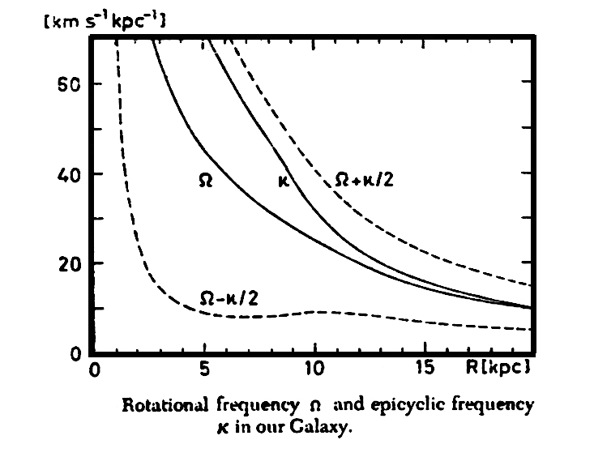
Nearly Kinematic Spiral Density Waves
Kalnajs 1973, Proc. Astr. Soc. Australia, 2, 174
Toomre 1977, ARA&A, 15, 437

Slide 21
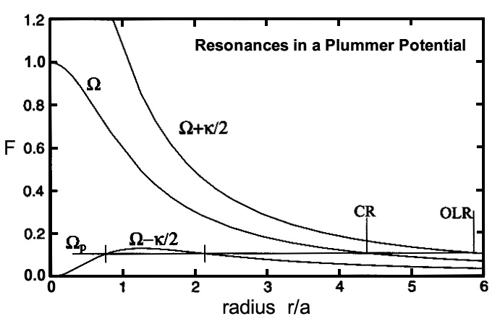
Nearly Kinematic Bar Density Wave
NB: Bars are triaxial
because they are made of
x₁ orbits
analogous to
very elongated z-axis tubes.
They have lots of
angular momentum.
In contrast, giant ellipticals
are triaxial because
they are made mainly of
box orbits.
They have insignificant
angular momentum.
Therefore bars and ellipticals
are fundamentally different.
Bars are a disk phenomenon.
No disk ⇒ no bar!

Slide 22
Dynamics of Bars
Bars — like spiral arms — are density waves.
They are made of elongated, not-quite-closed orbits
called x₁ orbits.
These are analogous to z-axis tubes,
but they are more elongated.
They are nearly resonant (inner Lindblad resonance)
orbits that would precess exactly together
if Ω_{p} = Ω - κ/2 = constant with radius.
Since Ω - κ/2 is not quite constant with radius,
it is the job of bar self-gravity to make the orbits
precess exactly together.

Slide 23
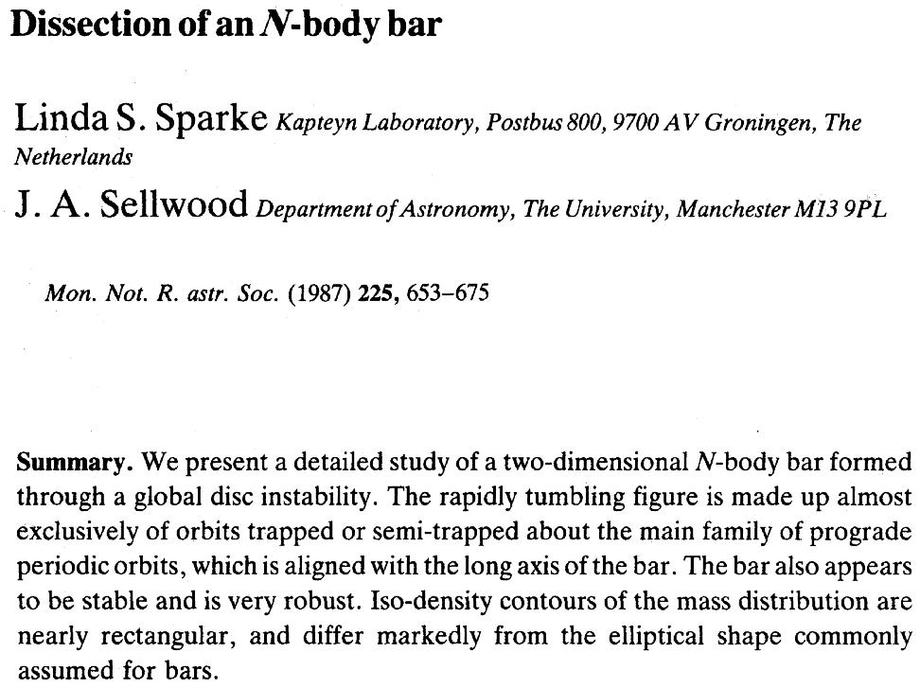
Bars look “too robust” when n-body models cannot secularly build pseudobulges.

Slide 24
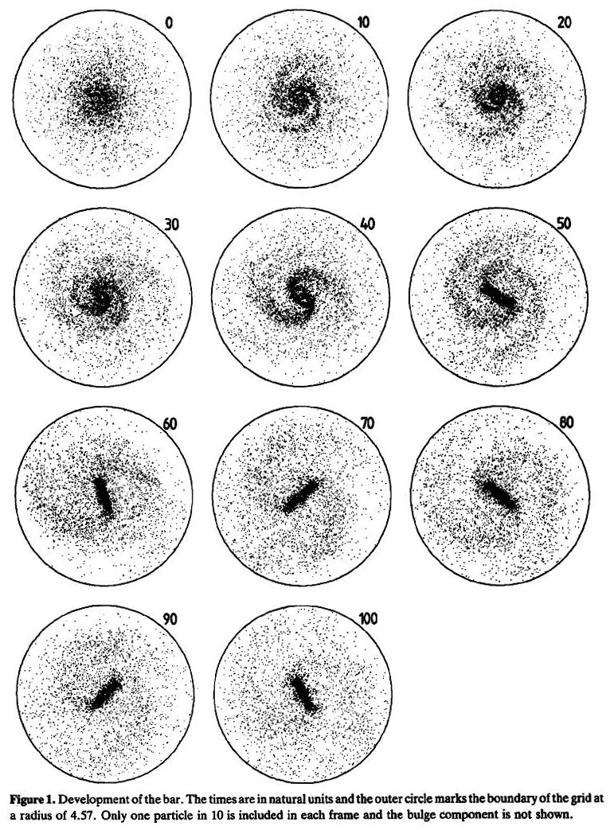

Slide 25
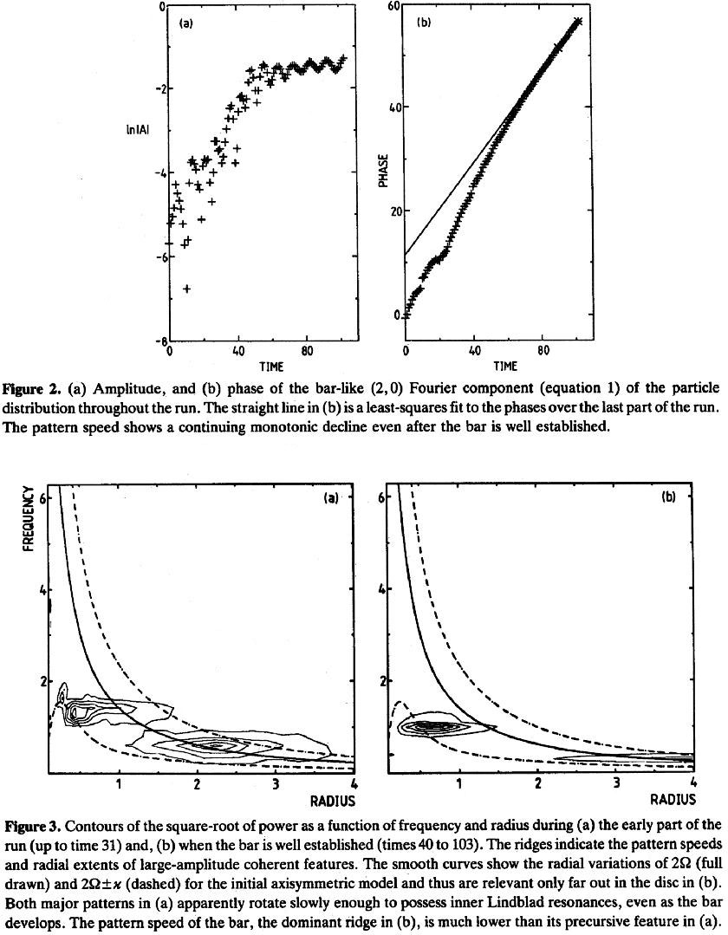
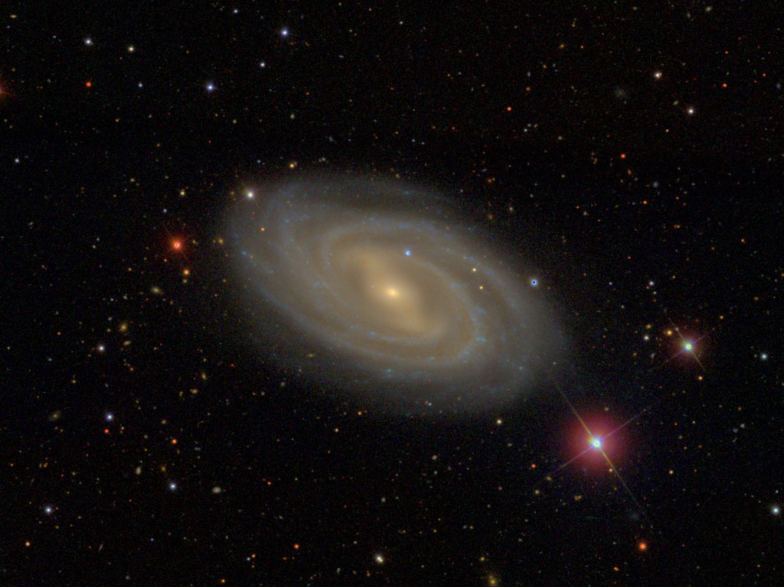
The bar grows by transferring angular momentum
outward. As a result, the outer disk expands.
Stellar orbits in the bar get more elongated
and the bar pattern speed decreases.
Spiral structure is the signature that
angular momentum is being transported outward!
NGC 3992
Note how the bar at small radii
and the spiral structure at larger radii
both want to have
Ω_{p}= the local value of Ω - κ/2.

Slide 26
SB(s) versus SB(r) galaxies
NGC 1300
NGC 2523
SB(r) galaxies like NGC 2523 are “more dynamically evolved” than SB(s) galaxies like NGC 1300.

Slide 27
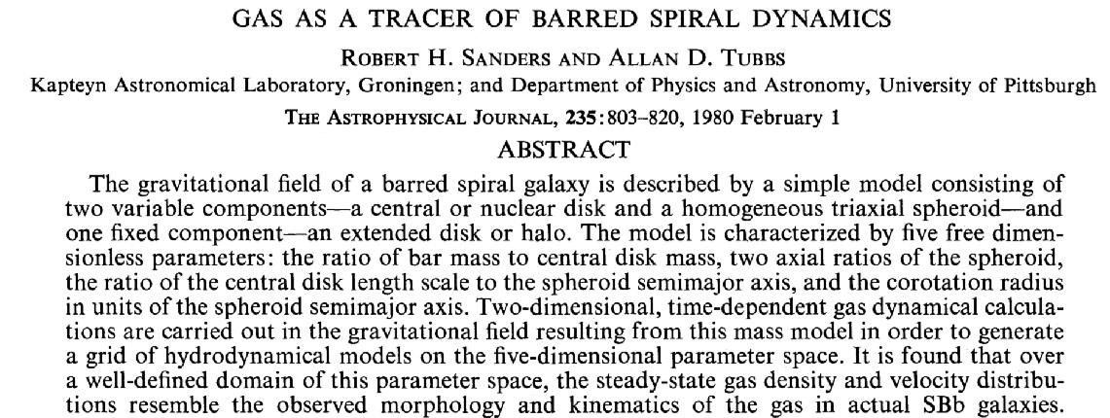
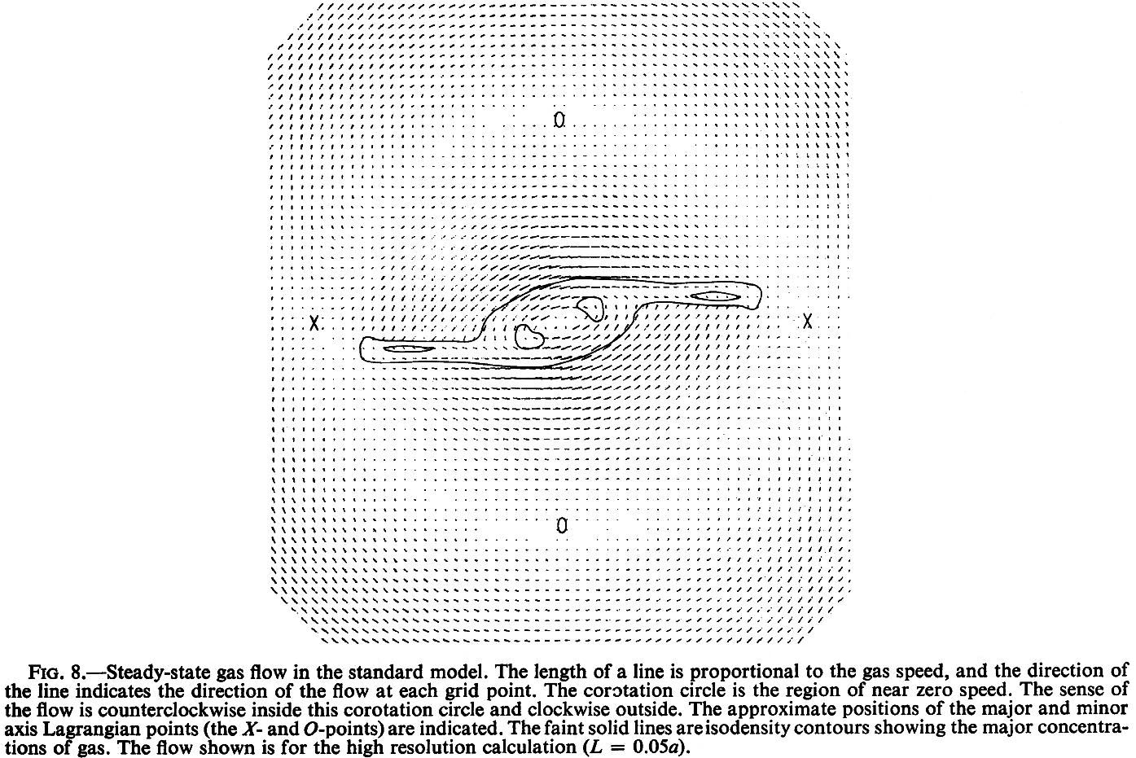
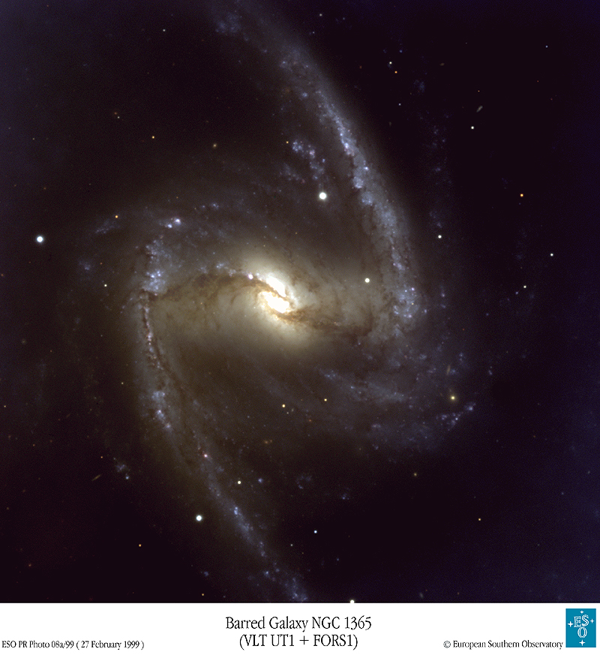
Note: the rotation direction is opposite to that in the images.

Slide 28
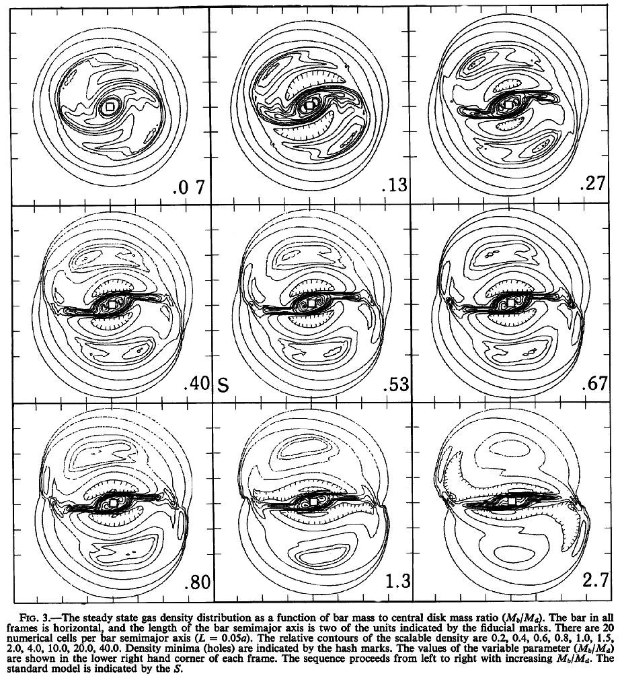
Stronger bars
(larger bar/disk ratio)
make stronger shocks.
Note the tendency
to make “inner rings”
when the bar is strong.

Slide 29
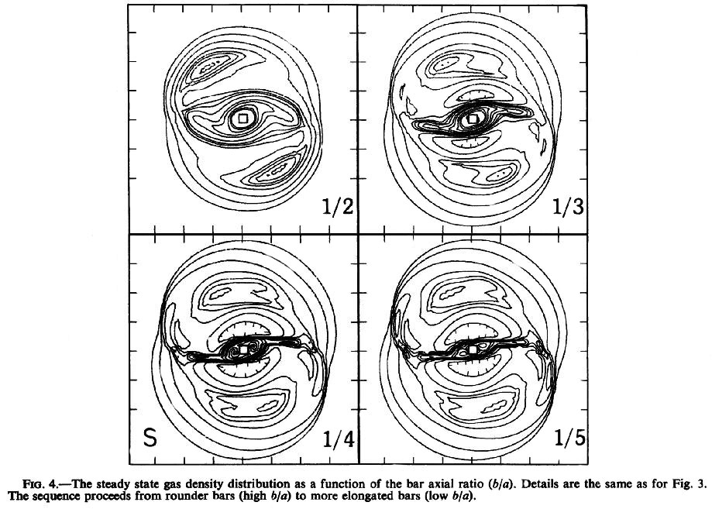
Stronger bars
(smaller bar axial ratio)
make stronger shocks.
Note the tendency
to make “inner rings”
when the bar is strong.
Important: you “never”
see dust lanes in the
bars of SB(r) galaxies!

Slide 30


High pattern speed Ω_{p}
makes SB(s) structure.
Low pattern speed Ω_{p}
makes SB(r) structure.
Therefore a barred galaxy
tends to evolve
from SB(s) toward SB(r).
Unrealistic!

Slide 31

Summary
SB(s) structure is favored if the bar is weak or rotating rapidly.
SB(r) structure is favored if the bar is strong or rotating slowly.
A straight dust lane on the trailing side of a bar is a sign of a shock in the gas. The gas is compressed when it slows down, concentrating the dust, too.
The fact that the dust lane is nearly radial implies that the gas loses a lot of energy. It therefore falls toward the center, where it gets concentrated, sometimes into a tiny ring. Since the star formation rate is roughly proportional to (gas density)^{1.4}, the infall tends to feed a starburst.
Dust lanes are
more curved in
weaker bars
(Athanassoula).
NGC 6782

Slide 32


Slide 33

Fraction of mass
transferred to center
0 %
3 %
7 %

Slide 34

The radius of the central mass gets shrunk by a factor of 50
between time = 100 and time = 150. It is essentially a point mass.

Slide 35


Slide 36

Bar suicide
People are in violent agreement that bar suicide happens;.
even that it is caused by secular growth of central masses.o
Disagreements re: how much central mass is needed. Buto
Estimates now are ~ 10 – 20 % of the disk mass;o
Answer depends on bar, disk and halo properties;
Answer depends on compactness of central mass.

Slide 37
Bar suicide
People are in violent agreement that bar suicide happens;.
even that it is caused by secular growth of central masses.o
Disagreements re: how much central mass is needed. Buto
Estimates now are ~ 10 – 20 % of the disk mass;o
Answer depends on bar, disk and halo properties;
Answer depends on compactness of central mass.

Slide 38


What does a defunct bar look like?
Suggestion: a lens.

Slide 39



G
If bars commit suicide,00000
where are the defunct bars?00000
Kormendy (1979); …; Kormendy & Kennicutt (2004): lenses?
The lens of the SA0 galaxy NGC 1553 is hotter than
the galaxy’s pseudobulge (Kormendy 1984, ApJ, 286, 116):

Slide 40


G
Suggest: Defunct bars are lens components.
Lens components are “shelves” in brightness distributions;
i. e., they have shallow brightness gradients interior to a sharp outer edge.
They have intrinsic axial ratios of ~ 0.9 (Kormendy 1979, ApJ, 227, 714).
There is no overlap in the shape distributions of bars and lenses.
Lens brightness profiles are often Gaussian; i. e., Sérsic functions with index n ≈ 0.5
(Kormendy & Bender 2012, ApJS, 198, 2. 116):
NGC 3245 SA(lens)0
NGC 2859 SB(lens)0

Slide 41


It is very likely that the inner oval disks in oval galaxies are lenses (i. e., defunct bars).
NGC 1068
NGC 4151
Notes:
41

Slide 42
G
Bar suicide
Klypin et al. (2005):
“It takes billions of years to dissolve a bar:
expect to observe bars – pseudobulges at different stages.”
I agree. Further signs:
1 – See many bars embedded in lenses of same size but relatively
few barless lenses (NGC 1553 is the best exception).
2 – See many arbitrarily weak bars. When bars form via instabilities or gravitational tickling by companions, most of the disk mass interior to the end of the bar is involved, at least during growth phase. Do we really think that (say) 3 % of the disk can become bar-unstable while the rest stays stable? It is easier to understand weak bars as strong bars that have decayed (Kormendy 2005).
Total
DM
Disk

Slide 43



G
Bar suicide: Do we think that a few percent of the stars in a disk can become bar-unstable while the rest of the disk stays stable?
Total
DM
Disk
NGC 3081 (Buta + 2007, de Vaucouleurs Atlas)
NGC 3081 SAB(r,lens)0/a (Buta + 2004, AJ, 127, 1982)
lens
NGC 3081 contains a strong lens and inner ring but only a very weak bar.
How could such a bar form by disk instability?
Notes:
Buta & Block (2001) measure of Qbar ~ 0.17 (normal for an SAB) is not relevant because it includes the lens.

Slide 44

Disks and bars have been in place long enough
to allow secular evolution to happen.

Slide 45


In this “sticky particle” simulation,
a tumbling bar rearranges the disk gas
into an outer ring, and inner ring, and
stuff dumped onto the center.
inner ring outer ring
outer ring
inner ring
NGC 2523
NGC 1291
pseudobulge

Slide 46




There is a close correspondence
between SB galaxy properties and the results of n-body simulations.
ESO 426-2
NGC 2217
NGC 3945
NGC 3081
Kormendy & Kennicutt (2004)
Thanks to Ron Buta for the images.

Slide 47
NGC 1291 (R)SB(lens)0

Slide 48

NGC 4736 (R)SAb

Slide 49



SUMMARY: Secular ≡ Slow Evolution of Galaxies
disk
Evolution via
energy and angular momentum exchange
between stars or gas and
nonaxisymmetric components
such as dark halos, bars, and oval disks
(timescale » dynamical time).
This is believed to rearrange disk gas and build pseudobulges,
inner rings (r), and outer rings (R).
(r)
bulge
bar
NGC 2523
NGC 1291
lens
(R)
Note: Inner rings have the same (young) stellar population as the disk, not the bar.

Slide 50

The nuclear star formation
ring in NGC 4314 illustrates
the results of gas inflow:
it is building up the stellar
density near the center.

Slide 51
NGC 1365
Secular Evolution and the Growth of Pseudobulges
in Disk Galaxies
Kormendy & Kennicutt 2004, ARA&A, 42, 603

Slide 52
OUTLINE
1 — Barred galaxy structure and evolution: A heuristic introduction
⇒ Bar growth by outward angular momentum transport;
Construction of inner and outer rings;
Bar death ⇒ formation of lens components
2 — Internal secular evolution in disk galaxies
⇒ radial transport of gas by bars, ovals, spiral structure
— Secular growth of pseudobulges (PB) that retain
some memory of their disky origin.
Star formation rates ⇒ (PB/Total) ↑.

Slide 53

Kormendy 1982, in
Morphology and Dynamics of Galaxies, 12th Saas-Fee Course,
ed. M. Martinet & M. Mayor
(Sauverny: Geneva Observatory), 113
disk
(r)
bulge
bar
NGC 2523
NGC 1291
lens
(R)

Slide 54


Bulge Definition:
Alvio Renzini, following Allan Sandage:
“A bulge is nothing more nor less than an elliptical galaxy that happens to live in the middle of a disk.”

Slide 55

Definition
Bulge ≈ elliptical living in the middle of a disk.
Surrogate Definitions
Bulge = the central part of the galaxy that is brighter and thicker than the disk (edge-on galaxies)bbbbbbbbbbbb
Bulge = extra light at small radii above the inward extrapolation
of the exponential disk profile (“face-on” galaxies)
Problems: I will try to convince you that these surrogates oftennn
are not like ellipticals, especially in late-type galaxies.
.Classifying bulges via the surrogate definitions is easy,
but we don’t know what they are physically.b

Slide 56

Definitions Adopted Here
Classical bulge ≈ elliptical: formed by major mergers of galaxies
Pseudobulge: extra light at small radii or central thick component constructed from the disk by (mostly) secular processes
Problem: We know what we are talking about physically,
but classification can be difficult.bbb

Slide 57




Several evolution processes produce pseudobulges: i. e., central, dense gas+star subsystems that were grown (usually secularly) out of disks.
Stellar-dynamical bar formation: bars heat and buckle in the
axial direction and look box-shaped when seen edge-on.
Box-shaped pseudobulge = edge-on bar
(e.g., Combes & Sanders 1981, A&A, 96, 164;
0000Combes et al. 1990, A&A, 233, 82)
Gas-dynamical: Angular momentum transport by bars builds
inner and outer rings and
drives gas to center where it starbursts and
makes disky pseudobulges (see Kormendy 1993;
Kormendy & Kennicutt 2004 for reviews).
Nuclear bars – like their (often)-associated main bars – are
disk phenomena ⇒ pseudobulges.
Notes:
The disky pseudobulge is NGC 1353 (Carollo)

Slide 58




Dust lanes on the leading sides of bars are signs of shocks in the gas. Gas is compressed when it slows down, concentrating dust.
Dust lanes are nearly radial ⇒ shocked gas loses energy. It falls to the center, where it gets concentrated, often into a tiny ring.
Star formation rate ∝ (gas density)^{1.4}, so the infall tends to feed a starburst.
NGC 1512
NGC 1365

Slide 59

Regan, Vogel & Teuben 1997,
ApJ, 482, L143:
H I velocity contours
crowd in the dust lanes
of NGC 1530 consistent with gas shocks.
Gas flow toward the center is inevitable.
Michael Regan

Slide 60
M 83 (SABb)

Slide 61





NGC 4314
NGC 1326
NGC 4736
NGC 4314
NGC 1512
NGC 6782

Slide 62

Correlation between star formation rate surface density & total gas density for 20 circumnuclear star-forming rings () compared to
disk-averaged values for 61 spirals () and to the
central values for these galaxies (○). From Kormendy & Kennicutt (2004).
Typical
circumnuclear
star formation
rings
should make
pseudobulges
of mass
10⁷ — 10¹⁰ M
in ~ 1 — 3 Gyr.
Disk gas gets replenished by stellar mass loss & cold gas infall ⇒ gas consumption timescales are really longer.
Gas consumption time = 0.1 Gyr
1 Gyr
10 Gyr
Schmidt-Kennicutt Law:
Σ_{SFR} ∝ Σ_{gas}^{1.4}
Notes:
Does pseudobulge building work quantitatively? Yes!
Schmidt-Kennicutt star formation law

Slide 63

Radial profiles of CO (points with error bars) and stellar K-band light (solid curves) from the BIMA Survey of Nearby Galaxies (SONG).
SFR ∝ density^{1.4},
so the
pseudobulge/disk ratio is guaranteed to grow.
Regan et al. 2001, ApJ, 561, 218
Oval
Notes:
Leo Blitz colloquium

Slide 64


Spitzer MIPS (e. g., 24 μm channel) measures
warm dust reradiating light from
young stars ⇒ star formation rate (SFR).
SFR is high at the center of the oval and SB
galaxies but not in the unbarred NGC 3521.
Schematic Spectrum from Kennicutt (2003)
stars
dust
From David Fisher (see 2006, ApJ, 642, L17)
Notes:
David Fisher thesis

Slide 65

Spitzer MIPS (e. g., 24 μm channel) measures
warm dust reradiating light from
young stars ⇒ star formation rate (SFR).
SFR is generally low in classical bulges.
But pseudobulges have SFRs as high as
in their associated disks.
Schematic Spectrum from Kennicutt (2003)
stars
dust
David Fisher (2006, ApJ, 642, L17)
Notes:
David Fisher thesis

Slide 66



Bulges Of Nearby Galaxies with Spitzer
Fisher, Drory, & Fabricius (2009, ApJ, 697, 630)
Present-Day Growth Of (Pseudo)Bulges:
Are the present-day star formation rates in pseudobulges sufficient to form the bulge in a reasonable amount of time (a few Gyr)?
Are pseudobulge-to-total mass ratios growing?
Are today’s bulgeless Sc galaxies tomorrow’s pseudobulge galaxies?
NGC 2775: Classical Bulge
NGC 5055: Pseudobulge
IRAC 3.6 µm
MIPS 24 µm
IRAC 3.6 µm
MIPS 24 µm ⇒ SFR

Slide 67


Present-Day Growth of (Pseudo)Bulges
All bulges are forming some stars.
Late-type galaxy pseudobulges () o. 0. have higher SFR per unit stellar mass of the pseudobulge than
intermediate-type pseudobulges () o. which have higher SFR per unit stellar mass than
inactive pseudobulges (o) -- i.e., ones o. that are not visibly forming stars.
Classical bulges and red-sequence o.pseudobulges () have similar low SFR.
T = 10 Gyr
T = 100 Gyr
T ~ mass/SFR ~ growth time at present SFR.

Slide 68

Present-Day Growth of (Pseudo)Bulges
SFR/(stellar mass) of the bulge
is always higher than the
SFR/(stellar mass) of the disk.
Bulge growth through SF is ubiquitous in disk galaxies.
(Pseudo)bulge-to-total mass ratios
are growing.
However, in disks with classical bulges, the secular evolution is unimportant: it builds relatively little mass.

Slide 69

Why secular evolution is important in more than just barred galaxies
1 — Many “unbarred” galaxies show bars in the infrared.
2 — Unbarred but oval galaxies should evolve like SB galaxies.
3 — Unbarred, global-pattern spirals should evolve like SB xxx_{x}x.galaxies, only more slowly.
4 — Bars can commit suicide. Some presently unbarred xx_{x}xx.galaxies may have been barred in the past (e. g.,
Norman, Sellwood & Hasan 1996, ApJ, 462, 114).

Slide 70


Two-thirds of all disk galaxies look barred in the infrared,
including many (e. g. NGC 253) that look unbarred in visible light.
CFHT
2MASS
For example: Block & Wainscoat 1991, Nature, 353, 48
Mulchaey & Regan 1997, ApJ, 482, L135; Mulchaey et al. 1997, ApJS, 110, 299
Eskridge et al. 2000, AJ, 119, 536
Block et al. 2001, A&A, 375, 761
Jarrett et al. 2003, AJ, 125, 525 (2MASS Atlas)

Slide 71


Secular evolution in oval disks should be similar to that in barred galaxies.
Recognizing Oval Disks
NGC 4736
NGC 4736
1 — Photometric criteria
(Kormendy 1979, ApJ, 227, 714;
Kormendy & Norman 1979, ApJ, 233, 539;
Kormendy 1982 Saas-Fee course)
The brightness distribution consists of 2 nested ovals. Each is nearly uniform in surface brightness with a sharp outer edge. The outer oval is much fainter than the inner oval.
Generally, the axial ratios and position angles of these ovals are different ⇒ at most one is round.
2 — Kinematic criteria
(Bosma 1981ab, AJ, 86, 1791 and 1825)
The velocity field is symmetric about the center, but (i) the kinematic major axis changes PA with radius, (ii) the optical & kinematic major axes are different, & (iii) the kinematic major and minor axes are not
perpendicular.
The photometric and kinematic criteria agree very well and allow secure recognition of the most extreme oval disks (axial ratio ≈ 0.85).
NGC 4151
maximum rotation
no rotation

Slide 72

“Nuclear” Star Formation Ring in NGC 4736 (R)SAb
unbarred!

Slide 73

Weakly barred oval galaxy
Examples of barred galaxies
that are also oval
ESO 426-2
NGC 2117
NGC 3945
NGC 3081
NGC 3504 SABab
Kormendy & Kennicutt (2004)
Notes:
NGC 4151 (bottom-left) from Bosma’s thesis

Slide 74

Another example of an unbarred galaxy that is oval: NGC 1068
Kormendy & Ho 2013, ARA&A, 51, in press
Notes:
Hubble Atlas

Slide 75

NGC 2523 SB(r)b NGC 1300 SB(s)bc

Slide 76
Secular evolution and central starbursts happen in unbarred galaxies, too, when the spiral structure reaches the center.
M 51
NGC 4321
Gas enters spiral shocks at an oblique angle,
not nearly perpendicularly as in a bar.
Less energy is dissipated. Inflow is slower.
But inflow should happen.

Slide 77
Pseudobulges: Some Bulges Are Disk-Like
NGC 1365
Observational and theoretical evidence suggest that some “bulges”
are built secularly out of disk material.
These “pseudobulges” show photometric & kinematic evidence for disky dynamics.
(Kormendy 1993, IAU Symposium 153, Galactic Bulges, ed. Habing & Dejonghe, Dordrecht, Kluwer, 209;
Kormendy & Kennicutt 2004, ARA&A, 42, 603)

Slide 78
Spiral Structure Dominates the “Bulge” Part of the Galaxy
Pseudobulges Evidence Includes:
Carollo, Stiavelli, de Zeeuw, & Mack 1997, AJ, 114, 2366*
Carollo & Stiavelli 1998, AJ, 115, Carollo, Stiavelli, & Mack 1998, AJ, 116:
HST V-Band Survey of 75 S0—Sc galaxies ⇒
*“The widespread presence of star formation in the irregular bulges …
support scenarios in which a fraction of bulges form relatively late,
in dissipative accretion events driven by the disk.”
Courteau, de Jong, & Broeils 1996, ApJ, 457, L73:
Optical and IR photometry ⇒ “the surface brightness profiles of
late-type spirals are best fitted by two exponentials.* …
Many of these galaxies show spiral structure continuing into the central regions.
We invoke secular dynamical evolution and … gas inflow
via angular momentum transfer and viscous transport.”
*See also (e. g.): Andredakis & Sanders 1994; Andredakis et al. 1995; Carollo et al. 1997 - 1999
Notes:
Also: Lauren MacArthur

Slide 79






NGC 3885 Sa
NGC 7690 Sab
NGC 986 SBb
18″ x 18″ HST
Thanks to Marcella Carollo for the images.
NGC 3177 Sb
NGC 5806 Sb
NGC 4030 Sbc

Slide 80



The pseudobulge of NGC 1353 is as flat as its disk.
NGC 1353
Sandage: Sbc
de Vaucouleurs: SBb
Sérsic n = 1.3:
almost exponential
18″ x 18″ HST
Notes:
N = 1.3 -- almost exponential

Slide 81





NGC 4371
See also Erwin et al. 2003, ApJ, 597, 929.

Slide 82





NGC 3945
Kormendy & Cornell 2004, in Penetrating Bars Through Masks of Cosmic Dust, ed. Block et al. (Berlin: Springer), 261; see also Erwin et al. 2003, ApJ, 597, 929.
Notes:
Note the inner bar = another pseudobulge signature

Slide 83


Many pseudobulges have V/σ values above the oblate line describing rotationally flattened, isotropic spheroids in the V/σ — ε diagram.
NGC 4371
NGC 3945
NGC 4736
Erwin et al. (2004, South Africa bars meeting) find high V/σ values
indicative of pseudobulges in at least 30 % of 14 SB0 galaxies .
Notes:
Explain V/sigma - epsilon diagram.
NGC 2950 nuclear bar: more examples in next 2 slides.

Slide 84

Many pseudobulges have V/σ values above the oblate line describing rotationally flattened, isotropic spheroids in the V/σ — ε diagram.
NGC 1553 contains the
prototypical lens in an SA galaxy (Freeman 1975, IAU Symposium 69). Its lens is hotter then its pseudobulge, not surprising if it is a defunct bar (Kormendy 1984, ApJ, 286, 116).
Erwin et al. (2004, South Africa bars meeting) find high V/σ values
indicative of pseudobulges in at least 30 % of 14 SB0 galaxies .
Notes:
Explain V/sigma - epsilon diagram.
NGC 2950 nuclear bar: more examples in next 2 slides.

Slide 85

Central “Extra Light” ≡ “Bulge” Is Disky: Cold & Rapidly Rotating
Pseudobulge Evidence Includes:
Ganda et sauron 2006, MNRAS, 367, 46
Falcón-Barroso et sauron 2006, MNRAS, 369, 529
Peletier et sauron 2007, MNRAS, 576
Peletier et sauron 2008, IAU Symposium 245, 271
Peletier 2007, Rome meeting on galaxy disks
Bureau et sauron 2007, Rome meeting
(counterrotation ⇒ accretions happen)

Slide 86

Central “Extra Light” ≡ “Bulge” Is Disky: Cold & Rapidly Rotating
Pseudobulge Evidence Includes:
Falcón-Barroso et sauron 2006, MNRAS, 369, 529
Peletier et sauron 2008, IAU Symposium 245, 271
Reynier Peletier reviews stellar populations at this school.

Slide 87



Central “Extra Light” ≡ “Bulge” Is Disky: Cold & Rapidly Rotating
Pseudobulge Evidence Includes:
Falcón-Barroso et sauron 2006, MNRAS, 369, 529
2MASS K
SDSS gri

Slide 88


Central “Extra Light” ≡ “Bulge” Is Disky: Cold & Rapidly Rotating
Pseudobulge Evidence Includes:
Falcón-Barroso et sauron 2006, MNRAS, 369, 529

Slide 89

Many pseudobulges have V/σ values above the oblate line describing rotationally flattened, isotropic spheroids in the V/σ — ε diagram.
NGC 2950 Nuclear Bar
Kormendy 1982 Saas-Fee Course

Slide 90

NGC 2859 (R)SB(lens)0 has a nuclear bar.

Slide 91






Nuclear bars are pseudobulge signatures.
Nuclear bars are oriented randomly with respect to main bars ⇒ different Ω_{p}.

Slide 92

NGC 4565 (Sb) has a box-shaped pseudobulge.

Slide 93
N-body simulations ⇒ box-shaped “bulges” are edge-on bars*. Observing one is sufficient grounds for identifying a pseudobulge.
E. g. (Kormendy 2007, IAU 245):
NGC 4565 (Sb)
B/T = 0.4 (Simien & de Vaucouleurs 1986)
But this refers to the “boxy bulge”.
If the boxy bulge is a bar,
where is the real bulge?
*Bureau, Combes, Pfenniger, Sellwood … in many papers;
Lia Athanassoula’s lectures at this school.

Slide 94
Where is the bulge in NGC 4565? More face-on galaxies like NGC 3945
00000000000000000000000000000 show a disk, bar, and (pseudo)bulge.
NGC 4565 NGC 3945

Slide 95



Where is the bulge in NGC 4565?
Spitzer Space Telescope 3.6 μm IRAC images
and HST NICMOS penetrate dust well but still show starlight.
clearly defined but
tiny bulge (B/T « 0.4), well differentiated from the box=bar structure
(Kormendy & Barentine 2010, ApJ, 715, L176).
Is it a classical bulge or is it a pseudobulge?

Slide 96

NGC 4565 contains a pseudobulge + (“Boxy bulge” ≡ bar)
⇒ no sign of a merger-built bulge. But V_{circ} = 255 ± 10 km s⁻¹ (Rupen 1991).
pseudobulge
boxy pseudobulge ≡ bar
halo
Notes:
Scale heights: pseudobulge 1/alpha = 0.8 arcsec = .056 kpc
boxy “bulge” 10.0 arcsec = 0.70 kpc
thick disk 300 arcsec = 21 kpc
Wu+2001 get 9.2 arcsec = 0.65 kpc for the boxy bulge. D = 14.5 Mpc.

Slide 97

Our Galaxy has a boxy bulge (COBE), but its stars are old and formed over ≤ 1 Gyr.
Can this be consistent with a pseudobulge?
∃ no sign of a classical bulge (Freeman 2007, IAU245).

Slide 98

We do not understand galaxy evolution well enough to predict
Sérsic n, but we observe that pseudobulges and classical bulges have different n and can use this as a classification tool.
Fisher & Drory 2008: Bulge and pseudobulge systematics from HST + ground-based photometry
(⇒ larger dynamic range than past studies) of 61 galaxies.
Classify bulges and pseudobulges
morphologically:
classical bulge ⇐ smooth, featureless light
distribution (like an E)
pseudobulge ⇐ nuclear bar,
nuclear spiral structure,
nuclear star formation;

Slide 99

Fisher & Drory 2008: Bulge and pseudobulge systematics from
HST + ground-based photometry of 61 galaxies.
Photometric decomposition into Sérsic-function (pseudo)bulge + exponential disk
M81: classical bulge
pseudobulge

Slide 100


Fisher & Drory 2008
NGC 1300 (pseudobulge)
NGC 3115 (bulge)
We do not know
how to predict n,
but … …we observe that
pseudobulges
have n ≤ 2;
classical bulges
have n ≥ 2.
elliptical galaxy
classical bulge
pseudobulge

Slide 101

Fisher & Drory 2008 find that
pseudobulges almost always have B/T ≤ 1/3.
S0
Sa
Sb
Sc
NGC 2950
robustly contains a pseudobulge
(e.g., Kormendy 1981, 1982)
but has B/T = 0.51.
Is there a classical bulge, too?
As far as we know,
no Sc or later-type galaxy contains a classical bulge
(Kormendy & Kennicutt 2004).

Slide 102

Parameters ← Sérsic fit to major-axis profile
Bulges really are like ellipticals
living in the middle of a disk.
Bulge parameters: Fisher & Drory (2008)

Slide 103

Parameters ← Sérsic fit to major-axis profile
Bulges really are like ellipticals
living in the middle of a disk.
Pseudobulge parameters: Fisher & Drory (2008)
Classical bulges have n ≥ 2.
Pseudobulges have n ≤ 2.

Slide 104

Bulge and pseudobulge parameters from Fisher & Drory (2008).
See also Falcón-Barroso et al. 2002, MNRAS, 335, 741
Similar results: Carollo 1999, whose sample includes still “fluffier” pseudobulges.
Note: pseudobulges fade out by
→ low surface brightness,
not be becoming like nuclear star clusters.
Therefore pseudobulges and nuclear star clusters are different.

Slide 105

Pseudobulges: Some Bulges Are Disk-Like
Kormendy 1993, IAU 153, 209
Freeman 1970, ApJ, 160, 811
Some disks have central brightness profiles that are much steeper than the inward extrapolation of the outer exponential (cf. surrogate definition of a bulge). These are “pseudobulges”.
BUT: Pseudobulges tend to thicken in the axial direction
because low Toomre Q → instabilities, heating;
because stars get heated in the axial direction by resonant scattering off of bars
(Pfenniger & Norman 1990, ApJ, 363, 391);
because of buckling instabilities.
Result — It is not trivial to distinguish pseudobulges from classical bulges. Not all are flat.
Notes:
We are lucky that pseudobulges are so often disky.
They don’t need to be.

Slide 106

Preliminary Prescription for Recognizing Pseudobulges
1 — disk structure:
shows spiral structure or has apparent flattening similar to that of the outer disk
2 — nuclear bar (in face-on galaxies)
3 — box-shaped (in edge-on galaxies)
4 — Sersic index n ~ 1 to 2 — that is, nearly exponential brightness profile
5 — more rotation-dominated than classical bulges in the V/σ — ε diagram
6 — low-σ outlier in Faber-Jackson (1976) correlation
between (pseudo)bulge L and σ
7 — dominated by young stars, gas, and dust,
but there is no sign of a merger in progress:
If star formation is ubiquitous, it must be secular.
8 — “fluffier” structure (larger r_{e} or fainter μ_{e}) than the
fundamental plane relations for classical bulges and elliptical galaxies.

Slide 107

Bulge/Total ≥ 0.5 ⇒ classical bulge.

Slide 108

M 31 has a classical (E-like) bulge.

Slide 109
Not all pure disk galaxies have built a pseudobulge.

Slide 110

CFHT image from Kormendy & McClure 1993, AJ, 105, 1793
M 33 has only a nucleus, not a bulge or pseudobulge.

Slide 111

Notes:
Inner disk “component” has been called a bulge.
Not likely. How would you distinguish “bulge” stars from “disk” stars” at 30”?
Protopsuedobulge?

Slide 112
Pseudobulge Statistics
1 — Sa galaxies mostly contain classical bulges.
2 — Sb galaxies: classical bulges and pseudobulges are comparably common.
3 — Sbc galaxies contain mostly pseudobulges.
4 — Sc — Im galaxies never contain classical bulges.
Many don’t contain pseudobulges either.
5 — S0 galaxies contain pseudobulges more often than Sas.

Slide 113



Perspective
1974: Hubble classification in active use, but
many common features in disk galaxies
and
unique peculiar galaxies (e.g., Arp Atlas)
were unexplained and sometimes not included in morphological classifications.
2013: These are understood within two paradigms of galaxy evolution from the late 1970s:
: Peculiar objects are mergers in progress.
: Previously unexplained features of disk galaxies are products of secular evolution.

Slide 114
Perspective
1974: Hubble classification in active use, but
many common features in disk galaxies
and
unique peculiar galaxies (e.g., Arp Atlas)
were unexplained and sometimes not included in morphological classifications.
2013: These are understood within two paradigms of galaxy evolution from the late 1970s:
: Peculiar objects are mergers in progress.
: Previously unexplained features of disk galaxies are products of secular evolution.

