Slide 1
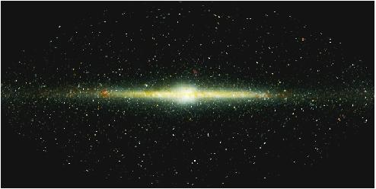
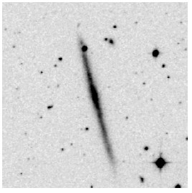
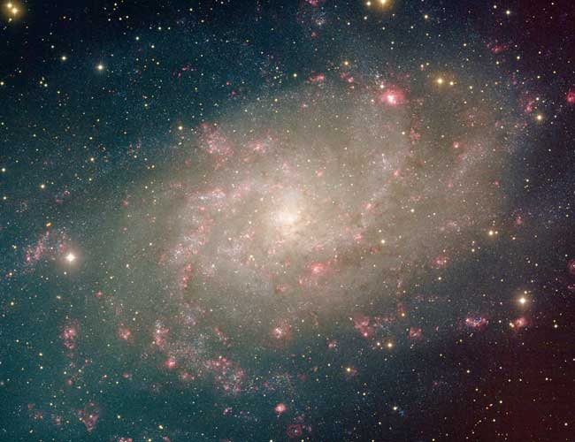
Galaxy disks

Slide 2
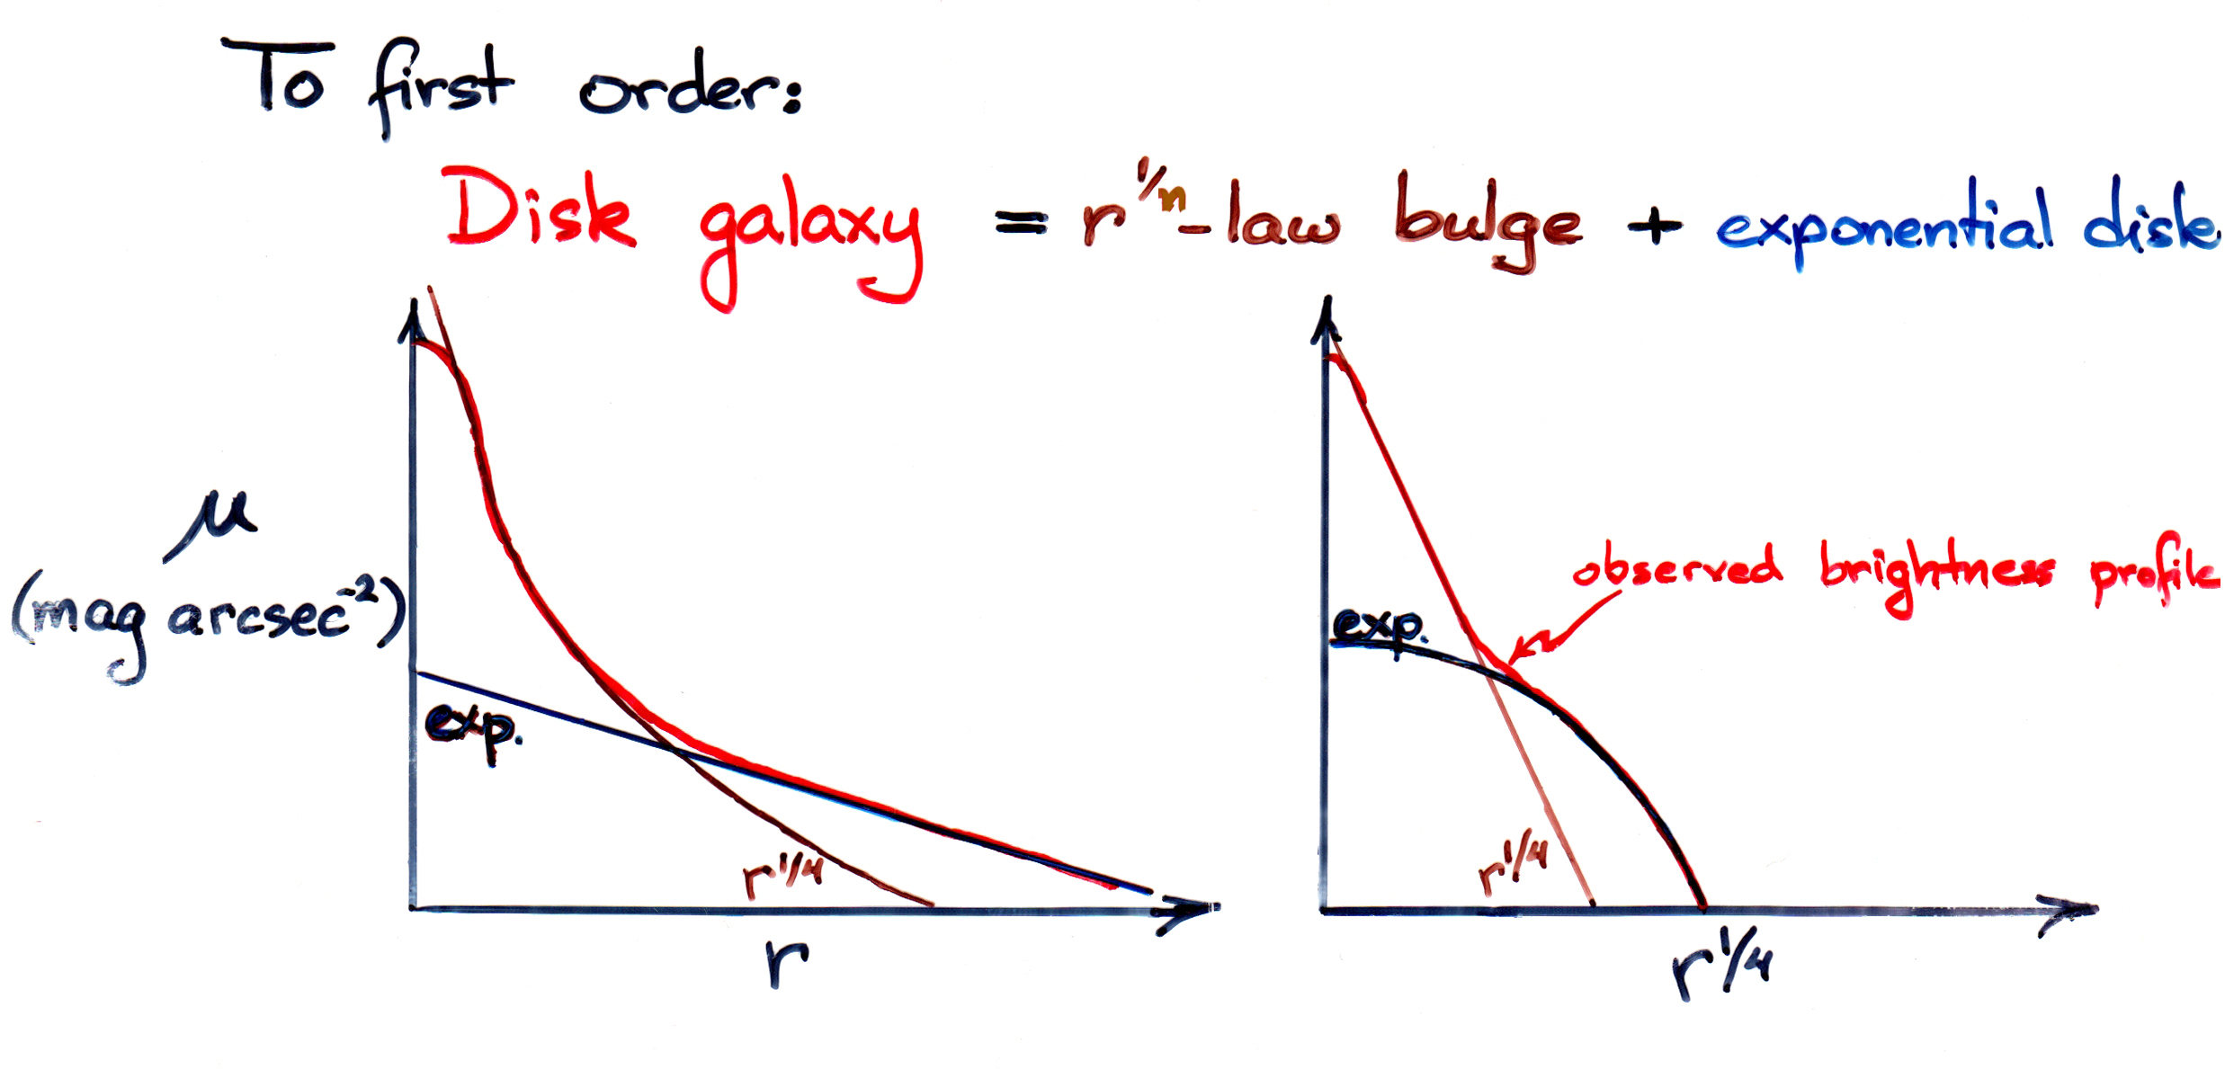

Slide 3
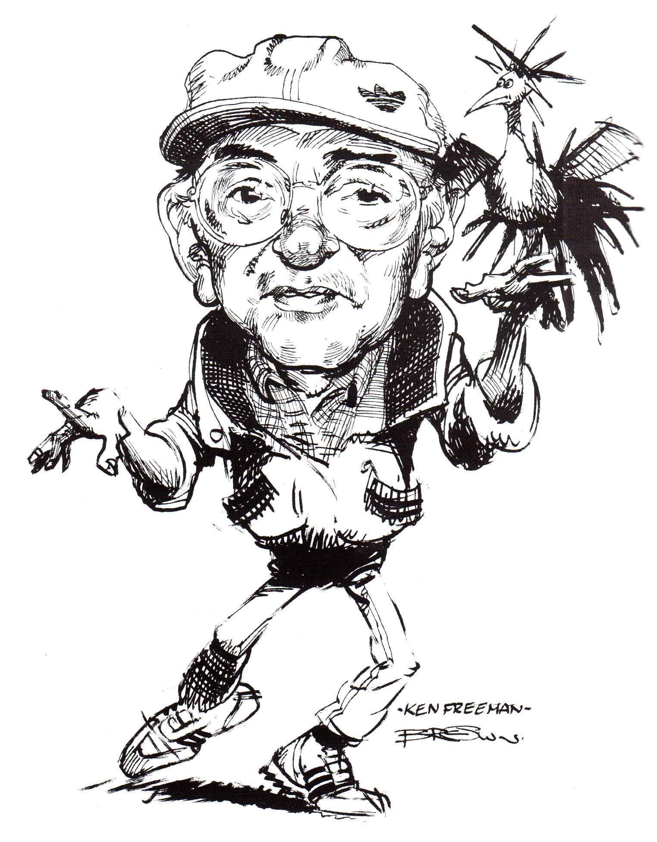

Slide 4
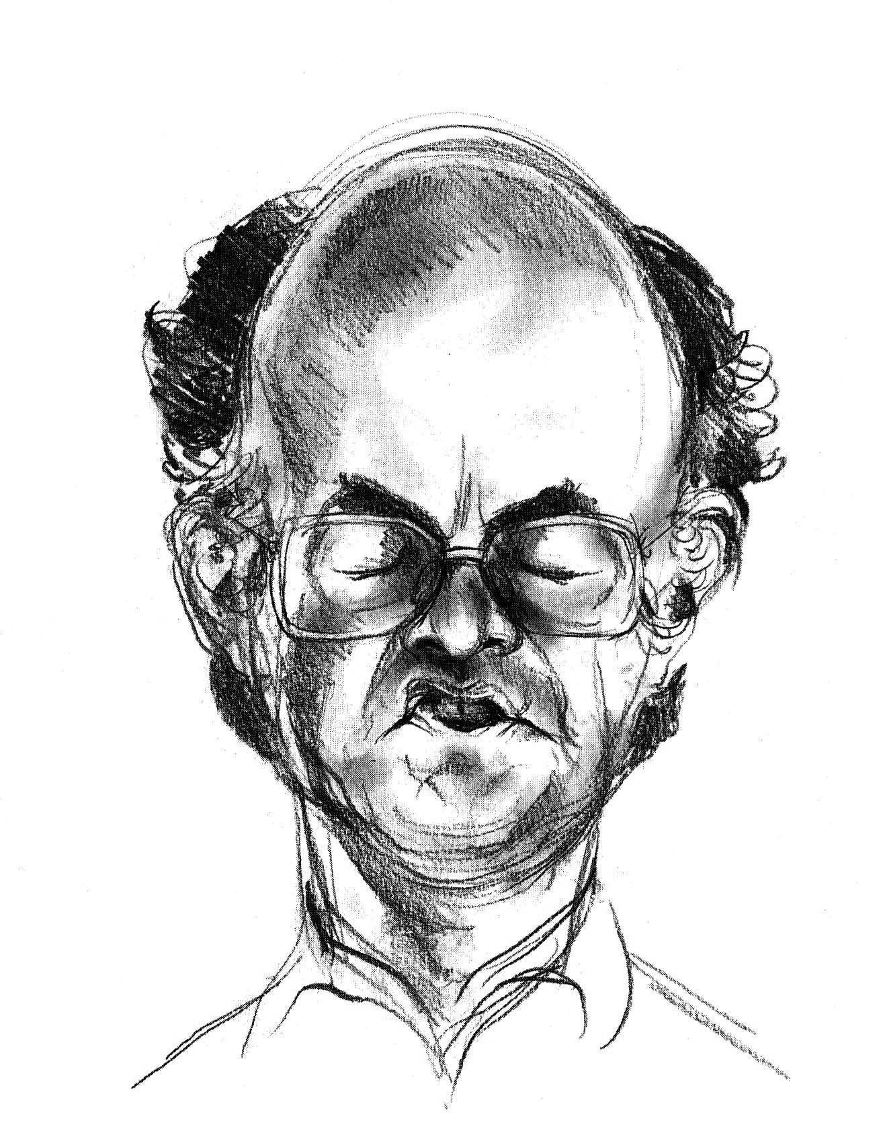

Slide 5
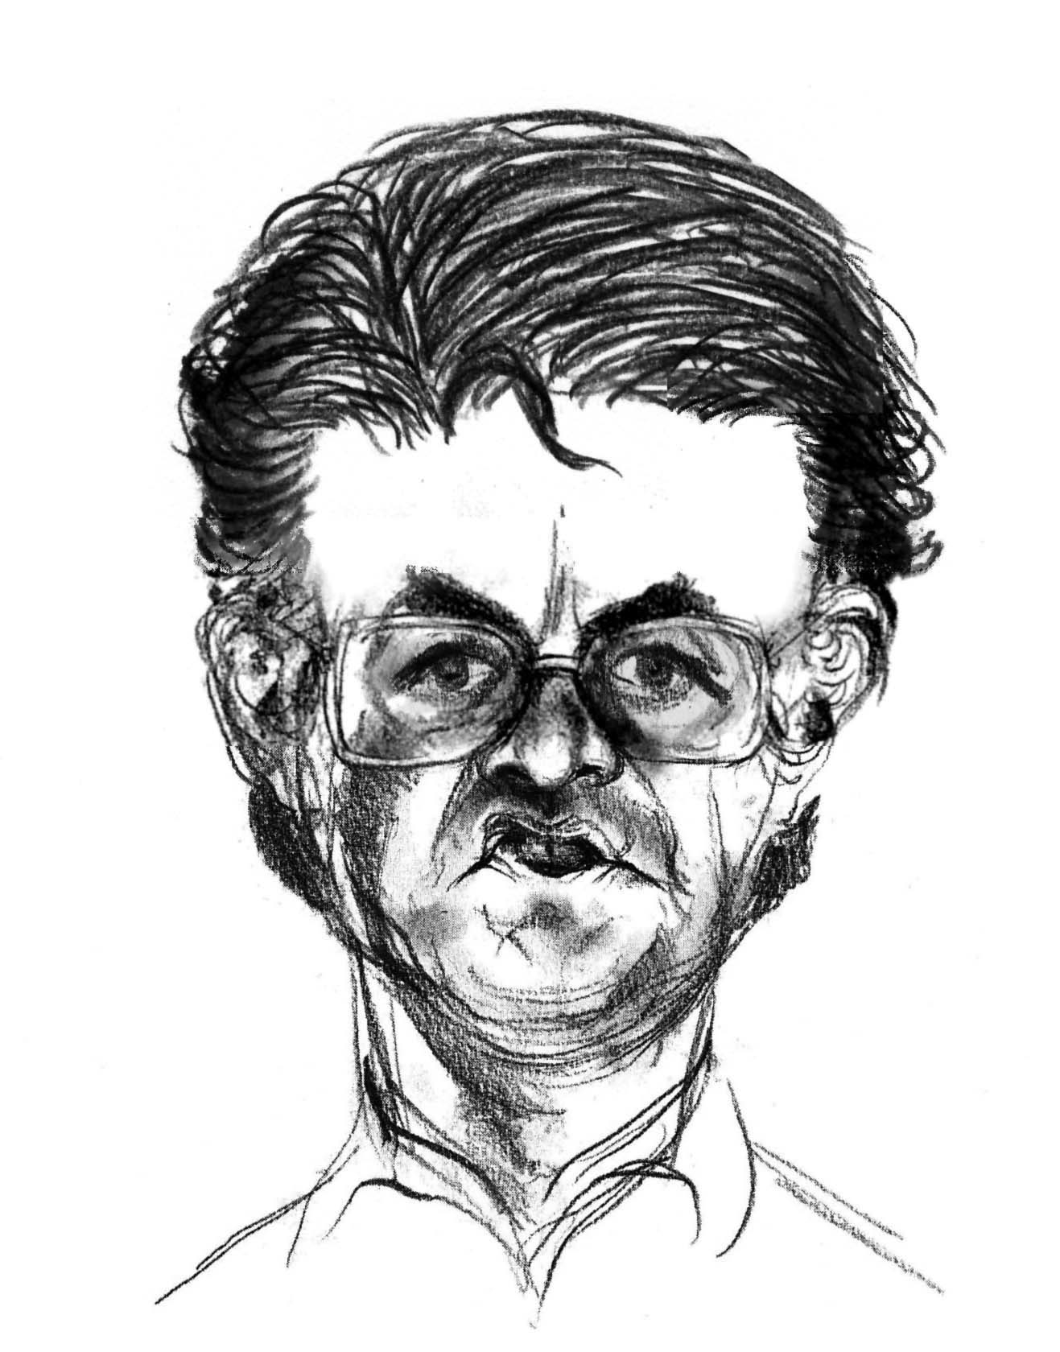

Slide 6
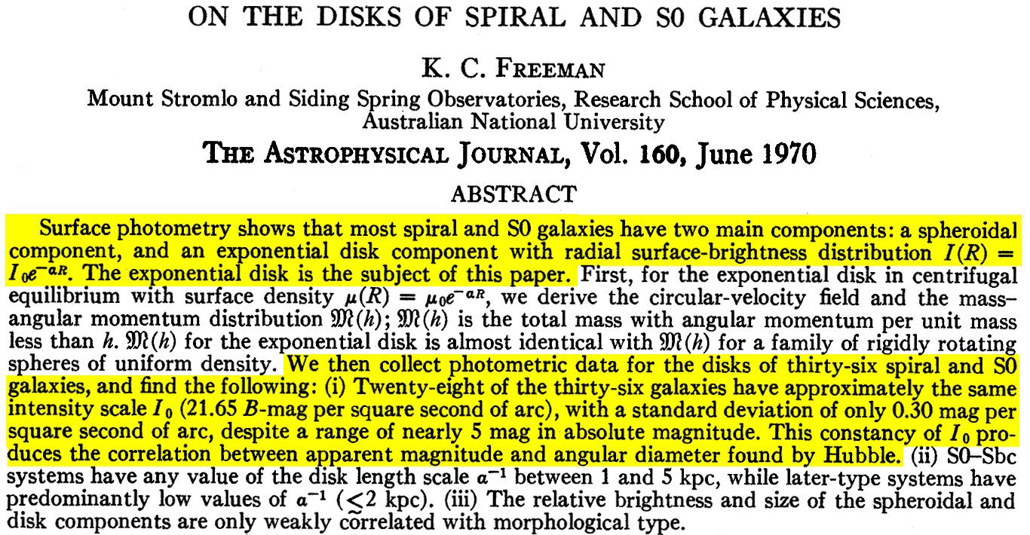

Slide 7
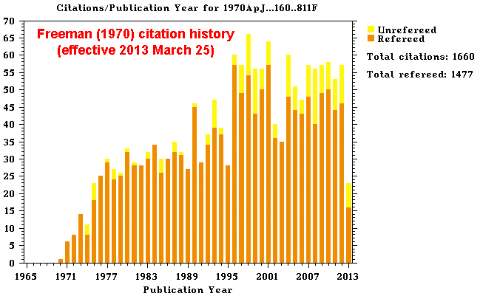

Slide 8
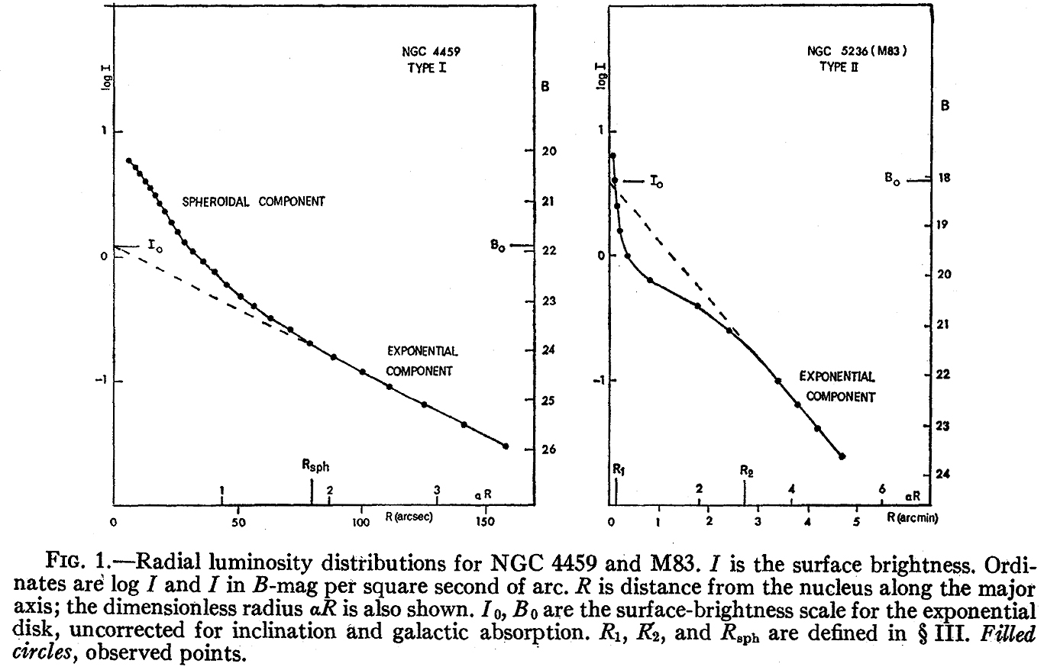
Freeman (1970) “Type I” and “Type II” Exponential Disk Profiles
Note: There are also non-exponential profiles & profiles with outer breaks.

Slide 9
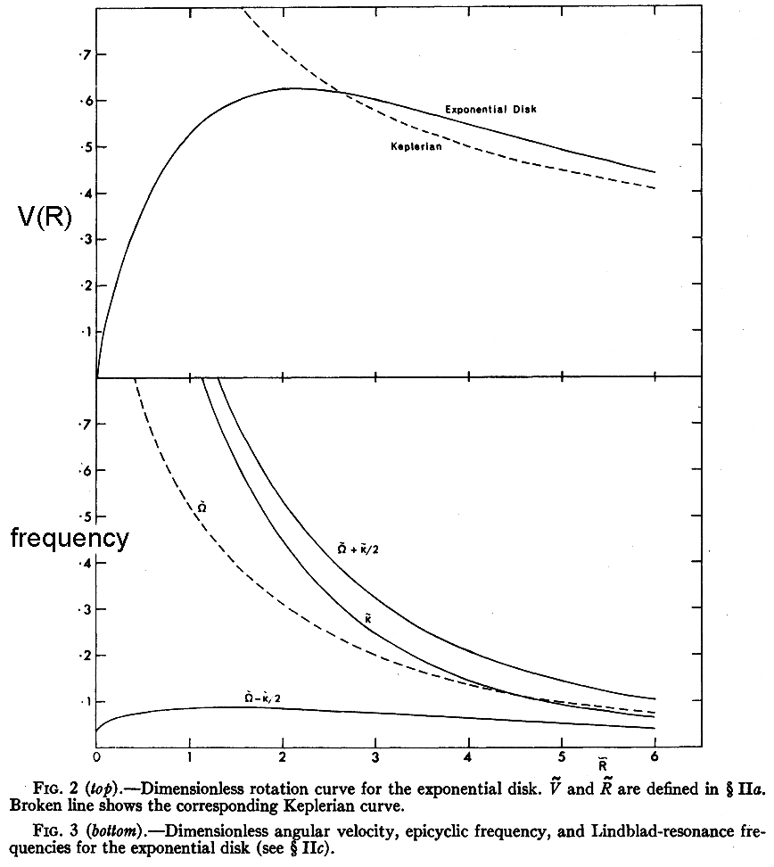
Properties of exponentials: Rotation Curve

Slide 10
K₀, K₁, I₀, I₁
are modified
Bessell functions.
<

Slide 11
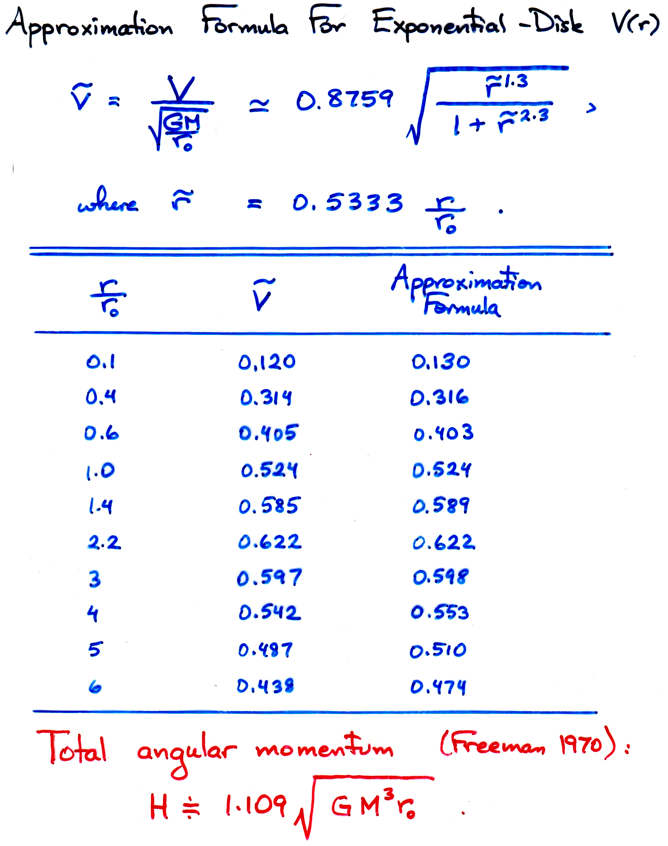

Slide 12
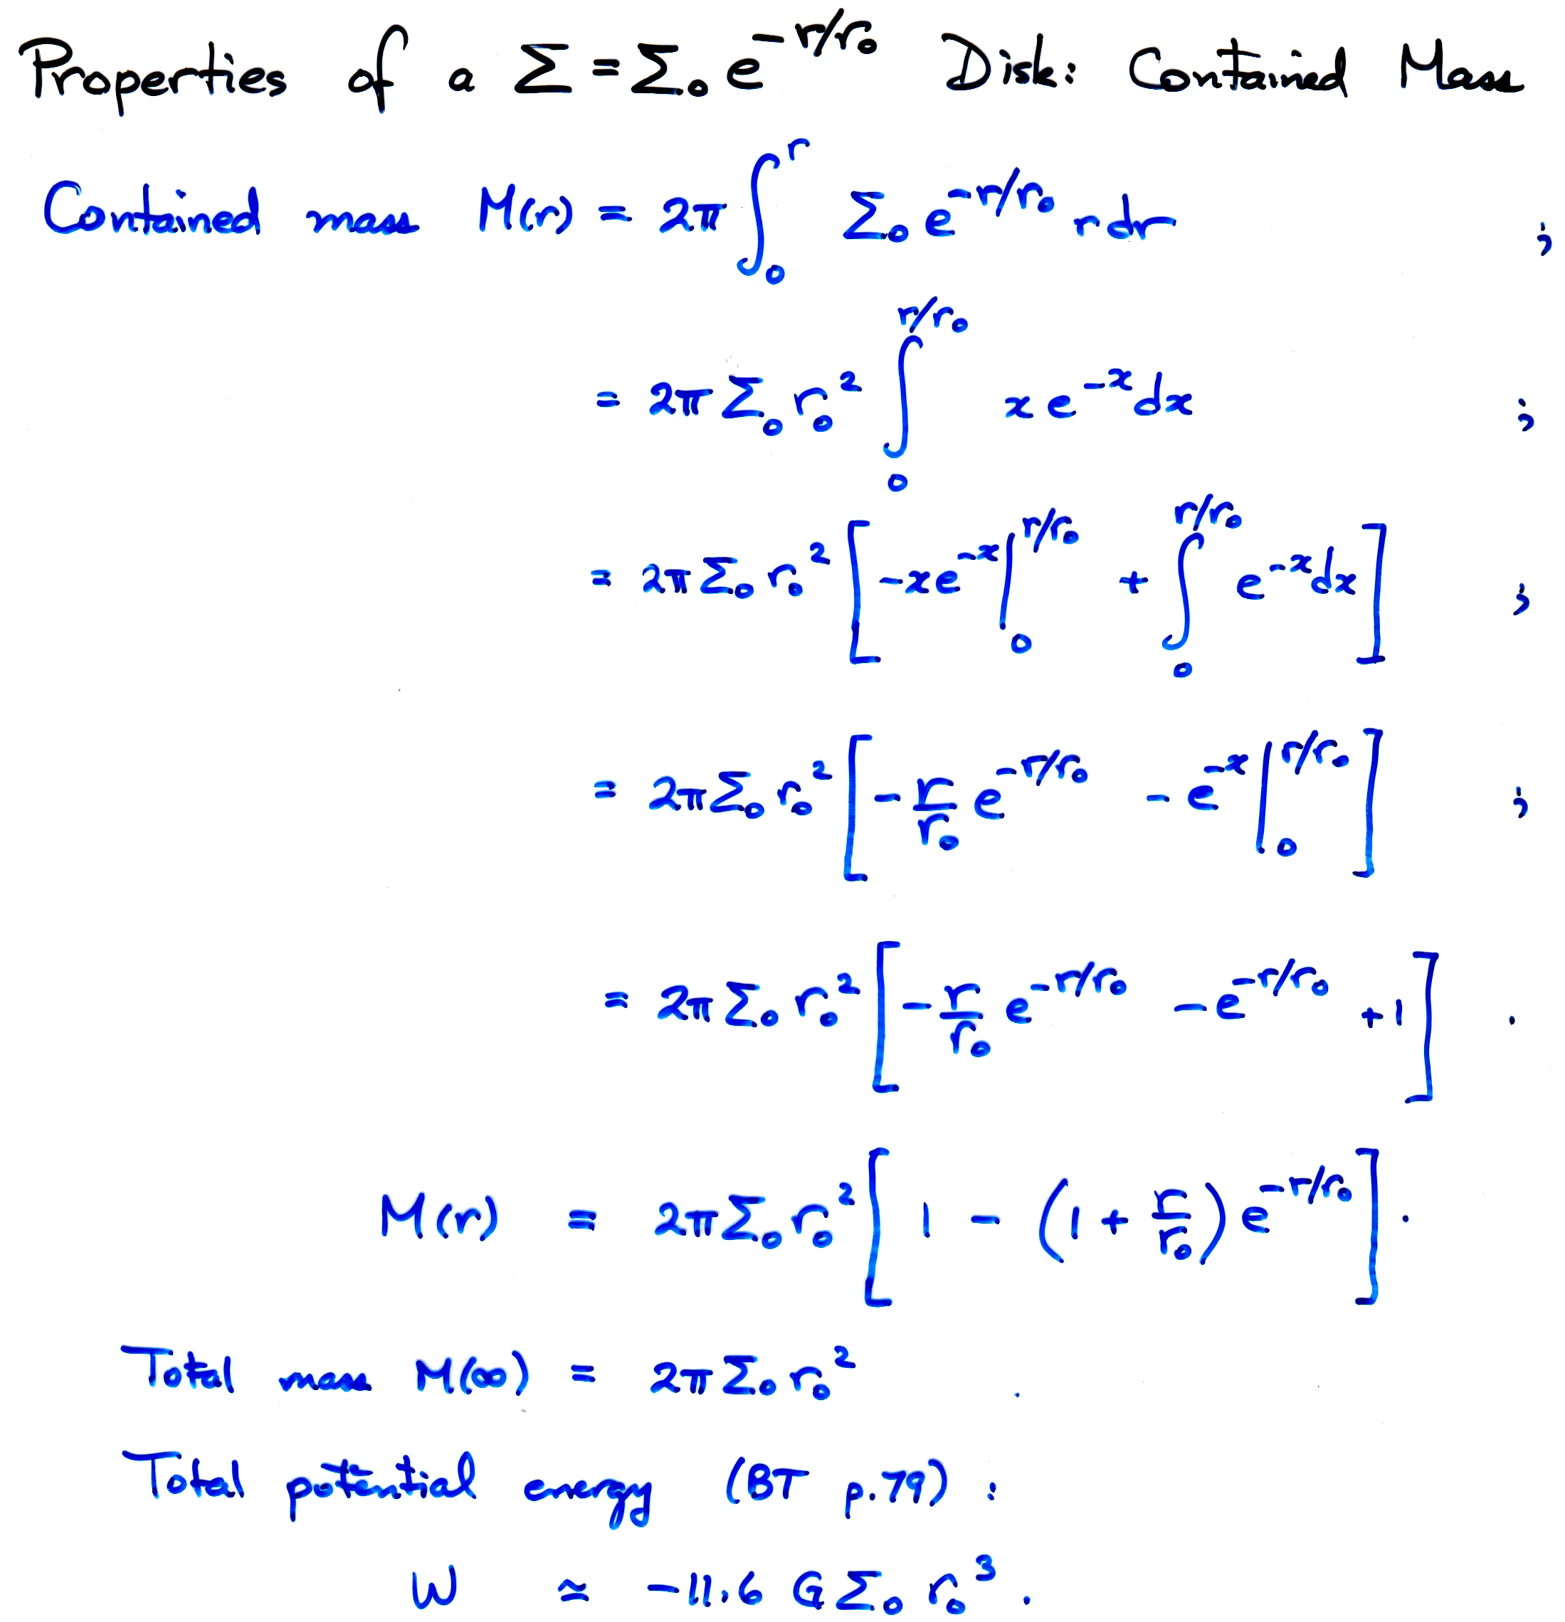

Slide 13
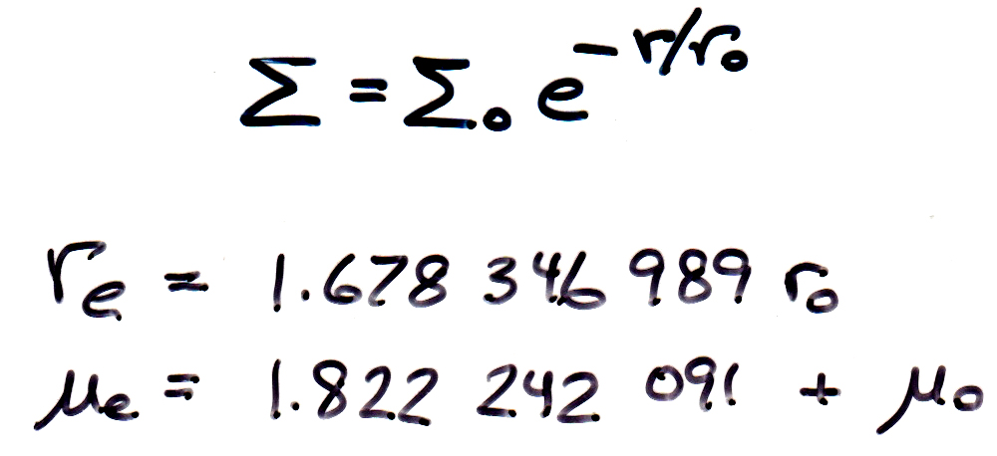
Effective Radius and Effective Brightness of an Exponential Disk

Slide 14
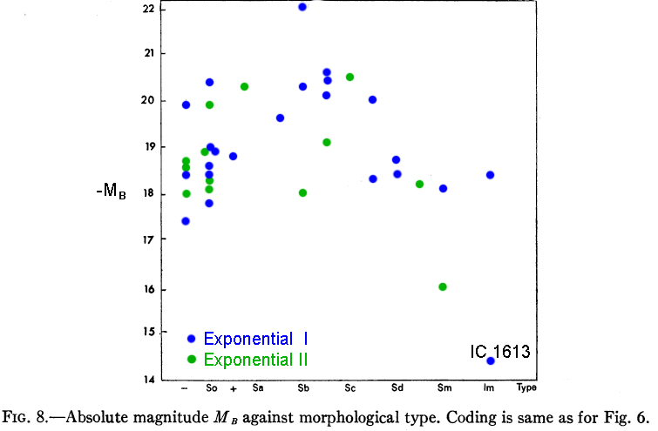
Freeman (1970) Results on Correlations of
Exponential Disk Parameters
H₀ = 100 km/s/Mpc

Slide 15
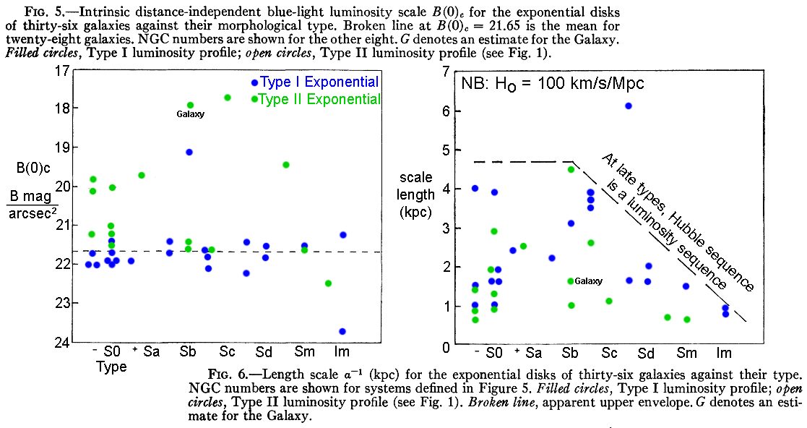
Freeman (1970) Results on Correlations of
Exponential Disk Parameters
The “magic” central disk surface brightness B(0)_{c} was a big surprise
and is still largely unexplained.
L = 2 π I₀ (scale length)²

Slide 16
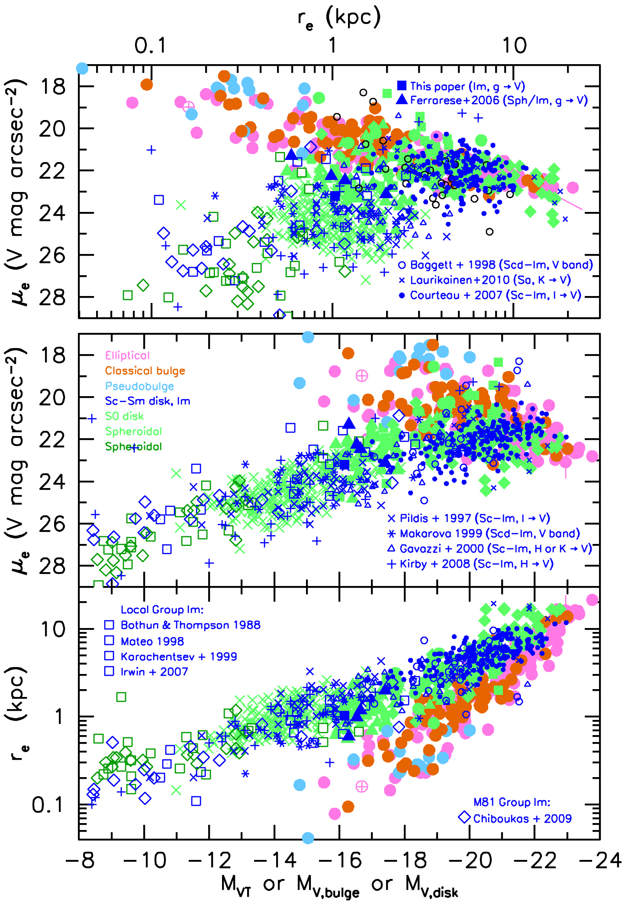
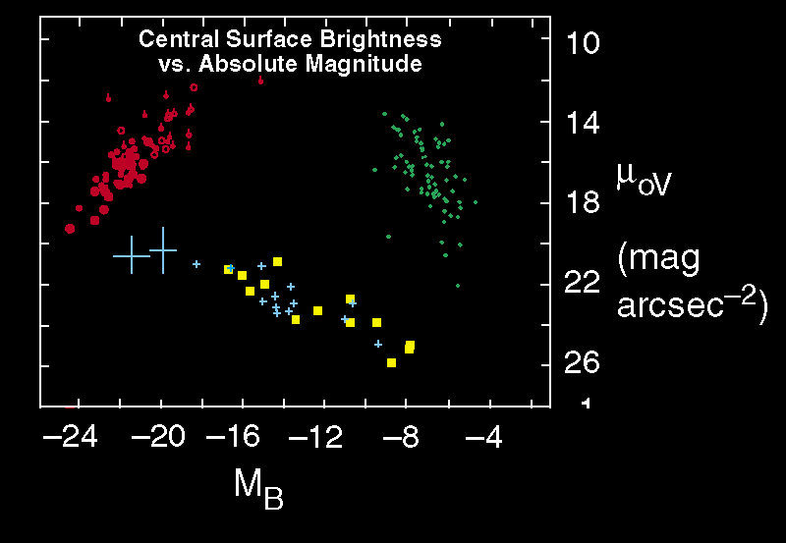
Global Parameter FP Projections (parameters from integrating 2-D profile)
To our augmented sample of classical bulges and ellipticals,
we add galaxy parameters
from bulge-disk decompositions (for early-type galaxies)
or
from Sérsic fits (for late-type galaxies)
for 407 galaxies from 14 independent sources.
This confirms that Sph galaxies have
the same parameter correlations as disks & irregulars
and supports our suggestion that
Sphs are defunct dS+Im systems.
Notes:
16
MOST IMPORTANT SLIDE
MOST IMPORTANT SLIDE
MOST IMPORTANT SLIDE
MOST IMPORTANT SLIDE

Slide 17
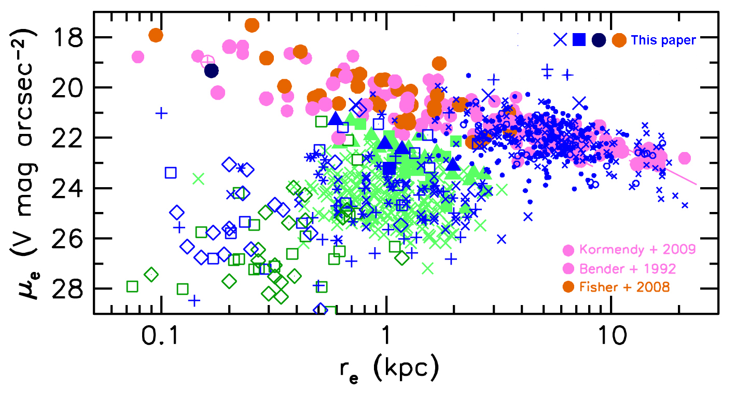
The E–Sph Dichotomy: Perspective
An E – Sph dichotomy is “necessary”
if Es form via major mergers and
if Sphs are defunct late-type galaxies.
Merger simulations predict the observed FP of ellipticals
(Robertson et al. 2006, ApJ, 641, 21; Hopkins et al. 2008, ApJ, 689, 17),
not an E+Sph+S+Im FP from which core Es deviate.
Ellipticals form a sequence of increasing dissipation
at decreasing L.
Spheroidals form a sequence of decreasing baryon retention at decreasing L.
The E and Sph sequences overlap in r_{e} and luminosity.
Notes:
17

Slide 18
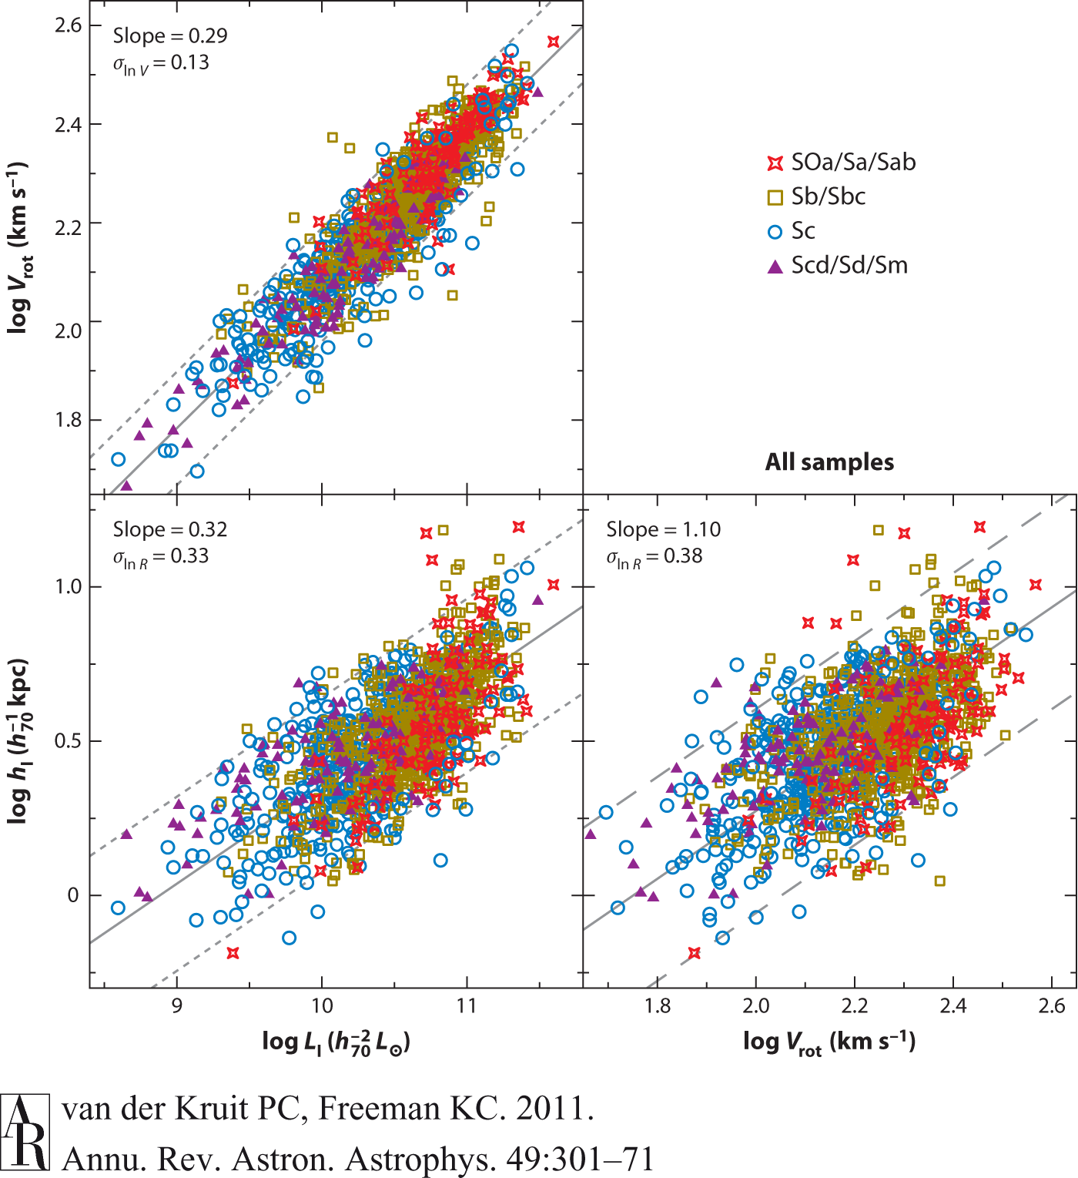
Tully-Fisher (1977, A&A, 54, 661) relation

Slide 19
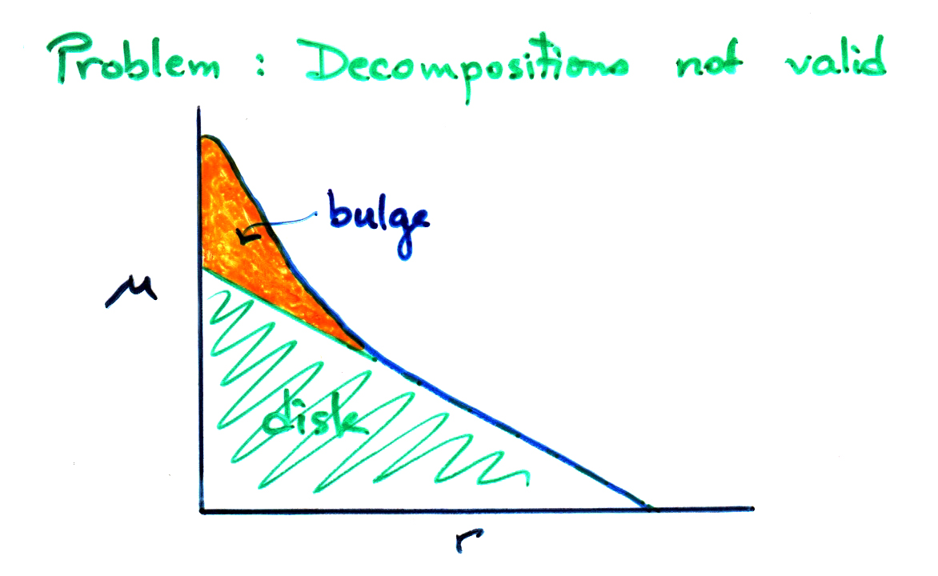
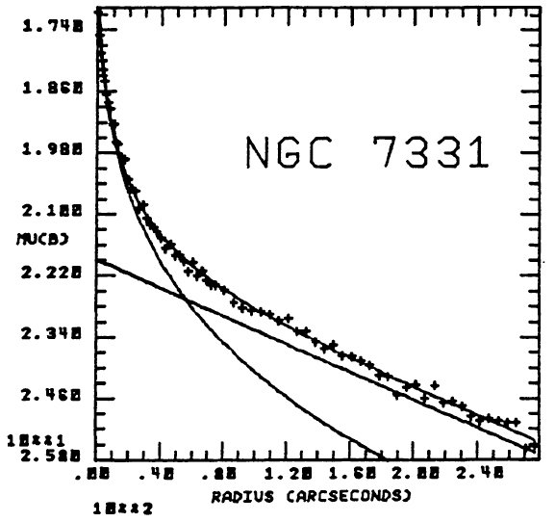
Problem with Freeman (1970): Need to
decompose the galaxy into bulge and disk parts that
add up to the observed surface brightness profile
Boroson 1981, ApJS, 46, 177
Like this:
First paper on profile decomposition: Kormendy 1977, ApJ, 217, 406
Early papers: Burstein 1979, ApJ, 234, 435 (on S0 galaxies)
Boroson 1981, ApJS, 46, 177 (extension to 2-D)
Kent 1985, ApJS, 59, 115 (105 galaxies)
Schombert & Bothun 1987, AJ, 93, 60 (caution: easy to screw up!)

Slide 20
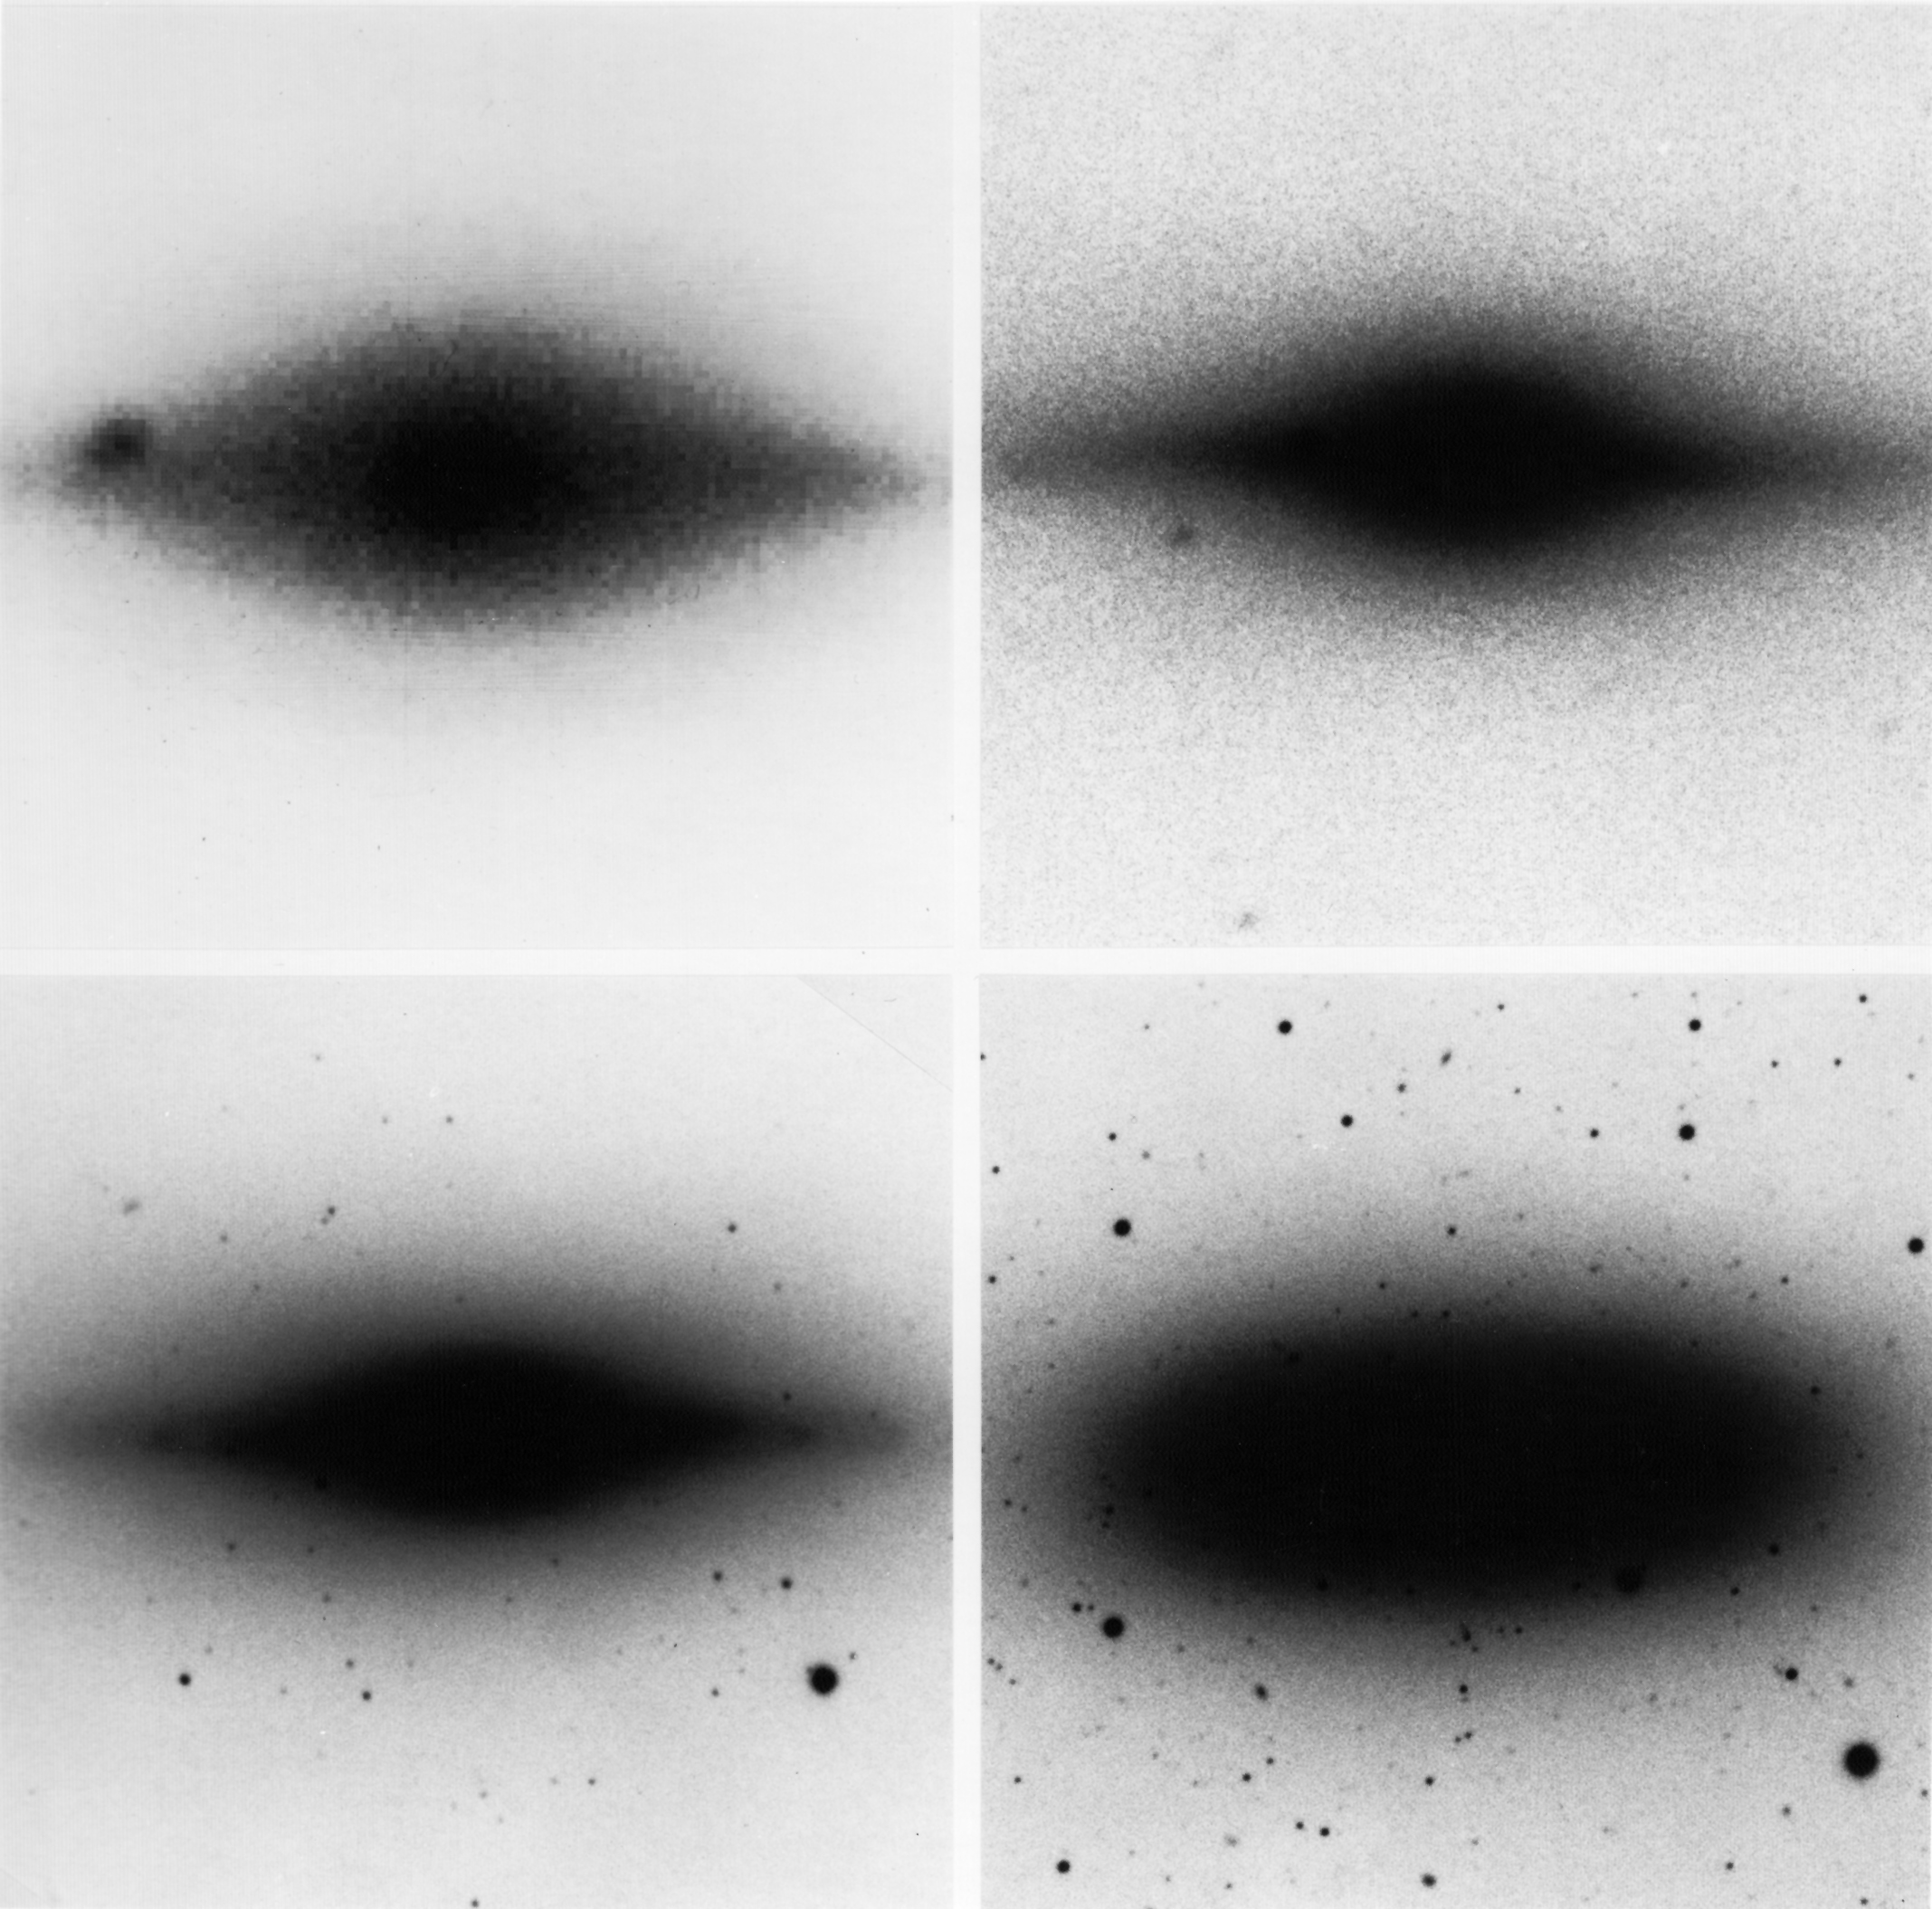
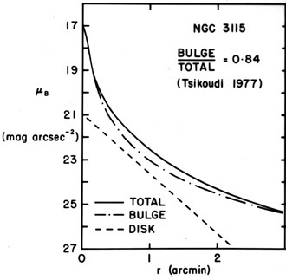
NGC 3115 (S0/)
Bulge dominates
at center and at
large radii.
Disk contributes
at intermediate r
but dominates at
no radii!
(Kormendy 1982,
Saas-Fee Lectures)
Hamabe 1982

Slide 21
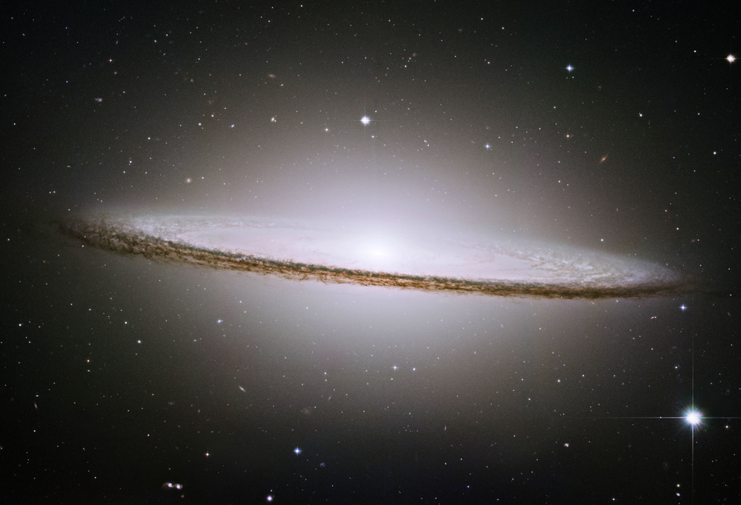
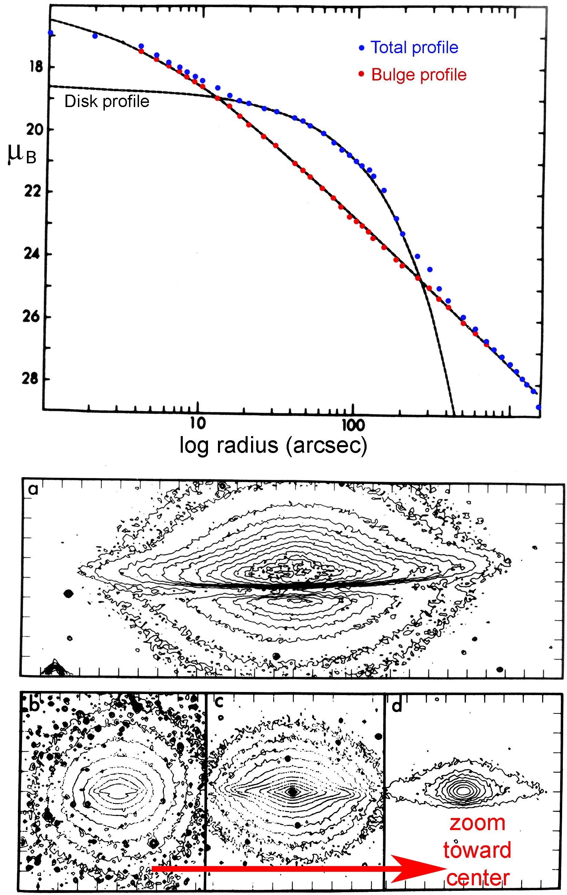
Similarly: Sombrero Galaxy
disk contributes only at
intermediate radii.
Measuring the disk requires
bulge-disk decomposition.
Burkhead 1986, AJ, 91, 777

Slide 22
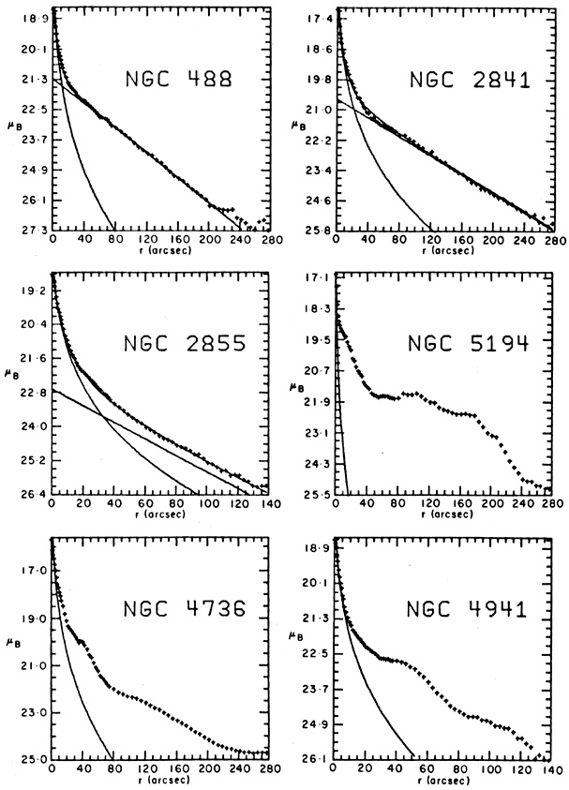
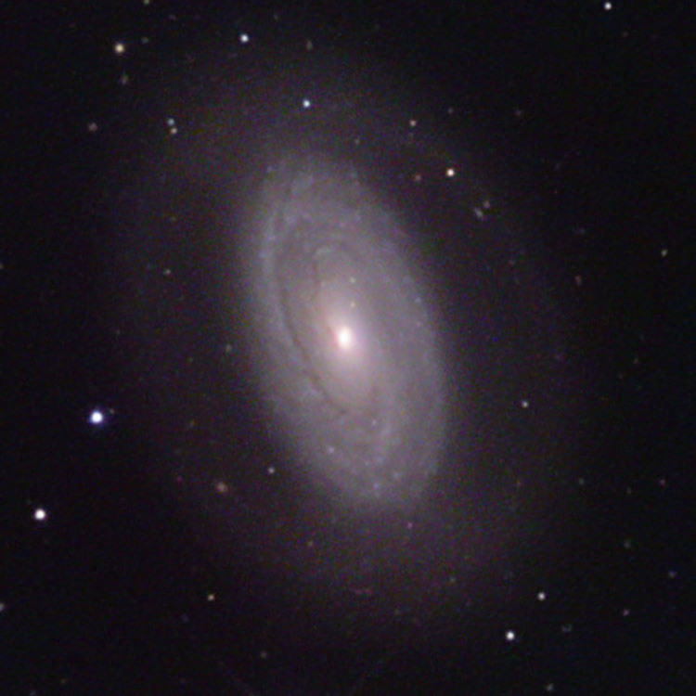
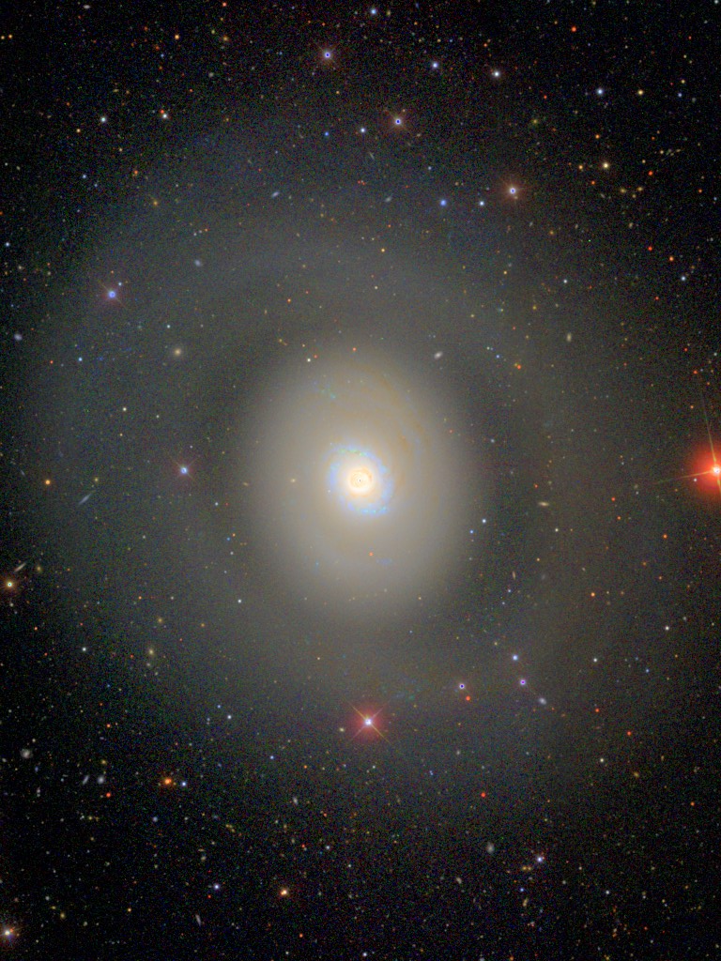
exponential disk
exponential disk
Boroson 1981,
ApJS, 46, 177
Of 26 spiral galaxies,
9 have exponential disks;
10 do not
(4 of these are oval);
7 are unclear.
exponential disk
Not exponential !
oval disk
oval disk

Slide 23
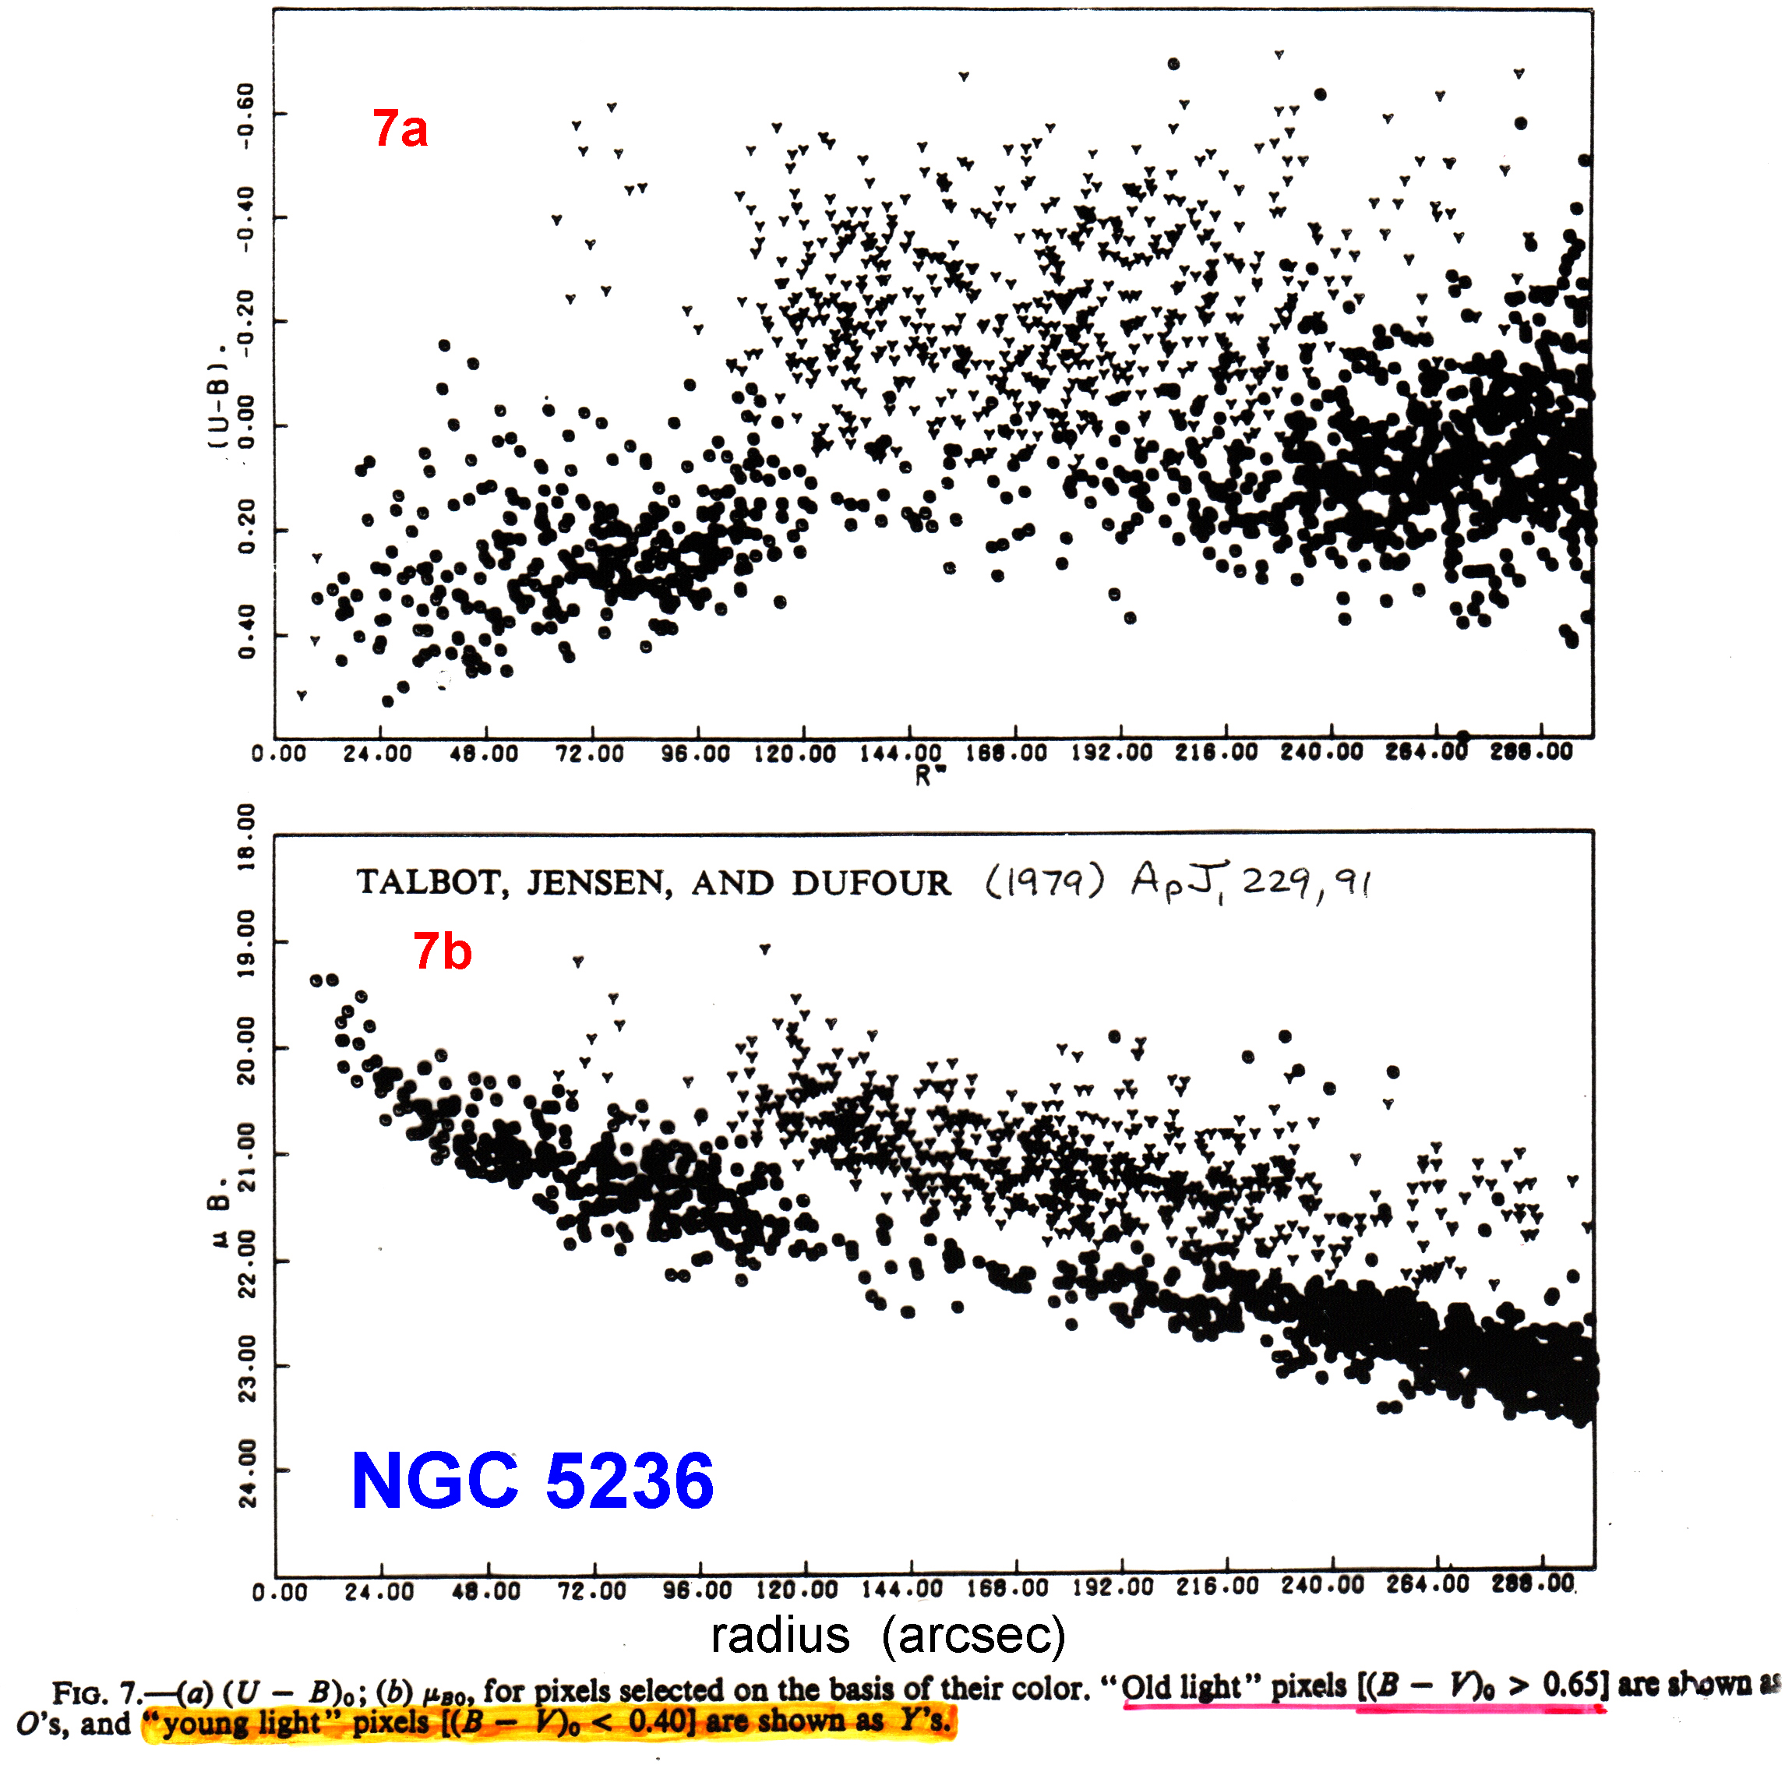
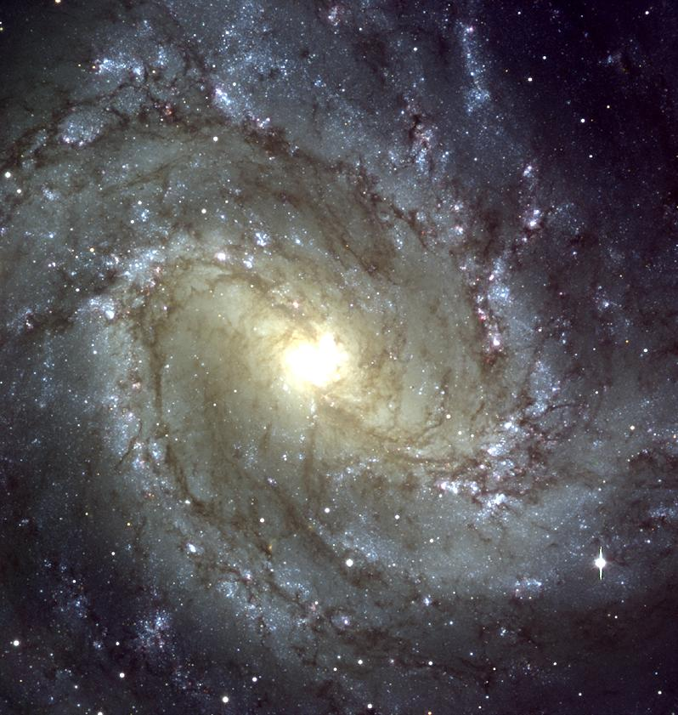
Sometimes a disk is non-exponential because of star formation.
pixels dominated by young stars
pixels dominated by old stars
pixels dominated by young stars
pixels dominated by old stars
But not in general (i. e., many non-exponential disks are still non-exponential at K band)
(see Elmegreen 1981, ApJS, 47, 229).

Slide 24
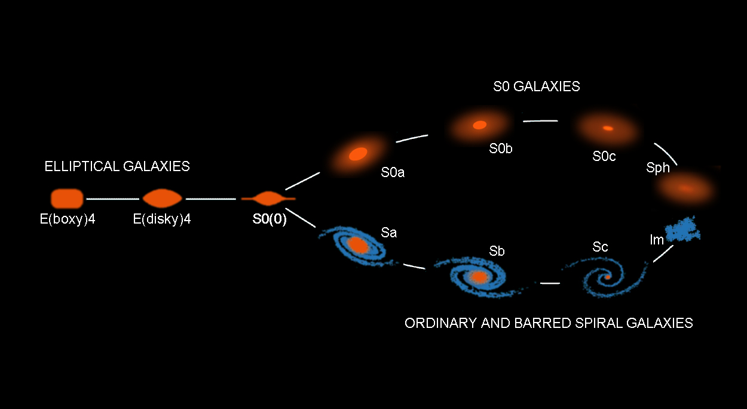
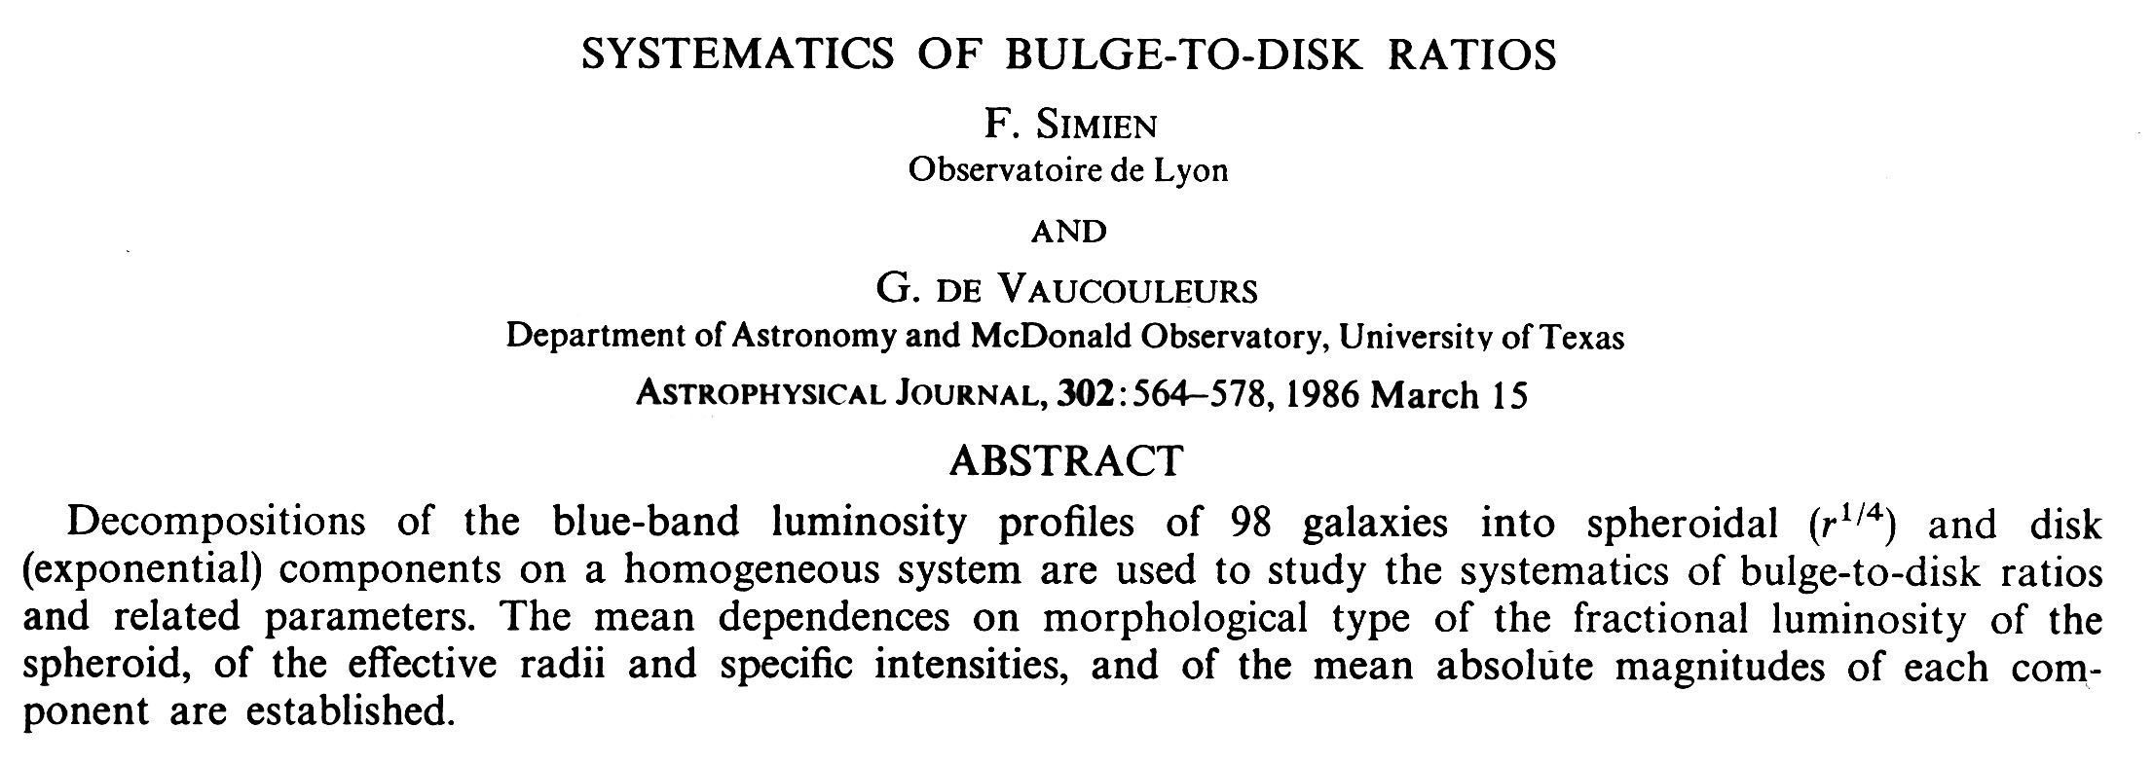
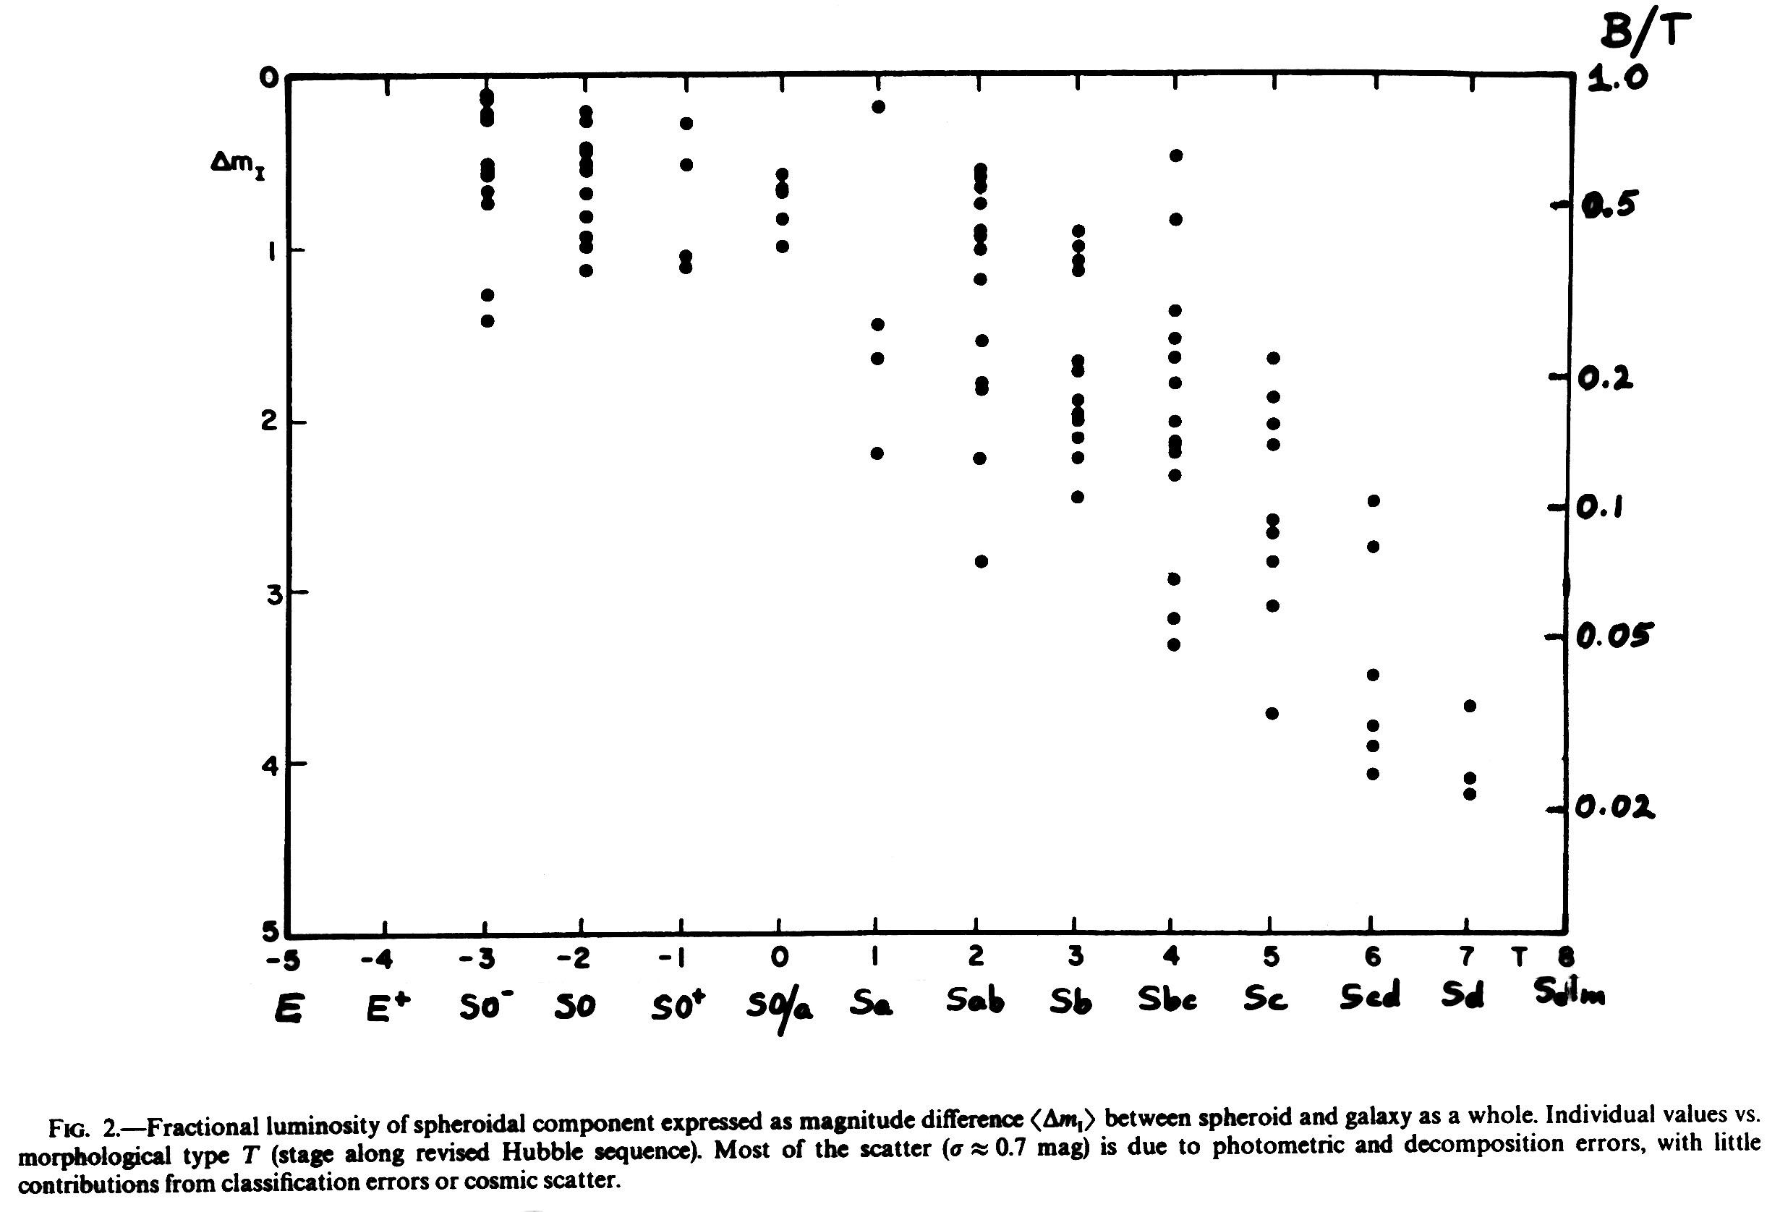
S0 B/T ∈ (0,1]
Pseudobulges ⇒ B/T is
smaller than this
at all Hubble types.

Bulge luminosity
Total luminosity
Note: Bulges and pseudobulges (Lecture 17) are combined.

Slide 25
Two-Dimensional Decomposition Machinery
(e. g.)
Byun & Freeman 1995, ApJ, 448, 563
Peng et al 2002, AJ, 124, 266 (GALFIT) (852 cites)
De Souza et al. 2004, ApJS, 153, 411 (BUDDA) (80 cites)
Mendez-Abreu et al. 2008, A&A, 478, 353 (GASP2D) (50 cites)
CAUTION !
These programs usually are based on the assumption
that the ellipticity of each component is constant with radius.
This is certainly wrong.
It leads to horrible overinterpretations
(e. g., “we decompose this galaxy into 8 components, …”)

Slide 27
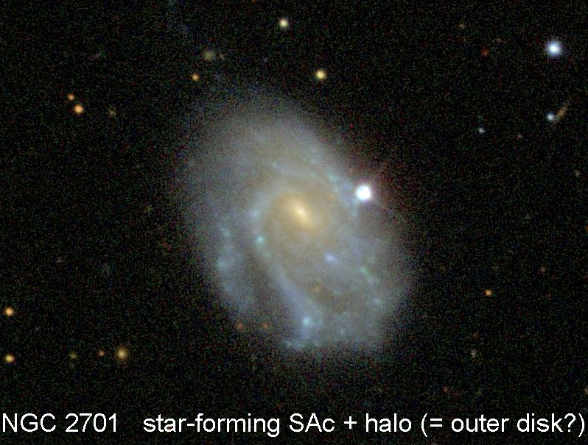
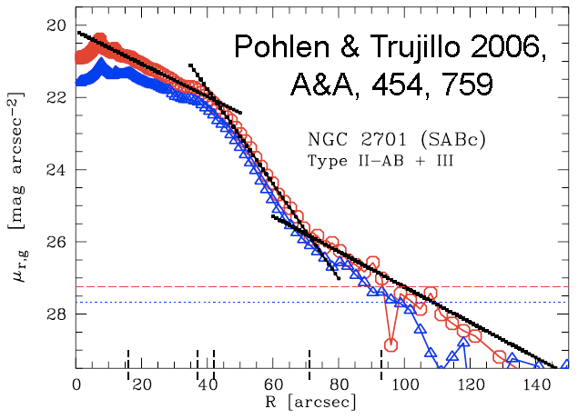
Radial Profiles of Galaxy Disks (Continued):
Pure Exponentials;
Outer breaks to steeper exponentials (“type II” truncations);
Outer breaks to shallower exponentials (“type III profiles”);
Etc. .

Slide 28
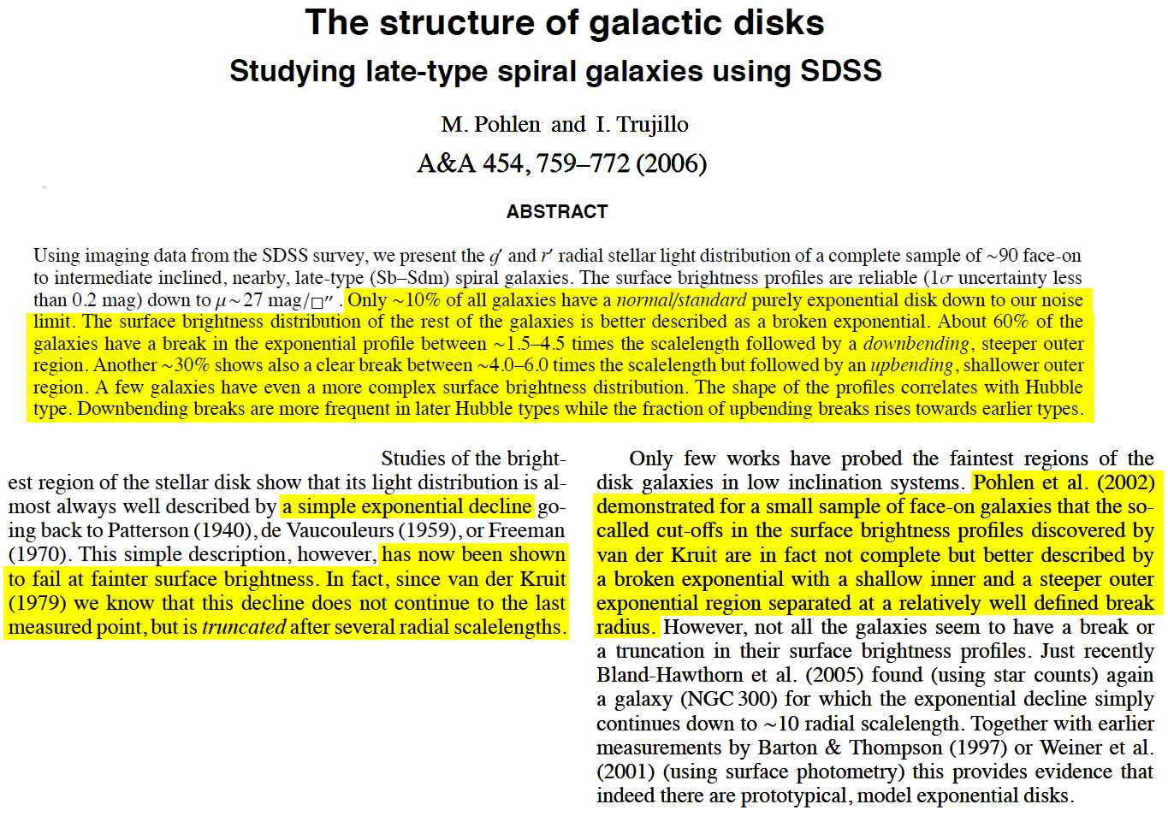
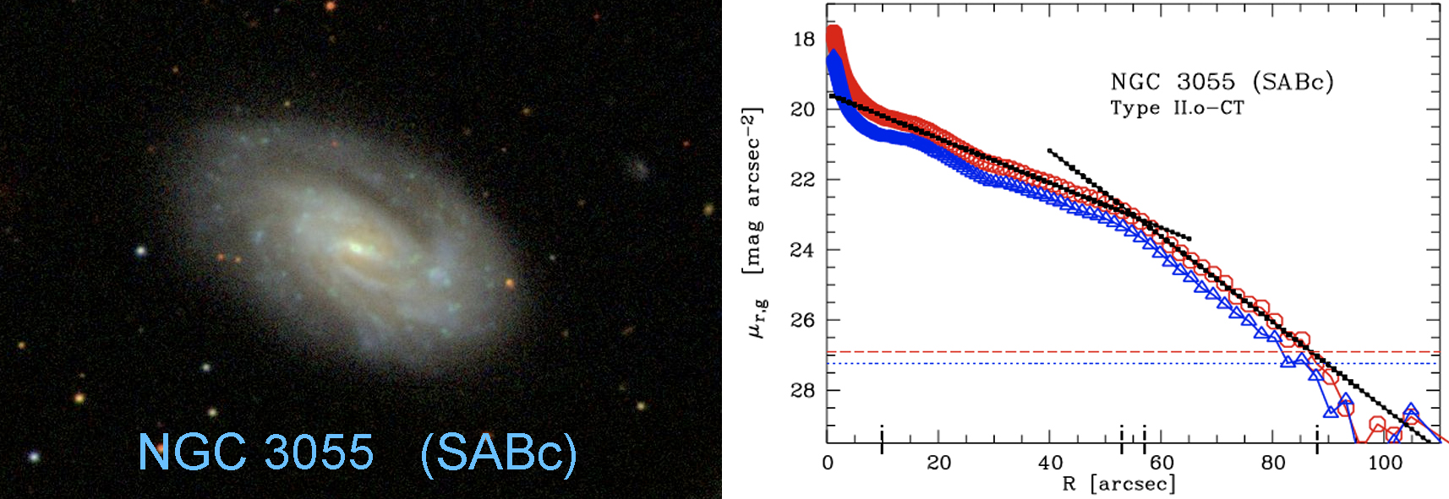

Slide 29
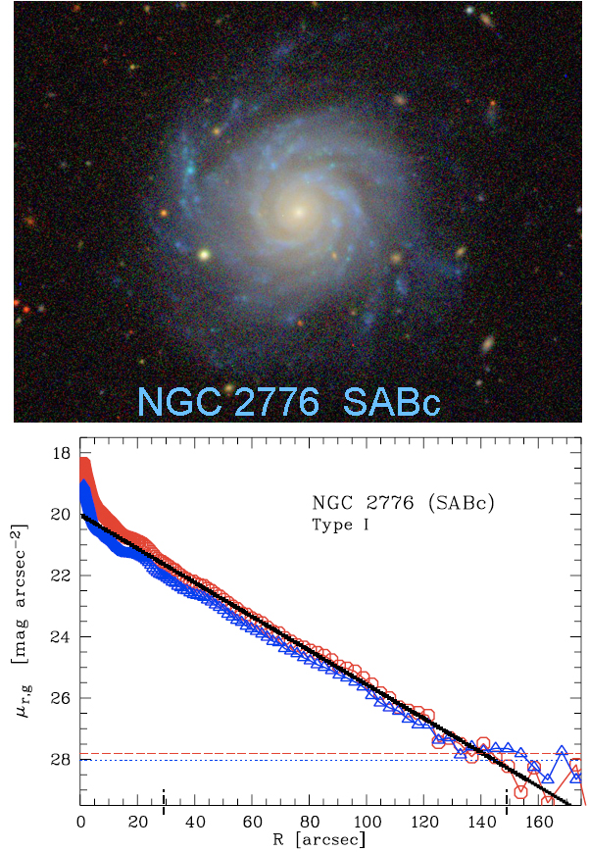
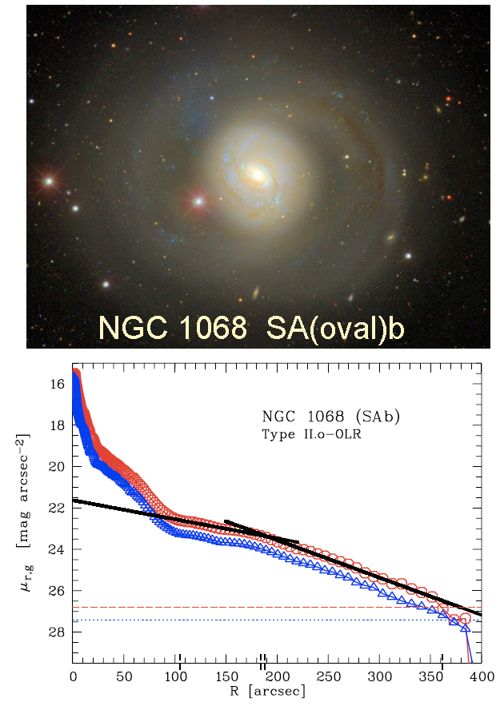
Some disks really are exponential.
Some “type II” “cutoffs” are parts of ovals.

Slide 30
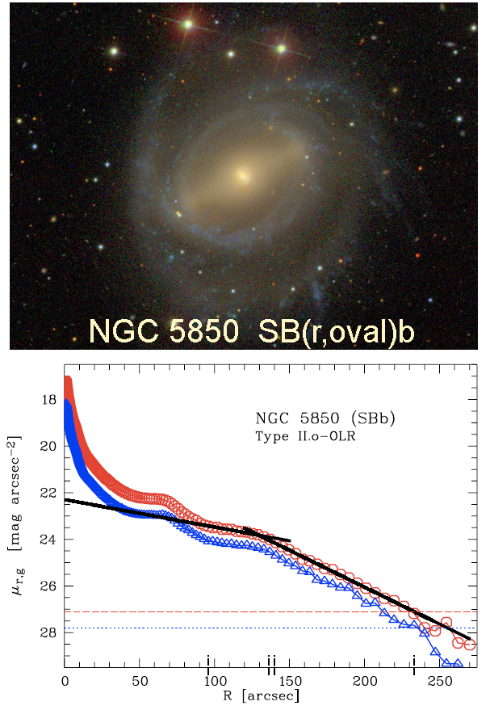
Some “type II” “cutoffs” are parts of ovals – the outer cutoff of the outer oval..

Slide 31
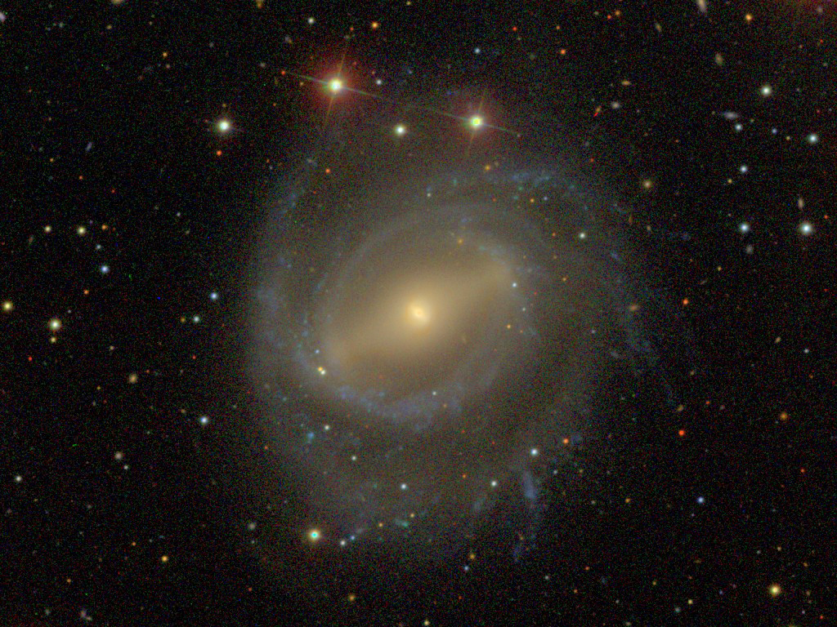
NGC 5850 contains both a main bar and a nuclear bar.

Slide 32
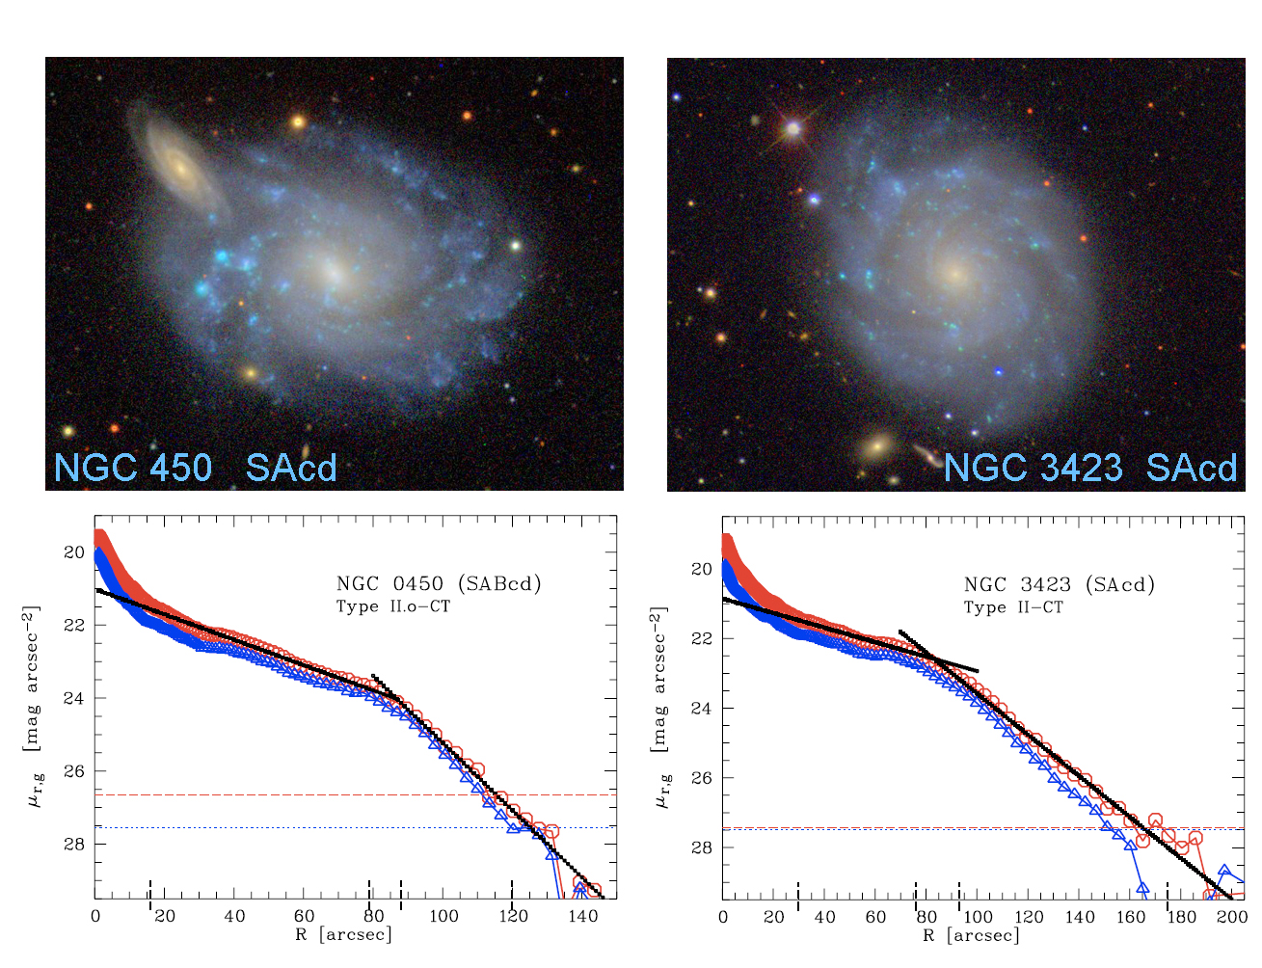
Here, the inner, actively-star-forming disk is the inner, flatter exponential
part of the “type II” profile, and the steep outer exponential
looks exactly like the cutoffs discussed by van der Kruit. 

Slide 33
The truncation
of
M33's disk
M33 is a pure
disk galaxy in
the Local Group:
no bulge;
no pseudobulge;
just a nuclear star
cluster like a
globular cluster.
(Ferguson et al 2003)

Slide 35
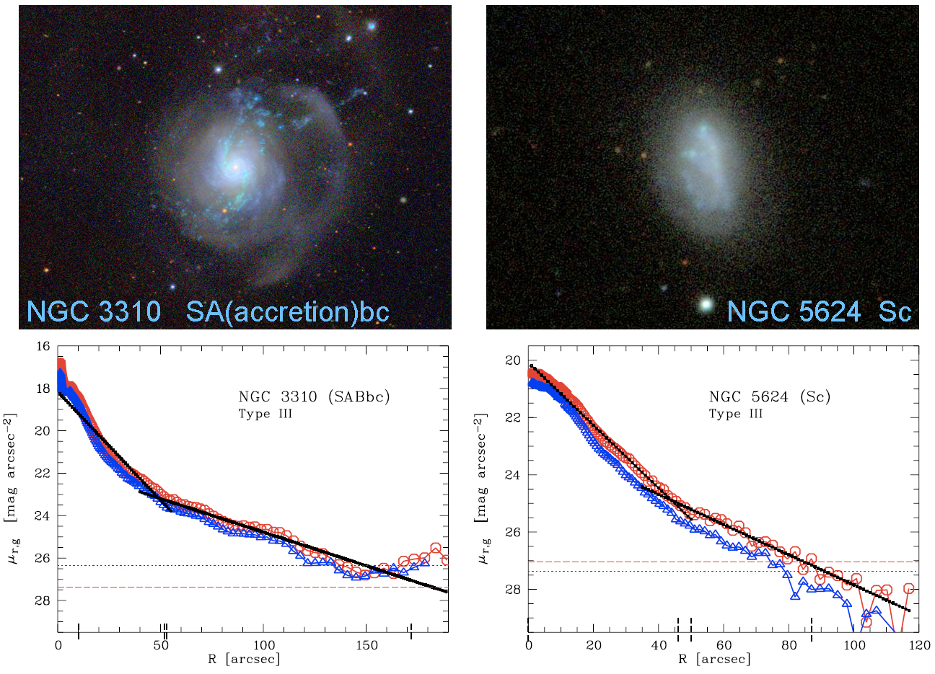
Sometimes the “type III” profile – i. e., an outer upturn – results
from a centrally concentrated starburst embedded in outer structure
that may be affected by an accretion … or not.

Slide 37
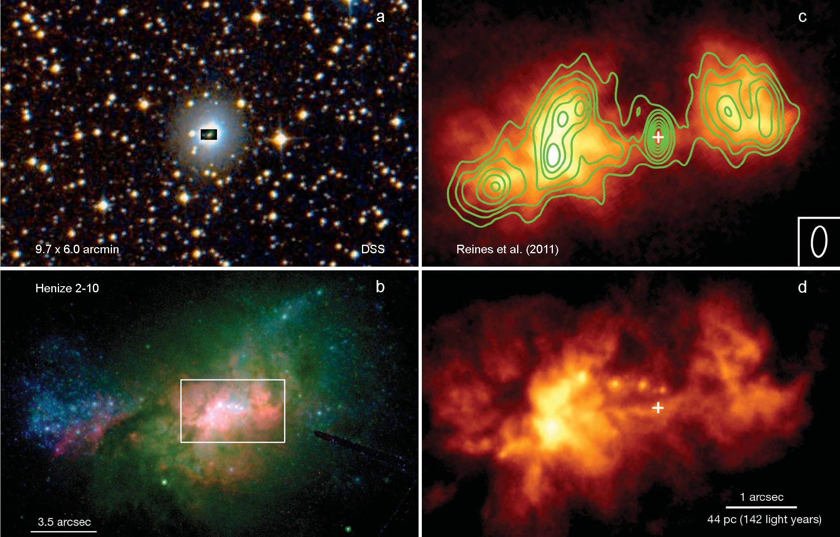
Even bulgeless dwarf galaxies can contain supermassive black holes.
The blue compact dwarf galaxy Henize 2-10 contains a
supermassive black holes with mass M ~ 10⁶ M. (Reines et al. 2011, Nature, 470, 66).
Notes:
37

Slide 38
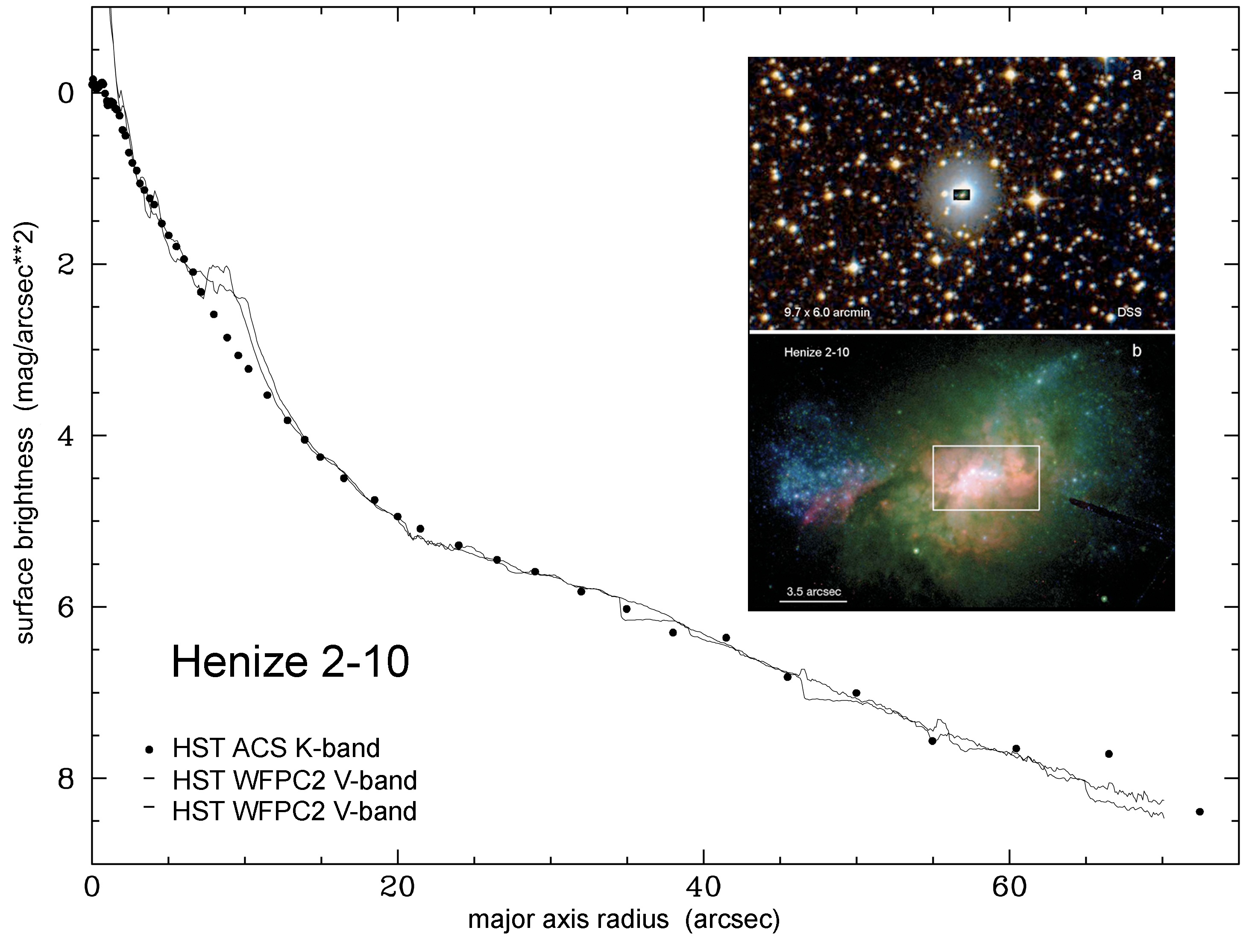
Henize 2-10 is a starbursting dwarf galaxy
interior to an exponential, outer envelope
(a disk?). So this is a more extreme
example of the “type III” profiles in the
previous slide. But: Henize 2-10 may
be a rare dwarfish example of
merger-induced bulge building
in action: the Sersic index of the
inner component is ~ 2.

Slide 39
Disk radial density profiles are not understood.
But there are many relevant suggestions:
Exponential: Uniform density sphere already has roughly the right density distribution.
Preserving the angular momentum distribution “gets you close”.
Secular dissipation gets you closer (see van der Kruit & Freeman 2011 for review).
Bar-driven secular disk evolution makes rings and oval disks
(see lectures on secular evolution).
Papers on star formation thresholds and rates claim some success:
Kennicutt 1989, ApJ, 344, 685 (Toomre 1964 Q stability criterion explains cutoffs)
Kregel, van der Kruit, & de Grijs 2002, MNRAS, 334, 646 (SF threshold ⇒ truncation)
Schaye 2004, ApJ, 609, 669 (thresholds and truncations)
Elmegreen & Hunter 2006, ApJ, 636, 712 (“type III” profiles). vdK+F2011 are skeptical.
In edge-on galaxies, disk flaring (because the halo “takes over” the potential)
can cause the surface brightness to drop steeply.
If disks grow from the inside outward by cold-gas accretion from the
cosmological hierarchy, then there may be a maximum radius out to which
the disk has so far been built (e. g., Larson 1976, MNRAS, 176, 31).
Whether for this reason or not, V(r) drops ⇒ density truncations are sometimes seen.

Slide 40
Underlying Moral
Disks are much more complicated than ellipticals:
Mergers + violent relaxation smooth out the structure
and erase much of the “memory” of the previous formation history.
Disks have many more evolution processes:
cosmologial accretion;
gas dissipation;
secular structural evolution ⇒
spiral, bar, ring, oval, and other structures;
star formation;
instabilities;
et (lots of) c.,
and all of these can and do depend on radius.
We know much less about disks than we do about ellipticals.
We need to be satisfied with squishier answers to scientific questions,
because less rigor is possible.

Slide 41
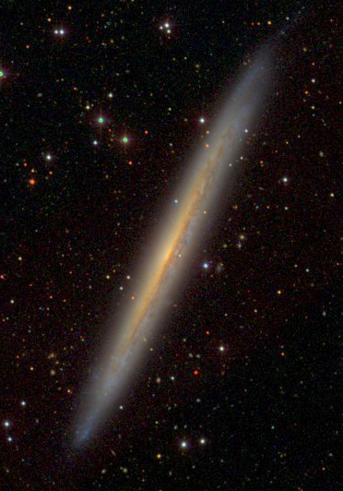
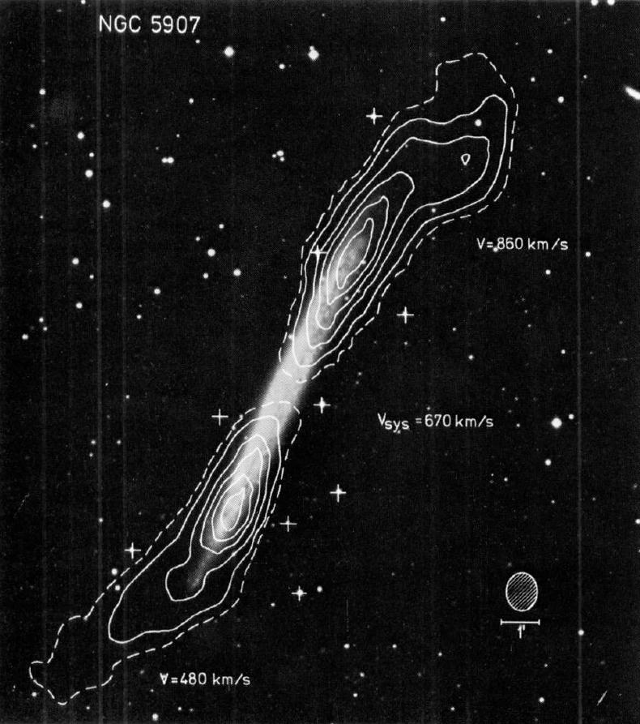
Many spiral galaxies have HI warps that start at the
outer edges of the optical disks (van der Kruit & Freeman 2011).
NGC 5907
Sancisi 1976, A&A, 53, 159

Slide 42
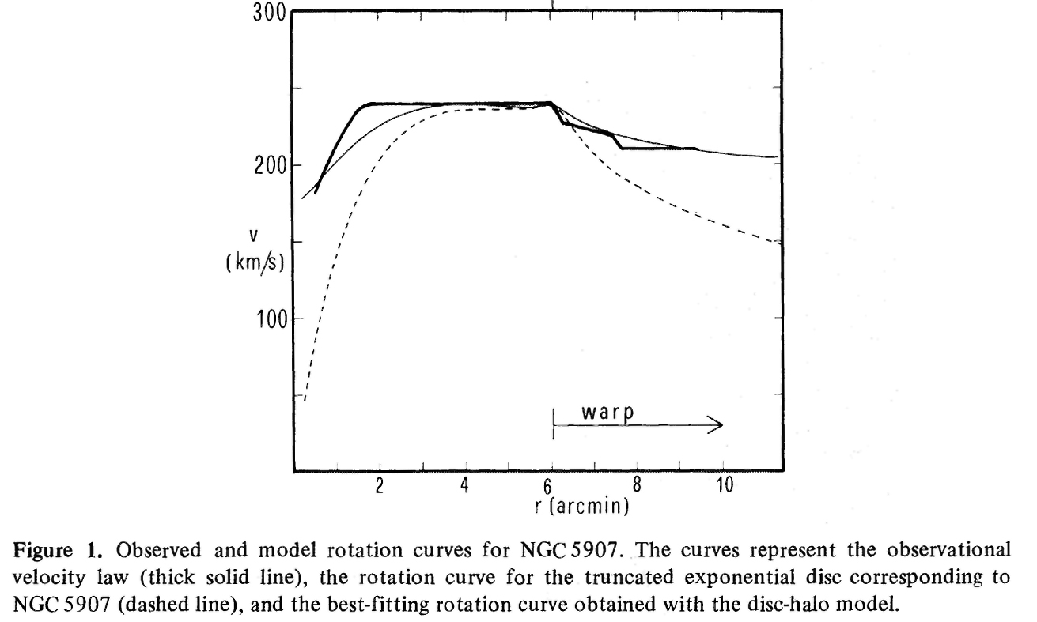
Casertano 1983, MNRAS, 203, 735: V(r) drops at the edge of the
optical disk ⇒ disk density is (at least somewhat) truncated there.

Slide 43
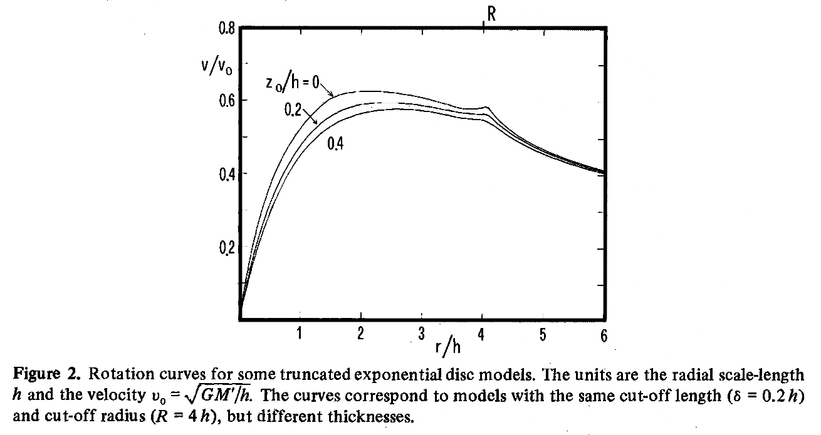
Casertano 1983, MNRAS, 203, 735:
Generic outward drop in V(r) when a disk is truncated
Nobody has followed up on these hints.
In fact, HI work is sadly neglected in recent years.

Slide 45
Annual Reviews

Slide 46
Caution:
If the disk inclination changes
in the warp,
then apparent changes in V(r)
may not reflect changes in disk density.

Slide 47
NGC 4244 HI disk flares vertically starting at the edge of the optical disk.
Olling 1996, AJ, 112, 457
Again, the rotation velocity drops
slightly at the edge of the optical disk.

Slide 48
NGC 4244 HI disk flares vertically starting at the edge of the optical disk.
Olling 1996, AJ, 112, 457
Gas velocity dispersion stays constant.
Disk restoring force gets weak at its outer edge. Rounder halo restoring force to the disk plane is weak. So the HI disk flares at constant velocity dispersion.

Slide 49
Recall: Kregel et al (2002, MNRAS, 334, 646) find that
R_{max} /h_{R} = 3.6 ± 0.6 for the 20 of 34 edge-on disk galaxies
in which they see radial truncation.
limits for galaxies
that did not show
disk truncation

van der Kruit & Searle (1981a,b; 1982)

Slide 50
Does the Milky Way Galaxy have an outer disk cutoff?
Chang, Ko, & Peng 2011, ApJ, 740, 34 find from 2MASS star counts
that the exponential scale length of the Galactic thin disk is h_{R} = 3.7 ± 1.0 kpc.
Then R_{max}/h_{R} = 3.6 ± 0.6 implies that R_{max} = 13.3 ± 4.2 kpc. Do we have a cutoff there?
Kalberla & Kerp (2009) find that the HI disk of the Galaxy is exponential with the above
scale length starting at the above R_{max}. Does HI extend the stellar exponential outward?
How much does H₂
take over at
R < 13 kpc?
Kalberla & Kerp (2009, ARA&A, 47, 27)
green line

Slide 51
Thin disks and thick disks
NGC 4762 = SB(lens,oval)0bc: A galaxy with a bright thick disk
(Tsikoudi 1980, ApJS, 43, 365)

Slide 52
NGC 4565: Note how the disk gets thicker but not much larger in radius
as you “stretch” the image to extremely high contrast.
NGC 4565 = SB(r)b: A galaxy with a bright thick disk
(Jensen & Thuan 1982, ApJS, 50, 421)

Slide 55
Pure (Bulgeless) Disk Galaxiesxxxxxxx
(systems like IC 5249)
Disks are fragile (e. g., Toth & Ostriker 1992, ApJ, 389, 5).
The existence of a thin disk limits the amount of mass
that can be accreted as lumps after the stellar disk formed.
That is, a thin disk means that the galaxy’s evolution was
relatively undisturbed by
lumpy accretion or by heating cause by halo substructure.
Many apparently pure disk galaxies also show
a weak, underlying stellar thick disk
(e. g., NGC 5907: Morrison et al. 1994).

Slide 56
NGC 5907
thin disk + thick disk
Morrison et al. 1994

Slide 57
NGC 5907 is a bright galaxy
(M_{B} ≈ – 20.5)
Its faint outer structure
could come from (many?)
very minor merger(s) or interaction(s).
This thick disk is not metal-poor
(from its colors), so
it probably did not form
from an episode of star formation
before the early thin disk settled.

Slide 58
IC 5249 also shows a very faint thick disk
(Abe et al. 1999, AJ, 118, 261).

Slide 59
Dalcanton & Bernstein (2002, AJ, 124, 1328) find that all are embedded in a flattened, low-surface-brightness, red envelope or “thick disk”.
B-R
R-K
Example: FGC 979: edge-on, bulgeless galaxy with a
thick red envelope around the thin disk.
(Dalcanton & Bernstein 2002)

Slide 60
Formation of the thick disk is an almost universal feature
of formation of disk galaxies. Almost:
But NGC 4244 (M_{B} = - 18.4) is really pure disk: it has just a single
exponential component with no thick disk.
Fry et al. 1999

Slide 61
Formation Picture for Thin and Thick Disks
Thin disk formation begins early, at z > 1 — 2
(i. e., 7 — 12 Gyr ago).
Any thin disk is partly disrupted by mergers that
heat it into the thick disk observed now.
Remaining gas + newly accreted gas then gradually settles
to form the present thin disk.
“The thick disk is a snap-frozen relic of the early,
heated thin disk (don’t expect much secular heating).”
K. C. Freeman

Slide 62
Formation Picture for Thin and Thick Disks
Caution: In contrast to Freeman’s conclusions,
Bovy, Rix, & Hogg 2012, ApJ, 751, 131
conclude that the thick disk of the Milky Way
is completely continuous with the thin disk:
It is not a distinct component.
This argues against distinct formation mechanisms such as minor mergers.
We do not know who is correct.
Therefore we do not know the origin of thick disks.

Slide 63
The existence of pure disk galaxies is interesting because,
for at least some late-type disks, it implies that:
• star formation did not start until the gas had settled
into the disk plane. Also,
• since the onset of star formation in the disk, the
disk suffered no significant dynamical disturbance
from internal or external sources.
Pure disk galaxies are not readily produced in ΛCDM
simulations: There is too much merger activity.
“I believe that pure disk galaxies are the
biggest challenge faced by our canonical CDM picture.”
K. C. Freeman

Slide 64
Fundamental problem for ΛCDM galaxy formation:
Why are there so many pure disk galaxies ?
Our Galaxy: no sign of a classical bulge (Freeman 2007, IAU245).
IC 5249
Understanding bulgeless, pure-disk galaxies is the biggest challenge
faced by our theory of galaxy formation via hierarchical clustering.
Secular formation of pseudobulges ⇒ fewer merger-built bulges
⇒ more pure-disk galaxies.

Slide 65
How do you make these: … when halos are grown like this? Note: The correct trick is not to use feedback to delay star formation until the halo is built. Because the thin disk of our Galaxy contains stars that are ~ 10-12 billion years old.
Our Galaxy
Notes:
65

Slide 66
Emphasize the puzzle:
Look for extreme examples of
giant, bulgeless galaxies:
Kormendy, Drory, Bender, & Cornell 2010, ApJ, 723, 54
measure random velocities of stars in the central clusters of the biggest bulgeless disk galaxies using HET HRS.
Notes:
66

Slide 67
NGC 6946 (Scd) V_{circ} = 210 ± 10 km s⁻¹ but velocity dispersion = 56 ± 2 km s⁻¹ (Kormendy, Drory, Bender, & Cornell 2010, ApJ, 723, 54) Therefore: No classical bulge, tiny pseudobulge, no supermassive BH

Slide 68
NGC 6946 (Scd) V_{circ} = 210 ± 10 km s⁻¹ but velocity dispersion = 56 ± 2 km s⁻¹ (Kormendy, Drory, Bender, & Cornell 2010, ApJ, 723, 54) Therefore: No classical bulge, tiny pseudobulge, no supermassive BH

Slide 69
M101 (Scd) V_{circ} = 210 ± 15 km s⁻¹ but velocity dispersion = 27 ± 4 km s⁻¹ Therefore: No classical bulge, tiny pseudobulge, no supermassive BH
M101

Slide 70
Giant (V_{circ} > 150 km s⁻¹) Galaxies With Distance < 8 Mpc
Most giant (V_{circ} > 150 km s⁻¹) galaxies in the local field
contain little or no classical bulge = remnant of a major merger.
However, in the Virgo cluster, > 2/3 of all stars are in merger remnants.

Slide 71
Fundamental Question for ΛCDM and Hierarchical Clustering: How did so many bulgeless disks form in field and void environments?

Slide 77
The Milky Way has a thick disk. It is old, with mean [Fe/H] of about - 0.7.
old disk
Velocity dispersions
of nearby F stars
The Milky Way thick disk
appears to be a
discrete component, i. e.,
it is not the hot tail
of the thin disk.
thick
disk
Disk heating saturates at 2-3 Gyr
Freeman 1991, 2004; Edvardsson et al 1993; Quillen & Garnett 2000

Slide 78
Slides to here are now used in AST386C.

Slide 80
This is surely the deepest surface brightness
profile ever measured for a
pure disk galaxy.
Disk Truncation
M33 Surface Brightness Profile:
i-band surface photometry out
to R ~ 35'
profile extended to R ~ 60'
using star counts
Ferguson 2003
sharp decrease in surface brightness
beyond 5 scalelengths..
~ 30 V mag arcsec ⁻²
Cf. van der Kruit's (1982) disk edges at ~ 3 - 5 scalelengths;
then abrupt truncation (also Pohlen et al 2002).

Slide 81
Disks have a roughly exponential light
distribution in R and z
I(R,z) = I_{o} exp (-R/h) exp (-z/h_{z})
out to R = (3 to 5) h, then often truncated
truncation quantified first by
van der Kruit & Searle (1981, 1982)

Slide 82
Reasons for the form of the observed light distribution
are not well understood - eg
Origin of radial exponential disk: collapse of a torqued
gas cloud within dark halo -> exponential gas disk in
place before star formation
OR
gas in disk is radially redistributed by viscous torques ->
exponential disk if star formation timescale ≈ viscous
timescale
10

Slide 83
The vertical structure of disks is directly associated with
their dynamical and star formation history: accretion,
heating, warping … these processes generate a vertical
scale height h_{z} that is usually about 300 pc
Look now at the radial truncation of the disks

Slide 84
NGC 4565
Truncated disk

Slide 85
Interpretations of the truncation radius
? the radius associated with the maximum angular momentum
of the disk baryons in the proto-galaxy - unlikely - many disks
have HI out far beyond the truncation radius.
NGC 2915 in HI
The HI goes out
to 22 scale lengths

Slide 86
? the radius where the gas density goes below the
critical value for star formation (Kennicutt 1989) -
star formation regulated by disk stability
? the radius to which the disk has grown today - unlikely !
The outer disk IS younger but still typically many Gyr old
( eg Bell & de Jong 2000, Ferguson et al 2003)

Slide 87
Stellar Content of the Outer Disk of M33
looks like an
intermediate/old,
fairly metal-poor
([Fe/H]~ -1.2)
population dominating
the outer disk of M33
Ferguson et al 2003

Slide 88
? star formation of a star-forming gas disk on viscous timescales
can drive the resulting stellar disk towards an exponential profile.
The outward angular momentum transport from this viscous evolution
will lead to a maximum value of angular momentum in the stellar disk
? truncation of proto-disk by encounters
(cf accretion disks : Clarke & Pringle 1993)
- unlikely because pure disks show truncation
Truncation of disks is probably related to the formation of the disks: remains an interesting problem

Slide 89
The Tully-Fisher law
Simple centrifugal equilibrium arguments for
a self- gravitating disk give
L ∝ V ⁴ / { I_{o} (M/L) ² }
where I_{o} and (M/L) are roughly constant
20

Slide 90
Observationally, the exponent of V in
the Tully-Fisher (L - V) law varies
from 3.2 at B to 4.5 at H.
Probably reflects a weak dependence of
I_{o} and M/L on L
(as for tilt of fundamental plane for ellipticals)

Slide 91
Tully-Fisher law: B to H
Sakai et al 1999

Slide 92
The zero point of the TF law needs explaining:
M_{I} = -10.00 ( log W₅₀ – 2.5) – 21.32
(Sakai et al 1999)
ie galaxy with M_{I} = – 21.32 has W₅₀ = 316 km/s, not
500 km/s. (W₅₀ is the inclination-corrected HI line
width at half peak height)
For a disk alone, the zero point depends
on {I_{o} (M/L) ² }. M/L comes from the stellar
population. The central surface density ...

Slide 93
The central surface density ∑ _{o} = I_{o} (M/L) depends
on M and J for the disk:
∑ _{o} ∝ M⁷ / J⁴
The J(M) relation is defined by dynamics of galaxy
formation and evolution - it determines the zero-point
of the TF law.
Because of the conspiracy for disks of
normal surface brightness, this argument
is not changed much by the presence of
the dark halo

Slide 94
Now look at LSB disks - here the gravitational field
is believed to be dominated by the dark halo everywhere
But the TF law for LSB galaxies is very close to
the TF law for HSB galaxies (Zwaan et al 1995)

Slide 95
LSB and HSB galaxies
follow same TF law
HSB
Zwaan et al 1995

Slide 96
In LSB galaxies, the dark halo → W₅₀
baryons → M_{B}
so the baryon mass is related to the halo dynamics
Why ? This is what makes the TF relation much more
interesting and complicated than the corresponding
fundamental plane for ellipticals, which is all baryonic
and is not really much more than the virial theorem.
The scaling relations for dark halos are probably
important for understanding the TF relation

Slide 97
Dark Halo Scaling Laws
ie relationship of halo (ρ_{o}, r_{c}, σ ) – L_{B}
• Use rotation curves for Sc-Im galaxies: adopt maximum
disks and nonsingular isothermal halos. No correction for
baryonic compression
The slope of the halo rotation curve near the center
gives the halo core density ρ_{o}
• Need rotation curves that extend to
the flat part of the rotation curve,
far enough so we can get an estimate
of the core radius r_{c}
• Also use small dIrr and dSph
which are in pressure equilibrium :
⇒ core density only

Slide 98
Dark Halo Scaling Laws
ρ_{o} ~ L_{B}^{- 0.35}
r_{c} ~ L_{B} ^{0.37}
σ ~ L_{B} ^{0.20}
ρ_{o}
(fits to Sc-Im only)
r_{c}
are dSph, dIrr
so expect the surface density
Σ ~ ρ_{o} r_{c}
to be ~ constant over this range
of M_{B}, and it is
σ
Kormendy & Freeman 2003

Slide 99
Errors in the data contribute significantly to the scatter :
eg distance errors, submaximality of disks, baryonic compression
30
Kormendy & Freeman 2003

Slide 100
Simple arguments (M ~ σ ² r_{c} , M ~ Σ r_{c}²) show that
constant surface density ⇒ a Faber-Jackson relation for
the dark halos : M_{halo} ~ (σ_{halo}) ⁴
From the σ scaling law, the galaxy luminosity L ~ (σ_{halo}) ^{5.1}
so there is a weak dependence of M_{halo} / L on L :
M_{halo} / L ~ L ^{-0.24}
consistent with some baryon loss from the lowest
luminosity galaxies

Slide 101
Summary of scaling laws for dark halos
• Constant surface density ⇒ Faber-Jackson law
• See that the dSph and dIrr have very high halo
densities. The virialized density depends on
collapse redshift, so ρ_{o} ~ (1 + z_{coll}) ³ and the
smallest dwarfs formed at least Δ z_{coll} = 7
earlier than the largest spirals.
Correction for baryonic compression will make ρ_{o}
smaller for giant galaxies and increase this Δ z_{coll}.
ρ_{o}

Slide 102
• Fainter dwarf galaxies are more numerous and more
dominated by DM.
Suggests possibility that there is a large population of
completely dark objects - virialized early, before or
during reionization, and lost or never captured their share
of baryons because baryons were too hot to be captured
in these shallow potential wells.
Empty halos are likely to be small and dense - darker
versions of Draco and Ursa Minor.

Slide 103
The scaling laws are related to the slope n of the power
spectrum of the initial density fluctuations |δ_{k}|² ~ k^{n}
Djorgovski (1992) showed that bound objects have
density, radius and velocity dispersion related by
ρ ~ R ^{-3(3+n)/(5+n)} etc
The observed scaling laws (eg ρR ~ constant over L)
imply that n ≈ -2.0 ± 0.1, close to what is expected
for ΛCDM at a halo mass of 10 ¹² M_sun
(Shapiro & Iliev 2002, Fall 2002)

Slide 104
Back to the Faber-Jackson relation for dark halos
M_{halo} ∝ σ ⁴ ∝ V ⁴_{rot,halo}
If M_{baryons} / M _{dark} is similar
from galaxy to galaxy,
a TF law
between M_{baryons} and V_{rot,halo}
would follow
(still need to get the zero point right)
More on TF and baryons ....

Slide 105
and lie 2-3 mag below the TF line
Some very gas-rich galaxies are under-luminous for their HI line widths
eg NGC 2915 and DDO 154 have
M_{dark} : M _{gas} : M_{stars} ≈ 100 : 10 : 1
and lie 2 to 3 mag below the TF relation
If the gas is converted to stars with M/L ≈ 1, they rise to
the TF relation (Freeman 1998; McGaugh et al 1999)

Slide 106
M_{B} if HI
converted to stars
with M/L = 1.0
^{x} •
M_{B} observed
Freeman 1998

Slide 107
Stellar mass
M* = (M/L)* L
Baryon mass
M_{bar} = (M/L)* L + 1.4 M_{HI}
slope 4.0
McGaugh et al 1999

Slide 108
Again, the TF law is about the relationship of
total baryon content of disks
to the circular velocity of the dark halos
Conclusion at this stage is that the TF law comes about because
the power spectrum of the initial fluctuations has n ~ -2,
which leads to a Faber-Jackson law for the dark halos
(2) there is approximate constancy of the baryon/dark matter
ratio from galaxy to galaxy

Slide 109
The Milky Way has a thick disk
It is old, with a mean [Fe/H] of about - 0.7
It appears to be a discrete component, rather
than the hot tail of the thin disk

Slide 110
Ages of field stars with [Fe/H] < -0.5 are
similar to the ages of the globular clusters
Gilmore et al 1989

Slide 111
Colors in the
thick disk at
large z are fairly
similar from
galaxy to galaxy
Ages > 6 Gyr
50
Dalcanton & Bernstein 2002

Slide 112
Edge-on disk
galaxies without
bulges
a/b is axis ratio
The thick disk is
about twice as
thick as the thin
disk
Dalcanton & Bernstein 2002

Slide 113
Overview of thick disks
The thick disk forms early, > 6 Gyr ago
(12 Gyr ago in the Galaxy)
Appears to be distinct from the thin disk
Probably formed by heating of the early thin disk in
an epoch of merging which ended > 6 Gyr ago.

Slide 114
However ....
ΛCDM simulations of formation of an early-type disk galaxy
(Abadi et al 2003) show that not all disk stars form in the disk
Many of the oldest stars in the disk are debris from accreted
satellites which ends up in the thin and thick disk.
Satellite orbit is dragged into disk plane by dynamical friction -
acts like dissipation, although system is collisonless

Slide 115
Why is this interesting ?
Because we see thick disk stars in the solar neighborhood
with [Fe/H] abundances as low as the most metal-poor
globular clusters.
Did they form as
part of early
disk formation,
or
were they
acquired ?

Slide 116
We could have anticipated this kind of settling
of debris to the disk
Decay of prograde satellite orbit around disk galaxy
(Walker et al 1996)
satellite is 10% by mass
circular orbit
radius 6 scale lengths
inclined at 30º to disk plane

Slide 117
Decay of
a prograde
satellite
orbit

Slide 118
satellite orbit decays by dynamical friction in < 1 Gyr
strong disk coupling for prograde orbits
disk provides abut 75% of integrated torque on satellite
dynamical friction against live halo provides the rest
debris of satellite will end up in the thin or thick disk
need existing disk and a satellite dense enough to
survive the ride down into the disk

Slide 119
How did pure disk galaxies avoid any significant star
formation until the baryons had settled to thin disk ?
Expect that the aggregation process - interacting lumps
of dark matter and baryons - should lead to star formation
as it does in present-day interacting systems
Need to keep the baryons in a state such that they can
settle quiescently to disk - eg via wind or blowout driven
by early star formation and SN (Sommer-Larsen et al 1999)

Slide 120
The disk would then be the relic of this outflow, forming
quiescently after the halo has virialized (eg Binney Gerhard & Silk 2001)
This process would still need some early star formation to generate the blowout (as in movie). But this early
star formation can’t leave many stars visible now outside the disk - a stellar halo of ~ 10⁸ M_{o} would be readily detectable in a galaxy like NGC 4244 with M_{stars} ~ 10¹⁰ M_{o} and M_{total} ~ 10¹¹ M_{o}
.

Slide 121
Summary
• disks typically have the exponential structure in R and z,
and are truncated radially at 3 to 4 scalelengths
• the radial exponential structure and radial truncation
of galactic disks are still not well understood: star
formation on viscous timescales may be important

Slide 122
• the Tully-Fisher law relates the baryon mass to the
depth of the potential well of the dark halo. May be
associated with the apparent constant surface density
of the dark halos and an approximately constant
baryon/dark ratio
• thick disks are very common but not ubiquitous
• the existence of pure (thin) disk galaxies means that
at least some disks form in a very quiescent manner
- no star formation until the disk had settled -
with an undisturbed history thereafter

