Slide 1
Before Today’s Lecture
Please pick up a diffraction grating from the boxes near the door.
Please put it back at the end of the lecture.
You can practice looking at the demonstration lights. It is best to hold the slide right up to your eye with the longer dimension horizontal.
Example:
For you should see
For you should see

Slide 3
Review: Spectra
The spectrum of an object is the amount of energy that it radiates at each wavelength.
Much of what we know about the Universe comes from spectra.
They tell us much more than images do.
Continuous Spectra
All macroscopic objects emit radiation at all times. Their atoms jiggle around by an amount that increases with temperature. Accelerated charged particles radiate. So: Everything radiates with a spectrum that is directly related to its temperature.
For example: people are warm; they glow brightly in the infrared. Similarly, a warm iron glows in the infrared but not in visible light. Then, as it is heated to higher and higher temperatures, it glows red, then white, then blue.

Slide 4
Continuous Spectra
An idealized object that absorbs all radiation that hits it is called a black body. In equilibrium with its surroundings, it emits exactly as much radiation as it absorbs. Then it emits a spectrum as described in Figure 6-6 of (most editions of) the text. This black body or thermal radiation has the following properties:
It is continuous radiation (there are no emission or absorption lines):
Its spectrum is brightest at a wavelength that depends on temperature, and the brightness falls more quickly toward the blue than toward the red. Specifically:
Wien’s Law: The wavelength of maximum brightness in Å is 30,000,000 K divided by the temperature in K. That is, l_{max} = 3.0 × 10⁷ Å / T(K). Hotter things radiate bluer light. If the temperature doubles, the wavelength of maximum brightness gets 2 times shorter.
Stefan-Boltzmann Law: The total energy emitted varies as the 4th power of temperature: E = σT⁴ = σ × T × T × T × T. The Stefan-Boltzmann constant σ is given in Box 6 — 1.
A black body is an idealized concept, but for many objects (including stars), the above are useful approximations.

Slide 5
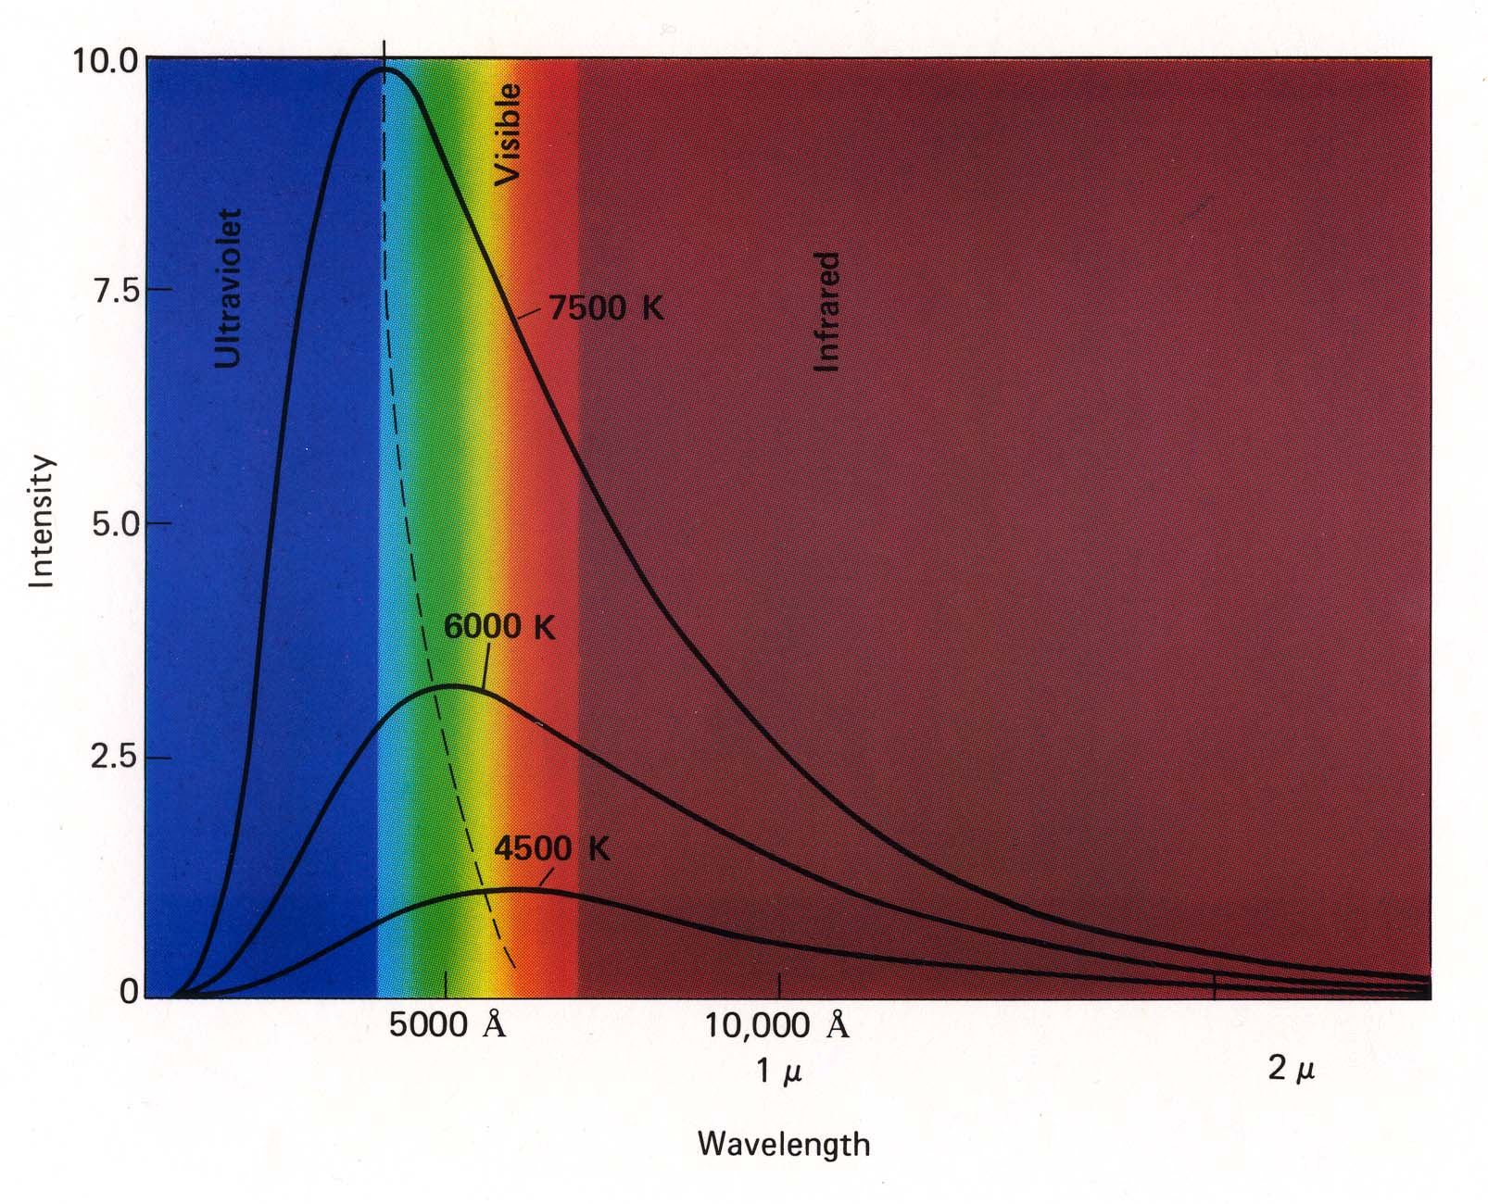
Review: Black Body Spectra

Slide 6
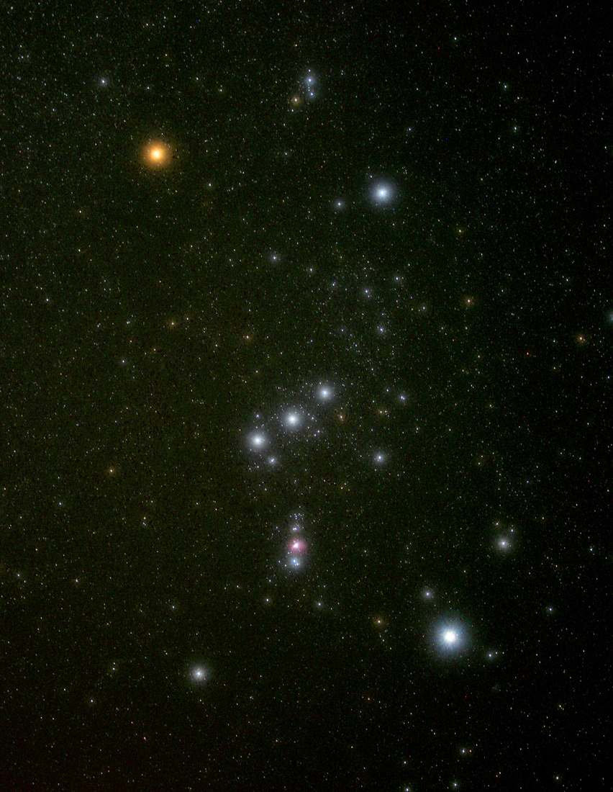
Constellation of Orion
Betelgeuse is a
red supergiant star
(T = 3500 K).
Orion Nebula gas cloud
and star-formation region.
Why it looks pink will be
discussed later in this class.
Rigel is a blue
supergiant star
(T = 12,130 K).
Notes:
Betelgeuse T = 3,500 K When Betelgeuse explodes as a supernova, it will be brighter than our full Moon for several months. This could happen any time in the next million years. Age = 10 Myr. At present, its radius is >> 1 AU.
Rigel T = 12130 K From 1 AU, it would have an angular diameter of 35 degrees and be 85,000 times as bright as the Sun. The flux at Earth would be like that a few mm from a welder’s arc. Age = 8 Myr.
Rigel is the intrinsically brightest star in our neighborhood (~ 1000 ly) of the Galaxy. Mass ~ 24 M_Sun.

Slide 7
Electromagnetic Radiation
Type of Wavelength Temperature of
Radiation Range (Å) Radiating Objects Typical Sources
Gamma rays Less than 0.1 More than 10⁸ K Neutron stars and
black hole accretion disks
X-rays 0.1 — 200 10⁶ — 10⁸ K Gas in clusters of galaxies;
solar corona; supernova remnants
Ultraviolet 200 — 4000 10⁴ — 10⁶ K Supernova remnants;
hot young stars
Visible 4000 — 7000 10³ — 10⁴ K Stars, warm gas clouds
Infrared 10⁴ — 10⁷ 10 — 10³ K Cool clouds of gas and dust;
planets, satellites, asteroids;
your body
Radio More than 10⁷ Less than 10 K Relic radiation from the Big Bang;
cold gas; star forming regions;
electrons moving in magnetic
fields (synchrotron radiation)
1 Å = 10⁻¹⁰ m

Slide 8
Everything Is Made Of Atoms
¹H
³He
⁴He
Proton Positive
Neutron Neutral
Electron Negative
Protons, neutrons and electrons are the building blocks of atoms. The proton and electron have opposite electric charges of the same strength, whereas the neutron is neutral. The proton and neutron are about 10⁻¹³ cm across and have about the same mass. The electron has 1/1,836 the mass of the proton.
¹²C

Slide 9
A Scale Model of the Hydrogen Atom
Suppose that we could make a hydrogen atom bigger by a factor of 10¹².
The nucleus now has a diameter of 1.6 mm — it is the size of a grape seed. The innermost possible electron orbit is the size of a football field. The next orbit is the size of 4.5 football fields.
The electron is too small to see. So: An atom is mostly empty space!
First Orbit
Second Orbit
Grape Seed

Slide 10
A Scale Model of the Hydrogen Atom
Suppose that we could make a hydrogen atom bigger by a factor of 10¹².
The mass is still less than 2 x 10⁻¹⁵ kg. We would have to multiply by another factor of 10¹² to get a mass that we could imagine.
It takes an enormous number of atoms to make something macroscopic. A grain of table salt contains more than 10¹⁸ atoms — enough to give a billion atoms to every person on Earth.
First Orbit
Second Orbit
Grape Seed

Slide 11
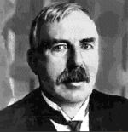
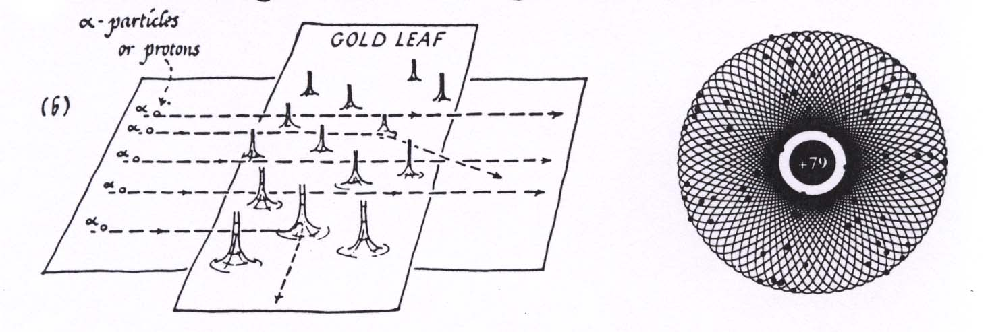
How Do We Know The Structure Of The Atom?
Democritus suggested that matter is composed of tiny objects called atoms. Chemists showed that there are about 90 kinds of atoms, each with different chemical properties.
Rutherford bombarded a thin gold foil with helium nuclei (called α-particles). Helium nuclei contain 2 protons and so are positively charged. Gold nuclei contain 79 protons and also are positively charged. So helium nuclei and gold nuclei repel each other. Result:
Most He nuclei went through the foil, but a few bounced off at large angles. This showed
that a gold atom is made of a tiny, heavy lump of positively charged matter – the nucleus–
surrounded by a much larger cloud of negatively charged electrons. For this work,
Rutherford got the Nobel Prize for Chemistry in 1908.
Other elements have different nuclear charges and numbers of electrons.
gold:
79 protons and electrons

Slide 12
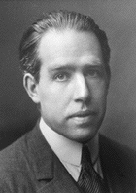
The Bohr Atom
To understand the structure of electron orbits and atomic spectra,
Niels Bohr in 1913 suggested the following new ideas:
Electrons in orbit around an atomic nucleus can only have certain specific energies. This situation is like that of a person standing on a staircase — he can stand on any step, but he cannot hover between steps.
An electron can move from one energy level to another; this changes the energy of the atom. Since electrons are attracted to protons in the nucleus, we have to add energy to move them farther from the nucleus. One way that an atom can gain energy is by absorbing a photon of light. In contrast, if an electron falls from an outer orbit to an inner orbit, the energy that is lost is emitted as a photon of light. The wavelength λ (Greek letter “lambda”) of the photon emitted or absorbed and the difference E in energy between the two levels are related by E = hc/λ, where c is speed of light and h is Planck’s constant.
An atom has a ground state of lowest energy in which it does not radiate.
Therefore: Processes that everybody thought could be continuous can happen only in discrete (“quantum”) jumps.

Slide 13
Absorption and Emission of a Photon
No thanks.
Wrong
energy
Aha!
Ahh.
Oops.

Slide 14
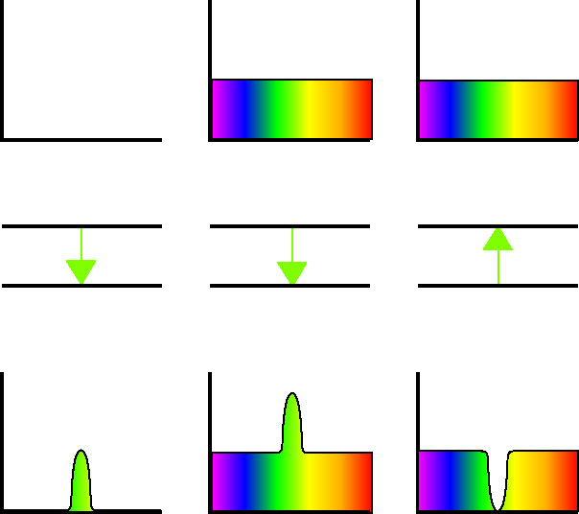
Spectra
When radiation
like this ...
Higher energy level
… passes by
an atom
that does this...
Lower energy level
emission line
… the resulting
radiation looks
like this.
emission line
absorption line
continuum

Slide 15
Kirchhoff’s Laws
The observed relationships between continuous spectra, emission-line spectra, and absorption-line spectra were summarized by Gustav Kirchhoff in 1859.
Kirchhoff’s Laws that describe the formation of spectra are:
1. A solid or liquid or sufficiently dense gas emits light of all wavelengths and so produces a continuous spectrum of radiation.
2. A low-density, hot gas emits light whose spectrum consists of bright emission lines. These lines are characteristic of the chemical composition of the gas.
3. A cool, low-density gas absorbs certain wavelengths from a continuous spectrum and leaves dark absorption lines in their place, superimposed on the continuous spectrum. Again, the lines are characteristic of the composition of the intervening gas. They occur at precisely the same wavelengths as the emission lines produced by the same gas at higher temperatures.

Slide 16
Absorption, Emission, and Continuous Spectra
Gas
Kirchhoff Law 3
Kirchhoff Law 2
Kirchhoff Law 1

Slide 17
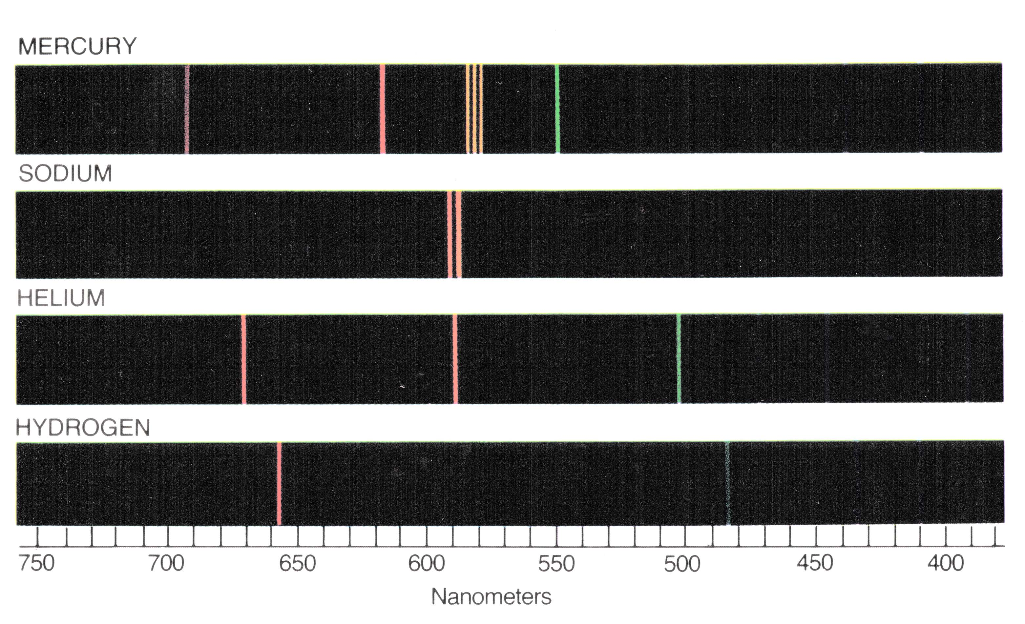
Examples of Emission Spectra

Slide 19
Hydrogen Atom Transitions
n = ∞
Lyman series (ultraviolet light)
Balmer series (visible light)
n = 5
n = 4
n = 3
Transitions to
higher levels
produce
absorption lines.
n = 2
Red Hα
n = 1
Transitions to
lower levels
produce
emission lines.

Slide 20
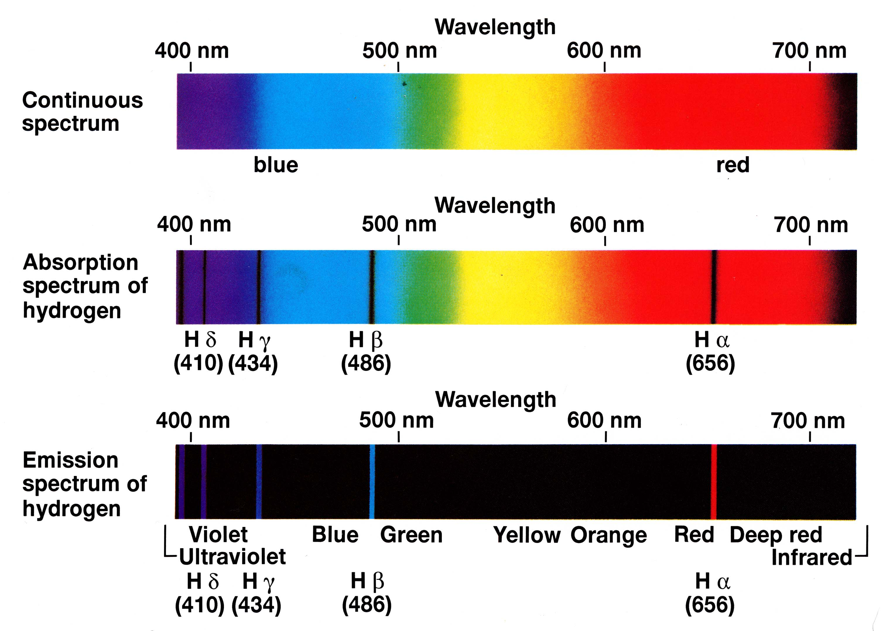
Spectrum of Hydrogen

Slide 21
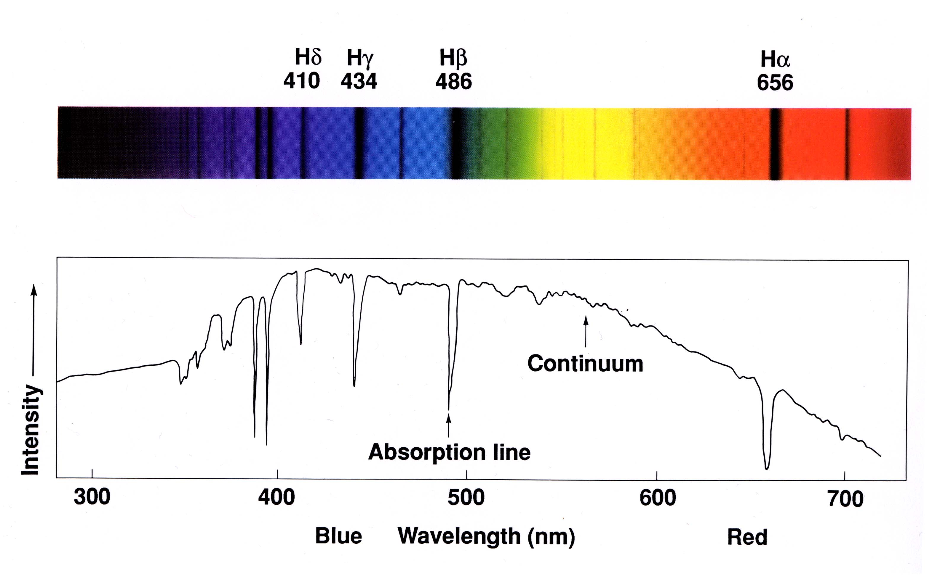
Spectrum of a Hot Star With Strong Hydrogen Lines
Note: We will often see spectra as plots of intensity versus wavelength and not as images.

Slide 22
Atomic Processes: What Happens In Real Life
Atoms in a star’s atmosphere create dark spectral lines by absorbing black-body radiation. The temperature of the star mostly determines which lines are visible, because most stars have similar atomic abundances.
Excitation and De-excitation
When an electron moves from a low-energy orbit such as the “ground state” to a high-energy orbit, the atom is excited. An atom can become excited by absorbing a photon of the correct energy or by colliding with another atom or electron.
Likewise, when an electron moves to a lower-energy orbit, the atom is de-excited. This can happen because of a collision with another atom or because a photon is emitted.
Ionization and Recombination
When an electron is not just moved to a higher-energy orbit but is actually ejected for the atom, the atom is ionized. The atom becomes an “ion” with a net positive charge. Because the electron escapes with some energy, any photon that has enough energy can ionize an atom.
When a free electron becomes bound to an ion, the atom recombines and a photon is emitted to carry away the excess energy.

Slide 23
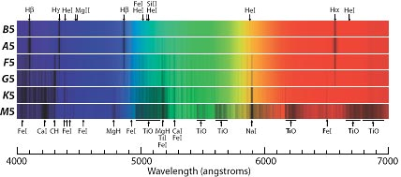
Stellar Atmospheres
Normal stars do not have solid surfaces; they are balls of hot gas. What looks like the “surface” of a star like the Sun is the place where the atmosphere becomes opaque (like the “surface” of a cloud on Earth). This is called the photosphere.
A typical star emits enormous amounts of energy. Energy always flows from hot places to cooler places, so the interior of a star must be much hotter than the “surface”.
The photosphere of the Sun is only 300 km thick and has an average temperature of 5800 K.
The temperature of the photosphere decreases with increasing altitude. Therefore the light emitted from the bottom of the photosphere must pass through cooler gas on its way to us. Atoms in the cooler layers become excited by absorbing photons of certain energies. This is why the light that reaches us shows dark lines superimposed on a continuous spectrum.
very hot star
less hot star

Slide 24
Stellar Spectra
The dark lines seen in stellar spectra depend on the composition of the star: if an element is absent, its spectral lines can never be observed. But temperature, not composition, is the main factor that creates the diversity of stellar spectra.
Temperature affects the spectrum in two ways:
The relative intensities of different wavelengths in the continuous spectrum depend on the
temperature in the lower layers of the photosphere (Wien’s Law).
2. To make absorption lines in the continuous spectrum, the atoms must be in the correct state
to absorb photons. This is a complicated function of the temperature in the photosphere.
Example of point 2: A hydrogen atom in the ground state cannot absorb a photon of visible light; the jump to the first excited state requires an ultraviolet photon. To produce absorption lines in the visible spectrum, the hydrogen must be hot enough to collisionally excite the atoms to the first excited state. This requires a temperature above about 6000 K. In level 2, an electron can absorb a photon that knocks it up to level 3 or higher: such a photon has an energy corresponding to visible light. Therefore a visible-light photon disappears from the continuous spectrum, producing a (dark) “absorption line”. But if the temperature gets much above 10,000 K, then most of the hydrogen is ionized, and it cannot produce any absorption lines at all.
For elements other than hydrogen, the story is similar but more complicated.

Slide 25
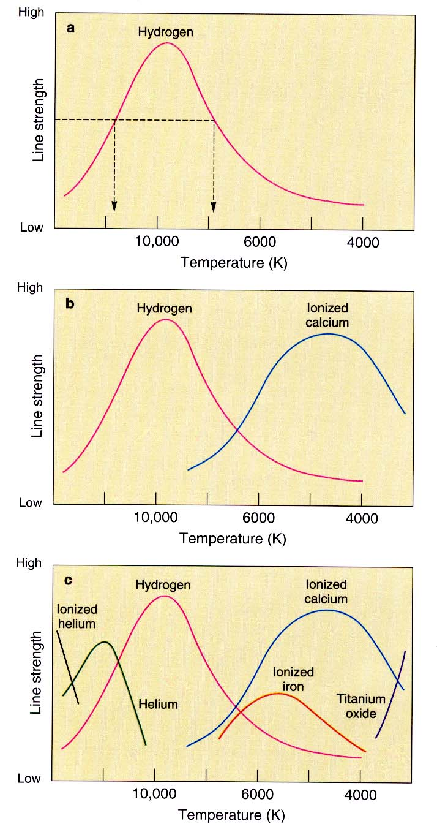
Line strength increases
with increasing temperature
because more hydrogen atoms’
electrons are excited by collisions to energy level 2
from which they can cause
absorption lines.
Line strength decreases as temperature increases
above the optimum value
because more hydrogen atoms have their electrons
in energy levels that are too high or because hydrogen is ionized by collisions.
hot
cool
Calcium nuclei have more protons than do hydrogen nuclei, so they also have more electrons. The outer electrons are less tightly bound than in hydrogen. So it takes less energy — and hence a lower temperature — to excite the outer electrons to the proper levels to make spectral lines.
Different atoms in the atmosphere of a star have spectral lines that depend differently on temperature.
By observing many lines of many elements, we can measure the temperature accurately.
O
B
A
F
G
K
M
Stellar spectral types

Slide 26
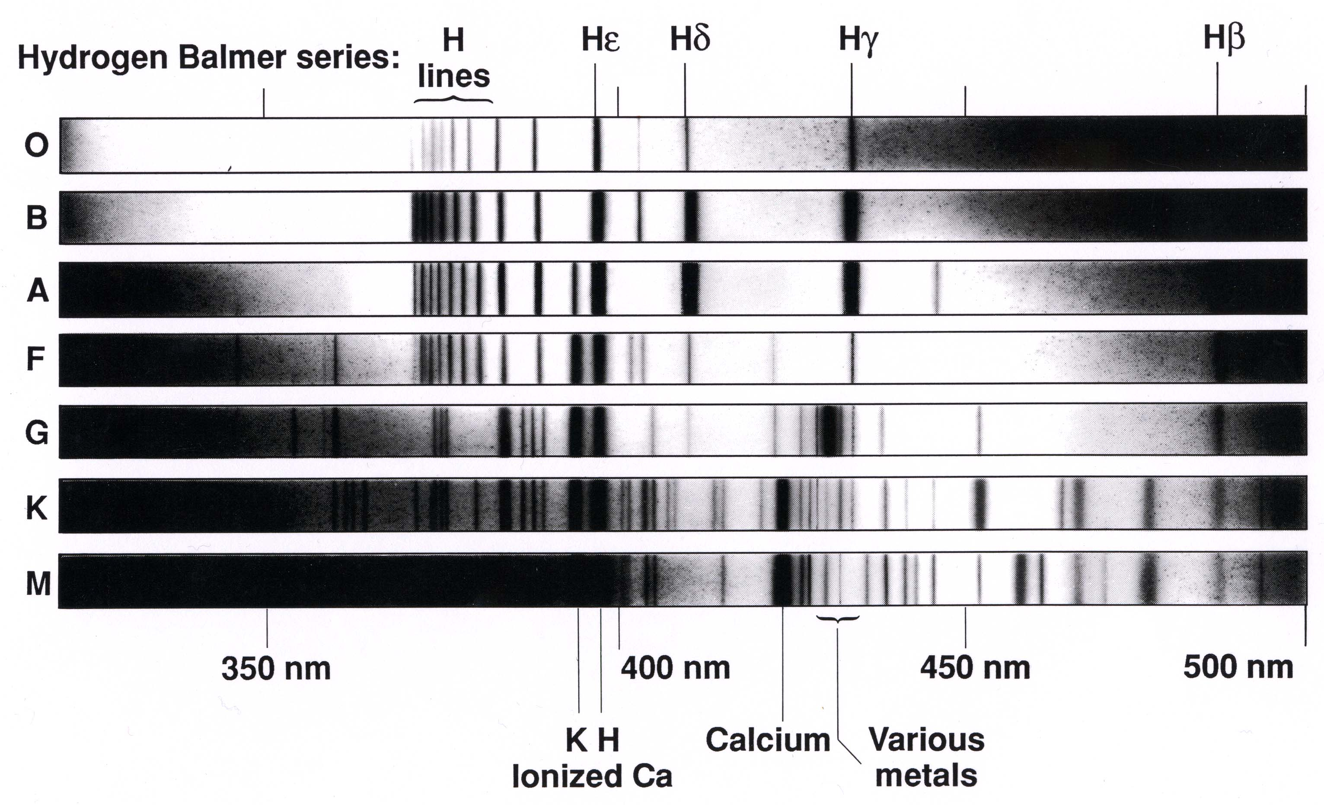
Spectral Types of Stars
Surface temperature
40,000 K
20,000 K
10,000 K
7,500 K
5,500 K
4,500 K
3,000 K

Slide 27
Spectral Types of Stars
With apologies for our sexist past,
the standard mnemonic to help you remember spectral types is:
or: Guy
Oh Be A Fine Girl, Kiss Me
hottest coolest
stars stars

Slide 28
Compositions of Stars
By taking the effects of temperature into account, we can use spectral lines to measure the compositions of stars. Despite their different spectra, most stars turn out to have very similar compositions.
The Sun’s composition is typical of most stars in our neighborhood. Some of the more common elements are listed below with their abundances in the Sun.
Hydrogen 73.4% Oxygen 0.8%
Helium 25.0% Carbon 0.3%
“metals” 1.6% Iron 0.2%
Nitrogen 0.1%
others 0.2%
In other stars, the ratio of Hydrogen to Helium is generally very close to 3:1, as it is in the Sun. “Metals” are everything else. Their contribution varies from less than 0.01% to as much as 3%. However, the mixture of different metals is almost the same over this entire range.

Slide 29
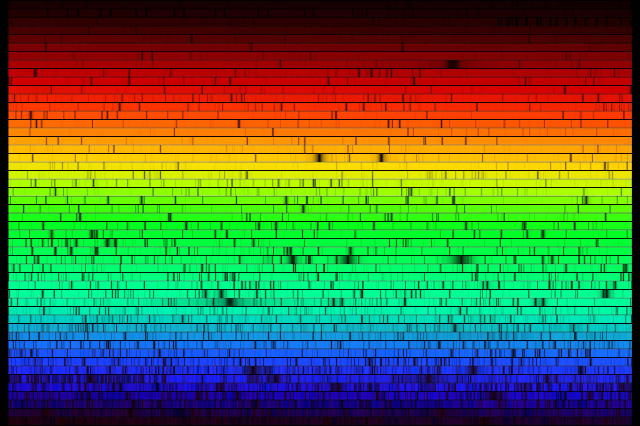
The spectrum of the Sun
Hydrogen
Sodium
Magnesium

Slide 30
Stellar Velocities
Wavelengths of spectral lines in gas that is at rest have been measured very accurately in laboratories on Earth. The wavelengths of the same spectral lines can be measured very accurately in stars.
When we observe that the lines are shifted from the wavelengths that we see on Earth, then we know that the star is moving away from us or toward us.
When a star moves toward us, the wavelengths of spectral lines are blueshifted.
When a star moves away from us, the spectral lines are redshifted.
The Doppler effect is familiar as applied to sound. The pitch of a siren is higher when the emitting vehicle moves toward us than when it moves away from us.
The class web site has an applet and a movie illustrating the Doppler effect.
The Doppler Effect

Slide 31
Doppler Effect
hear higher pitch
see blueshift
hear lower pitch
see redshift

Slide 32
Measuring Velocities Using The Doppler Effect
velocity change in wavelength
—————— = —————————
speed of light wavelength
The speed of light is 300,000 km/s.
Example 1: Suppose that we observe a spectral line whose laboratory wavelength is
known to be 6000 Å, but we see it at 6001 Å. Therefore the star is
moving away from us at (300,000) x (1/6000) = 50 km/s.
Example 2: Suppose that the same line is observed in another star at 5990 Å.
This star is moving toward us at (300,000) x (10/6000) = 500 km/s.

